Slide 1
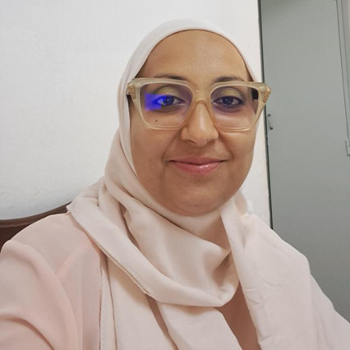
Professional Profile/Biosketch
Dr/Eng in Computer Science.
Development of intelligent, energy-efficient, and ethically aligned AI systems.
Raise awareness about rethinking AI to promote sustainable, energy-efficient, and inclusive intelligent systems.
Publication in top-tier venues and serves as a reviewer for IEEE and major AI conferences/ journals.
Rahma Fourati
IEEE Tunisia Systems Chapter Chair
Assistant Professor at Faculty of Law, Economics and Management Sciences of Jendouba (FSJEGJ), University of Jendouba, Tunisia
rahma.fourati@ieee.org
Personal
I am an ambitious and patient person who never gives up until I achieve my goals.
I’m drawn to places where the sea meets the mountain, where strength and serenity come together.
I chase my dreams with determination, and along the way, I try to help others as much as I can, believing that true purpose comes from perseverance and kindness.
IEEE Experiences
Senior Member of IEEE
Chair of IEEE Systems Council, Tunisia Section (25-26)
Vice Chair of IEEE Biometric Council, Tunisia Section (25-26)
Secretary of IEEE Signal Processing Society, Tunisia Section (2025-2026)
Vice Chair of IEEE Computational Intelligence Society, Tunisia Section Chapter (23-24)
Chair of IEEE Computational Intelligence Society, Tunisia Section Chapter (21-222)
Vice Chair of IEEE Computational Intelligence Society, Tunisia Section Chapter (19-20)

Slide 2

Council Committee: Chapters
What are your chapter goals?
Reactivation and Sustainability of the Chapter.
Maximize Technical and Professional Activities.
Develop membership in underserved regions, especially Northwest Tunisia.
Promote Senior Membership elevation.
Strengthen connections with other IEEE chapters and councils in Tunisia to promote joint activities.
What is the major or favorite event held in 2024 or 2025
empowers young people at risk by raising their awareness about cybersecurity and digital safety.
What are your chapter challenges? (communication challenges? )
No funding received for 2025 activities.
Limited sponsorship opportunities from industry or universities, especially for regional outreach activities.
Few Distinguished Lecturers are available within IEEE Region 8.
How can Systems Council make your chapter more successful?
providing financial assistance and visibility for upcoming events such as the ICICCS 2026 Conference on AI and the WiseAI Spring School 2026, both planned in the Northwest region of Tunisia.
facilitating the participation of DL
as keynote speakers in the conference.
Join Early Career Speakers Program (ECSP) for online chapter presence

