Slide 1


IEEE Systems Council Chapters Summit
Saturday, November 8, 2025

Slide 2
Chapters congress - Agenda
Draft Agenda (1pm – 5pm)
  Welcome & Opening Remarks – Andy Chen, Systems Council President – 10- min
  Member Services – Bozenna Pasik-Duncan, VP Member Services – 5 min
  Chapters – Loretta Arellano, Chapters Coordinator – 5 min
  Conferences – Paolo Carbone, VP Conferences – 5min
  Publications – Fabrice Labeau, VP Publications – 5 min
  Technical Operations – Andre Oboler, VP Technical Operations – 5 min
  Chapter Chair Presentations (each chapter in attendance) – Introduce team, goals, activities, and key takeaways – 5 min ea
  Open Discussion

Slide 3
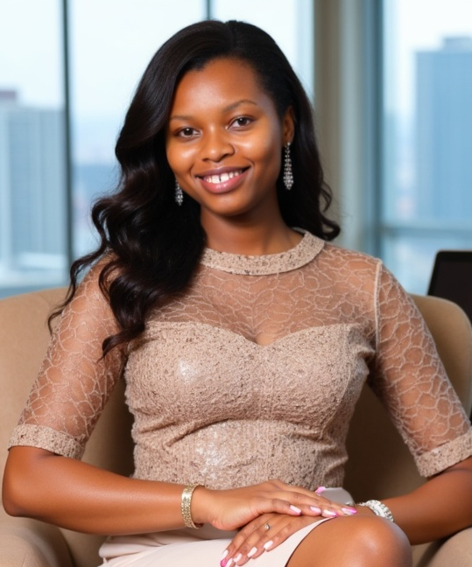
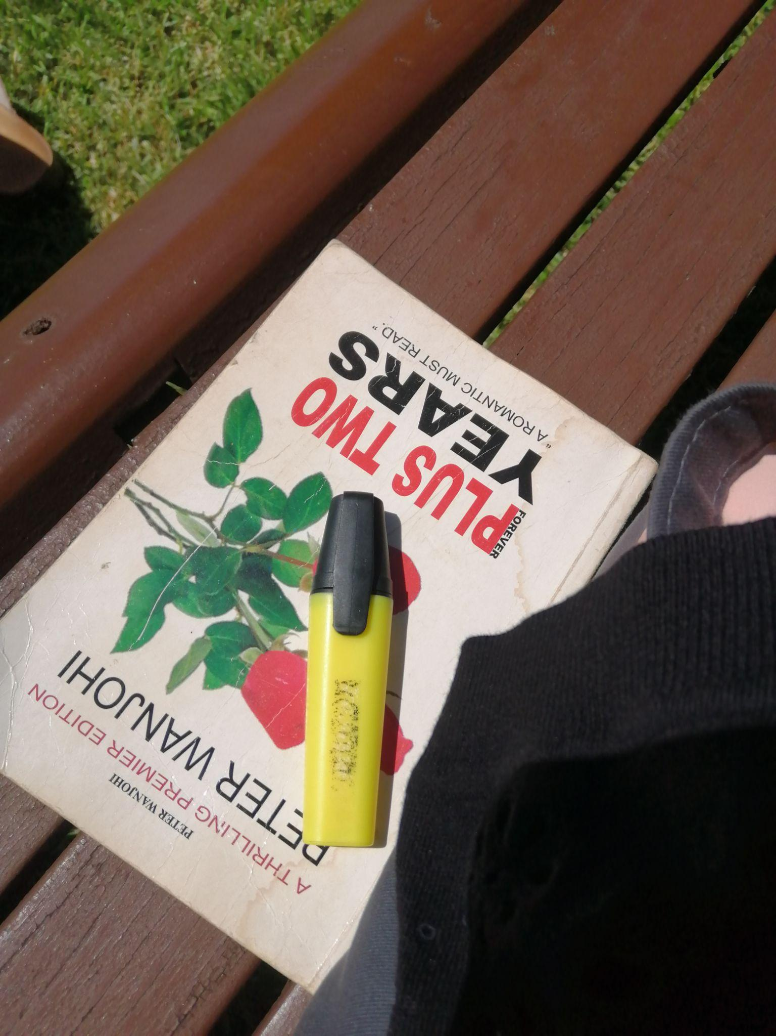
Evelyne Wambui
Kenya Section Jt. Chapter Chair
Region 8, Kenya Section
evelynewambui@ieee.org
Professional Profile/Biosketch
I am a cybersecurity professional with a background in computer networks, digital forensics, and threat intelligence; passionate about leveraging technology to enhance digital security, operational efficiency, and innovation. Beyond my technical work, I actively volunteers with IEEE initiatives, where I mentor students and leads programs that introduce emerging technologies like IoT and VR to inspire interest in STEM. I am a Co-founder and Chief Operations Officer at Triovault Technologies LTD, an ICT firm committed to securing digital futures.
Personal:
I enjoy swimming, reading novels, traveling, investigative shows and documentaries.
Favorite Book
IEEE Experiences (section level)
Chair, Jt. Chapter Systems and Sensors Council
Membership Coordinator, Signal Processing Society
Secretary, Geoscience and Remote Sensing Society
IEEE K-12 Initiative Volunteer (2023 – Present)
Registration Committee -IEEE AESS SYP Congress (Aug,2025)
Registration Committee -Tech Ignite Summer School (Sept,2025)
Registration Committee Co-Chair – IEEE SPS Africa Forum & Kenya SYP Congress (2023)
Registration Committee Chair – IEEE Kenya Students & Young Professionals Congress (2022)

Slide 4
Jt. Chapter Sensors and Systems Council , SEN39/SYSC45 (CH08922) Kenya Section
What are your chapter goals?
Collaboration with other OUs.
Industry Partnerships.
Distinguished Lecture Programs.
Technical Workshops.
What is the major or favorite event held in 2024 or 2025
IEEE K-12 Initiative in Partnership with IEEE Nanotechnologies Council at I.O.Me001 Innovation Center
What are your chapter challenges? (communication challenges? )
Lack of visibility and cross-chapter collaboration.
Leadership transition gaps.
How can Systems Council make your chapter more successful?
Access to Professionals and Lecturers for DLPs and Technical Workshops.
Funding to support equipment purchase for technical workshops and mentorship initiatives.
Regular surveys, open forums, and feedback integration channels.

