Slide 1
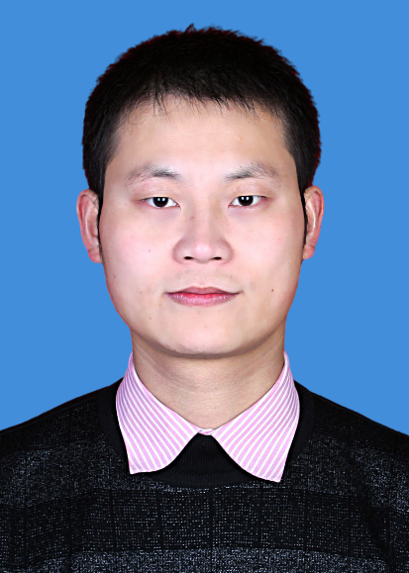
Yang Li
Chapter Chair
Region 10, Harbin Section
liyangnedu@gmail.com
Professional Profile/Biosketch
Professor at Northeast Electric Power University (China)
Clarivate Highly Cited Researcher (2024)
Section Chief Editor, Energy Reports (Elsevier)
Associate Editor for four IEEE TSG, TSTE, TII & TIA
Fellow, International Energy Foundation (IEF, 2021)
State Council Special Allowance Expert (2020)
Recipient, IEEE PES Technical Committee Prize Paper Award (2025)
Author of 20+ ESI Highly Cited and 30+ IEEE Trans. papers
Personal:
Enjoys research-driven travel, mentoring young scholars, and exploring system resilience in complex environments. Passionate about advancing global collaboration in AI–Energy Systems integration.
IEEE Experiences (section level)
Founding Chair, IEEE Systems Council Harbin Section Chapter (CH11207)
Director, Renewable Energy Modeling Technologies Subcommittee, IEEE PES Renewable Systems Integration Committee (China)
Recipient, IEEE PES Outstanding Engineer Award (2025)
Outstanding Reviewer Award, IEEE Trans. on Power Systems (2024)
Senior Member, IEEE since 2018

Slide 2
Systems Council Chapter, Harbin Section
Goals
Build a regional platform linking AI, power, control & communications.
Host ≥3 technical events in the first year (100+ participants).
Recruit 10+ members & 1 Distinguished Lecturer.
Strengthen university–industry collaboration across Northeast China.
How can Systems Council support us?
Support seed funding & Distinguished Lecturer programs for regional AI–Energy workshops.
Facilitate cross-chapter collaboration within Asia–Pacific.
Promote our activities via Systems Council newsletters & technical webinars.
Challenges
Newly formed chapter with limited visibility and initial funding.
Need to grow member engagement & communication channels.
Coordination across multiple regional universities & partners.
Major Events 2025 (Planned)
Inaugural seminar on AI-Enabled Resilient CPES.
Student workshop on AI for Energy Resilience.
Preparing IEEE AIRES 2026 – first Systems Council–PES collaborative event in China.

