Slide 1
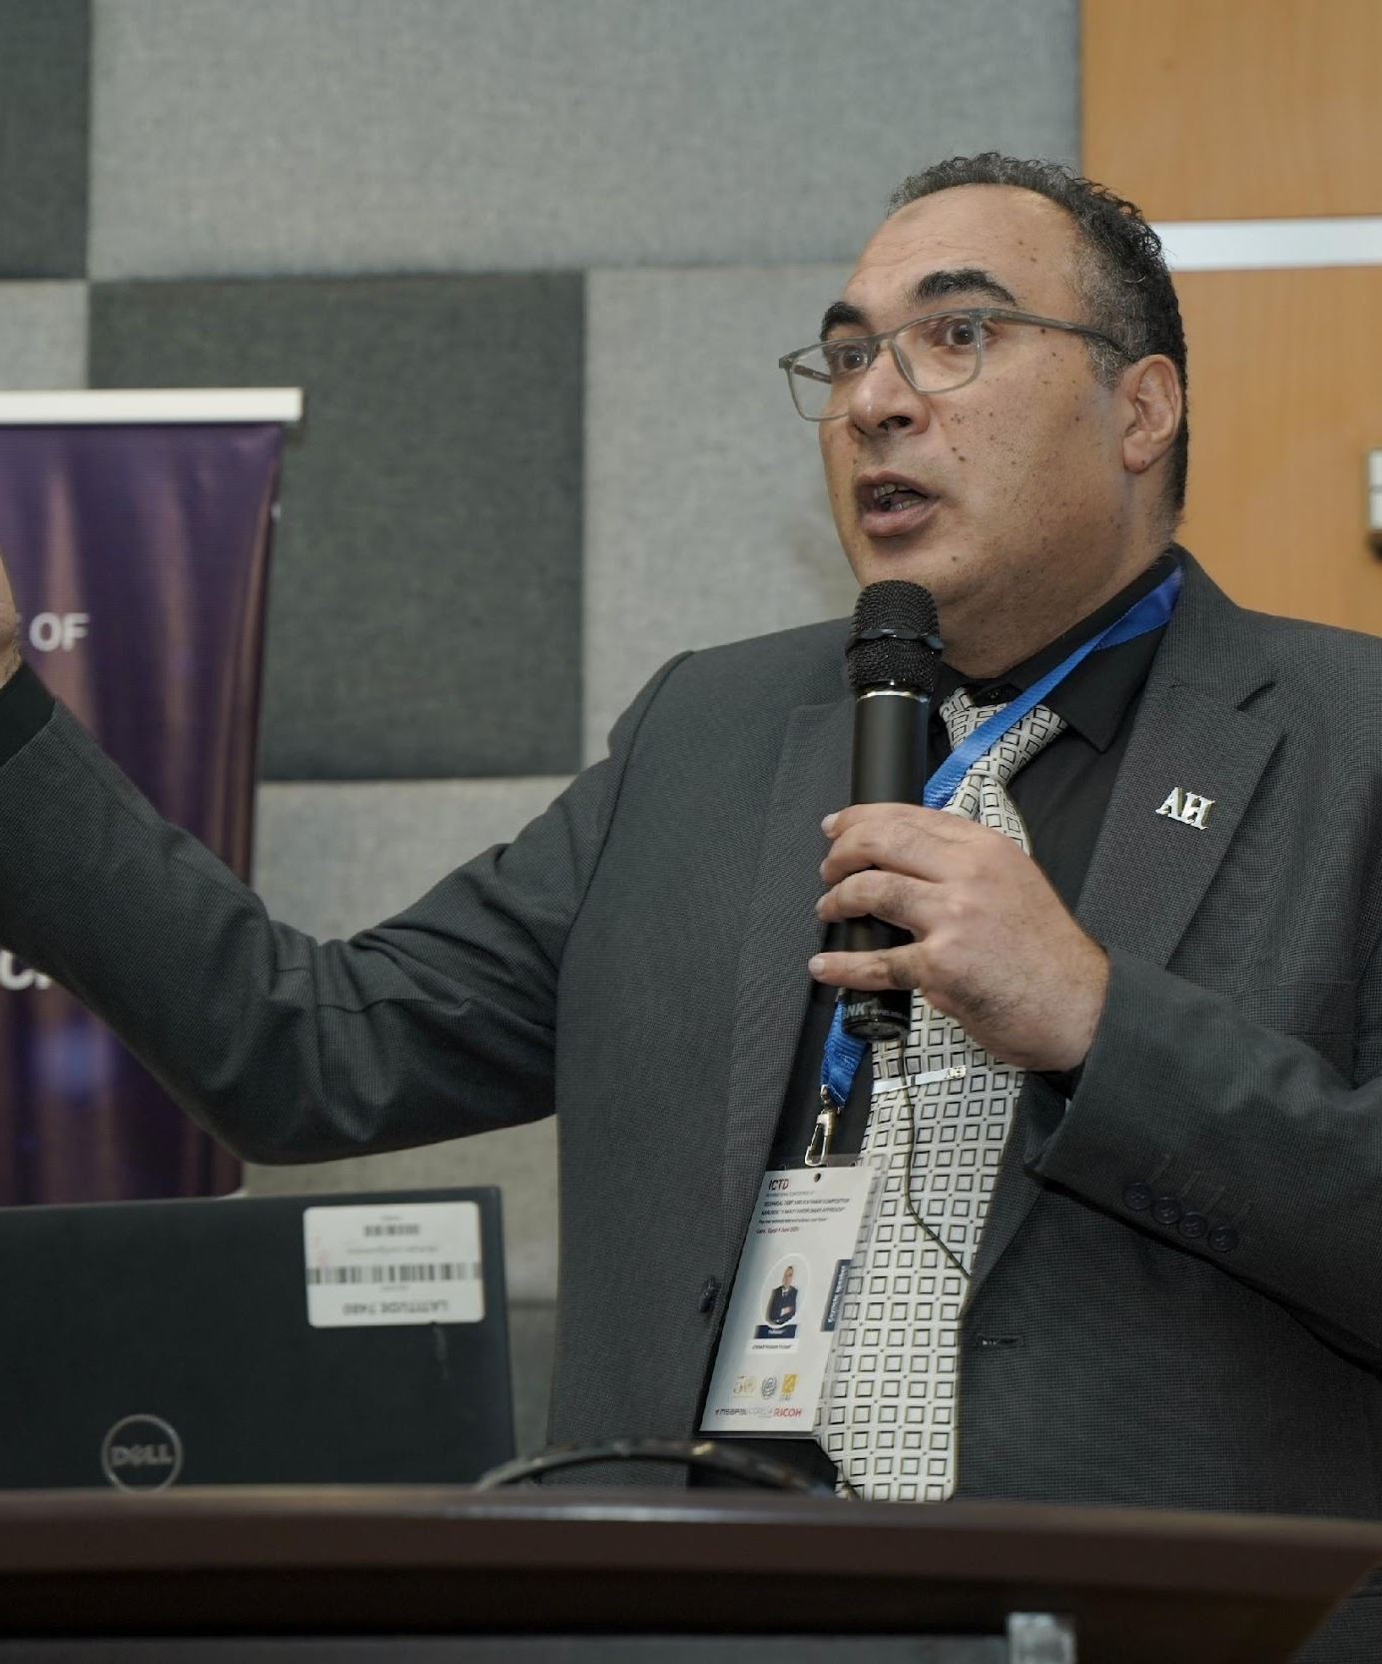
Ahmed Hassan Yousef
Egypt Chapter Chair
Region 8, Egypt Section
ahmedhassanYousef@ieee.org
ahassan@scu.eg
Professional Profile/Biosketch
I am the president of Elsewedy University of Technology, Egypt.
My background is a Computer Engineering Professor
My research area is software engineering with 120 publications in journals and conferences
IEEE Computer Society Distinguished Contributor
Recipient of IEEE Region 8 Appreciation token
Personal:
Have family, a son and a daughter
I enjoy reading novels, walking long distances, traveling.
IEEE Experiences (section level)
Egypt Section Chair (2020-2023)
IEEE Region 8 Conference Coordination Committee Member 2025-2026
IEEE Region 8 Nominations and Appointments Committee Member 2025-2026
IEEE Region 8 Section Vitality and Development Committee member 2022-2026
Africa Council Nominations and Appointment Committee Member 2023-2025

Slide 2

Systems Council Chapter, Egypt Section
What are your chapter goals?
Providing High Quality Technical Events to the members
What is the major or favorite event held in 2024 or 2025
What are your chapter challenges? (communication challenges? )
Council Funding for Conference Participation
Student Awareness
How can Systems Council make your chapter more successful?
MELECON 2026 Participation
DLPs Participation and Technical Workshops.
Membership Development Kits
Funding for society/student membership

