Slide 1

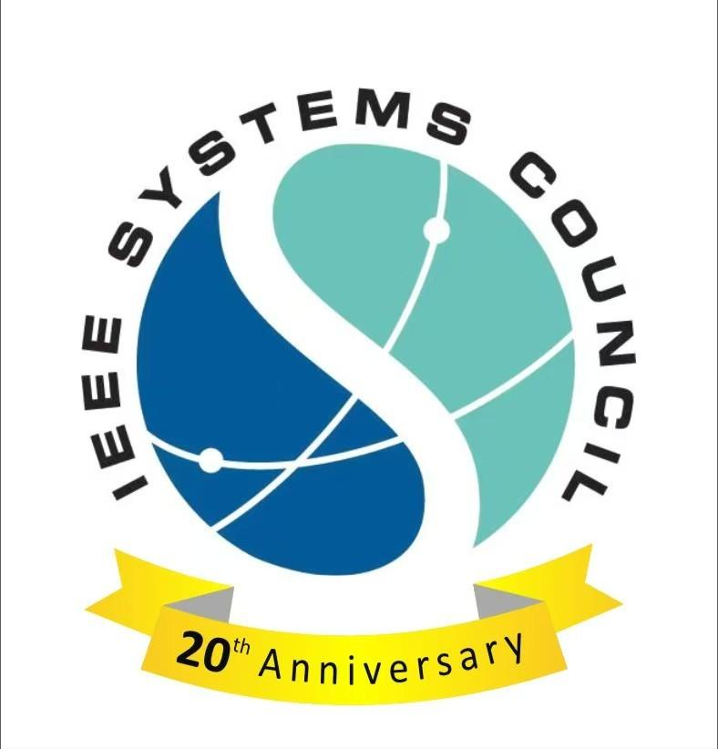
IEEE Systems Council Chapters Summit
Saturday, November 8, 2025

Slide 2
Chapters congress - Agenda
Draft Agenda (1pm – 5pm)
  Welcome & Opening Remarks – Andy Chen, Systems Council President – 10- min
  Member Services – Bozenna Pasik-Duncan, VP Member Services – 5 min
  Chapters – Loretta Arellano, Chapters Coordinator – 5 min
  Conferences – Paolo Carbone, VP Conferences – 5min
  Publications – Fabrice Labeau, VP Publications – 5 min
  Technical Operations – Andre Oboler, VP Technical Operations – 5 min
  Chapter Chair Presentations (each chapter in attendance) – Introduce team, goals, activities, and key takeaways – 5 min ea
  Open Discussion

Slide 3
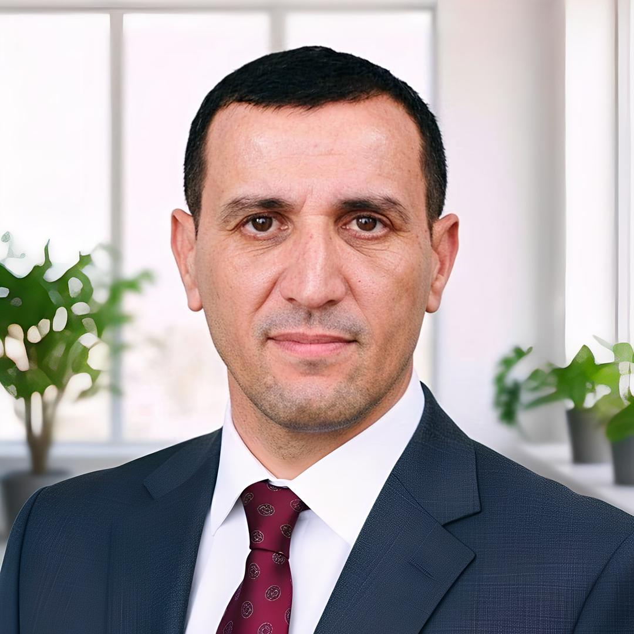
Abdelhamid IRATNI
IEEE Algeria Section – Systems Council
University of Bordj Bou Arréridj, Algeria
iratni@ieee.org
Professional Profile/Biosketch
Position: Professor of Control Engineering, University of Bordj Bou Arréridj, Algeria
Experience: Over 20 years in academia, research, and IEEE leadership
Expertise: Automation, smart grids, digital twins, and renewable energy systems
Focus: Driving innovation in systems engineering and fostering industry-academia collaboration
  LinkedIn: https://www.linkedin.com/in/abdelhamid-iratni/
Personal
Proud father of two sons and two daughters
Enjoys traveling and meeting inspiring people
Passionate about exploring new ideas beyond academia
Finds energy in reading and nature walks
IEEE Experiences
Senior Member, IEEE
Chair, Chapter Coordination Committee, IEEE Africa Council
Member, IEEE Region 8 Conference Coordination Committee (2025–2026)
Conference Coordinator, IEEE Algeria Section
Founder and Chair, IEEE Circuits & Systems and Systems Council Chapters, Algeria
Organized workshops, technical seminars, and mentorship programs integrating personal interests:
Hiking-themed IEEE networking events to connect young professionals in informal settings
Mentorship programs encouraging innovative thinking in smart systems and AI

Slide 4
Systems Council Chapter, Algeria Section
What are your chapter goals?
Strengthen member engagement through mentorship and recognition programs
Expand IEEE conference impact with sessions inspired by reading and research trends
Promote industry-academia collaboration in smart systems and renewable energy
Enhance diversity and inclusiveness, encouraging young engineers through mentorship
Organize nature-inspired IEEE events, like outdoor innovation retreats, to foster creativity
What is the major or favorite event held in 2024 or 2025
The IEEE Systems Council Chapter in Algeria was officially created in February 2025, so no events were held in 2024. Since its inception, the chapter has focused on promoting systems engineering to the local community by presenting at various Algerian universities, engaging researchers and students through targeted outreach sessions.
What are your chapter challenges? (communication challenges? )
Limited funding for large-scale conferences and technical events
Lack of student awareness about IEEE opportunities
Need for stronger cross-chapter collaboration and visibility
Integrating personal engagement activities into technical programs
How can Systems Council make your chapter more successful?
Facilitating access to Distinguished Lecturers and international experts to deliver high-impact technical workshops and mentorship sessions.
Providing targeted funding and resource support for student membership growth, lab equipment for hands-on training, and chapter development initiatives.
Encouraging the creation and activation of student branches and affinity groups, especially in emerging universities and regions.
Supporting regional collaboration and knowledge exchange between Systems Council chapters to share best practices and co-organize technical events.
Offering membership development toolkits and outreach frameworks to increase visibility and engagement within local communities.

