Slide 1

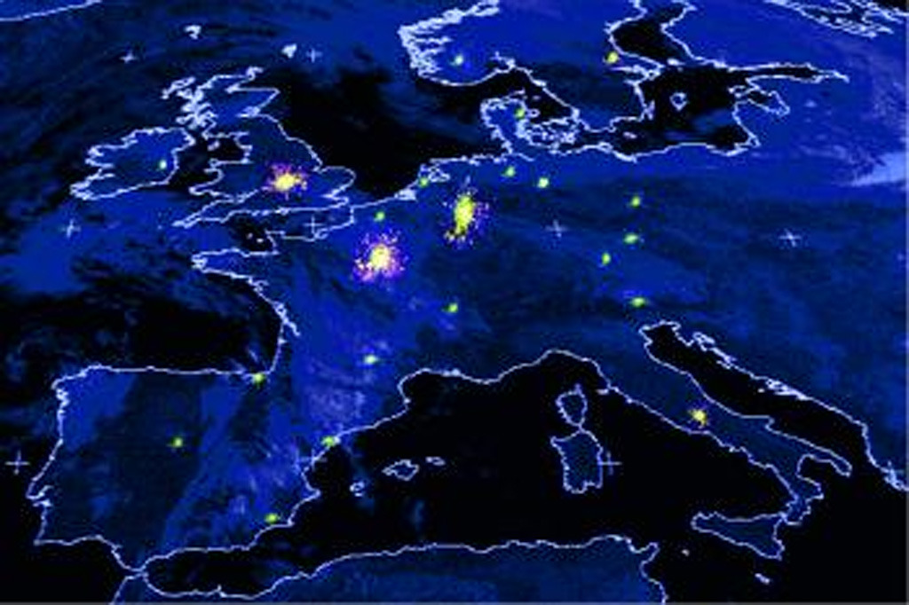
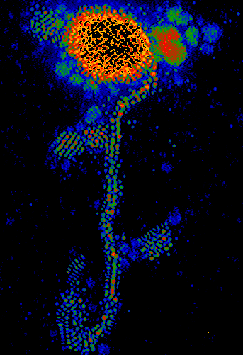
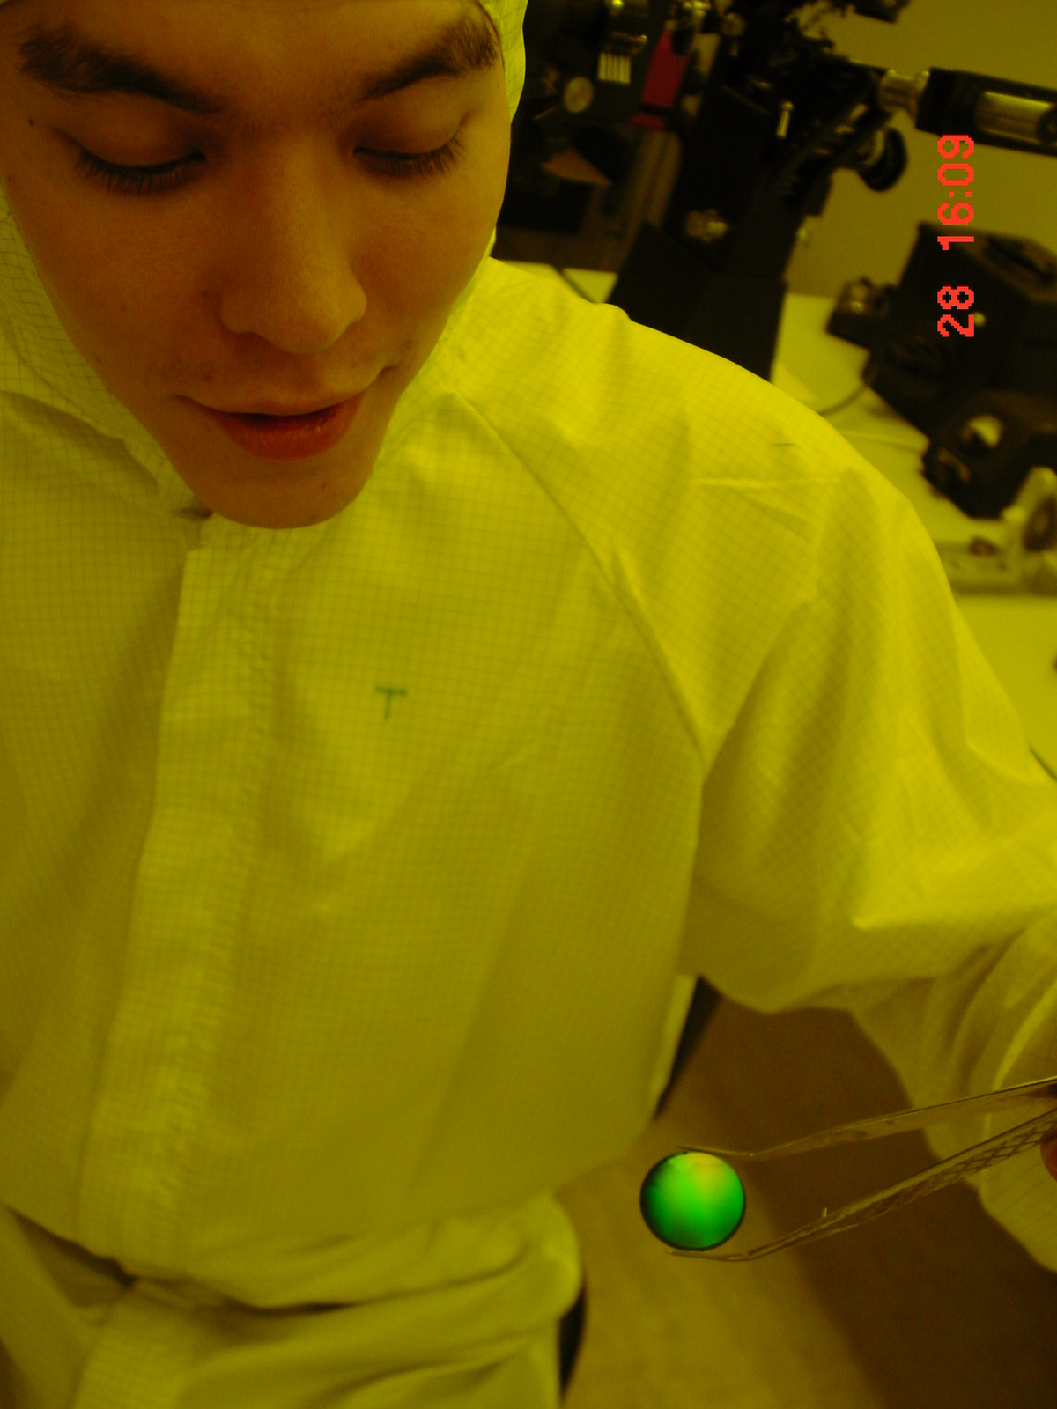
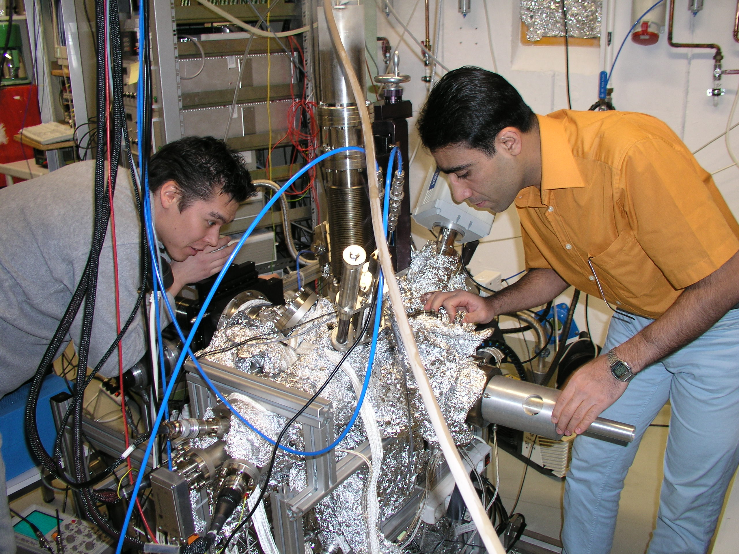

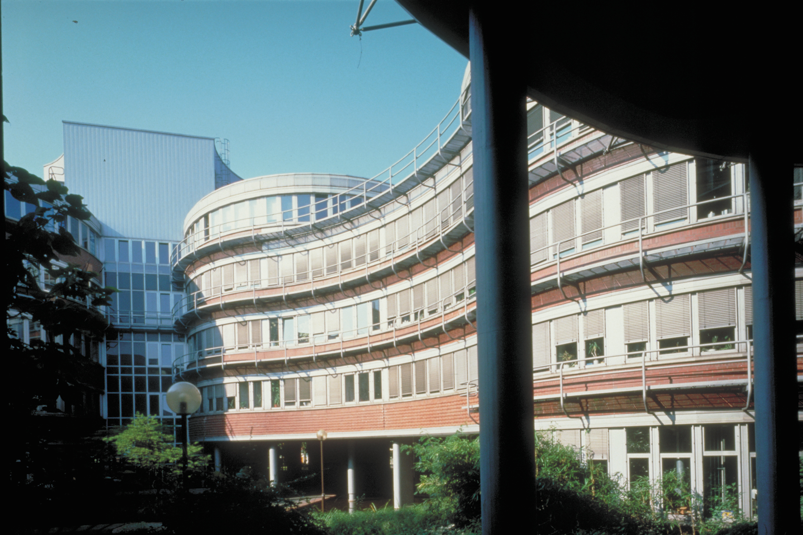
Functionalized Hybrid Nanomagnets:
New Materials for Innovations in Energy Storage and Medical Theranostics
Michael Farle
Faculty of Physics, University Duisburg-Essen and
Center for Functionalized Magnetic Materials (FunMagMa),
Immanuel Kant Baltic Federal University
Notes:
Imagine a future in which food is used to activate specific immune reactions in a human body based on an external noninvasive magnetic stimulus. Dream of a material that stores and releases energy reversibly by temperature changes between day and night. These visions may be realized by using magnetic nanoparticles that are functionalized to be biocompatible, environmentally stable and recyclable, self-healing, and low-cost.
In this presentation I will discuss the basic concepts of magnetic nanomaterials and their magnetic properties with a focus on how to tune specific parameters in a controlled fashion to achieve the dreams of the future. I will highlight state-of-the-art experimental technologies that allow us to understand microscopic properties and interactions in relation to electronic structure changes caused by changes in size, shape, and composition of nanomaterials. Then I will discuss how this understanding is used when nanomagnets are functionalized for targeted drug delivery or composed to form macroscopic materials for new energetic applications like magnetic refrigeration. I will demonstrate that the seemingly complex behavior of hybrid metal/metal, metal/oxide, or oxide/oxide interface materials can be understood from the three fundamental interactions in magnetism: magnetic exchange interaction due to orbital overlap, spin-orbit interaction due to inner- and intra-atomic relativistic corrections (e.g., crystal field effects) and the long-range magnetic dipolar interaction. Several examples will be presented, including the formation of above-room-temperature ferromagnetic interface layers between low-temperature antiferromagnetic layers and the evolution of lattices of magnetic textures (skyrmions) in confined dimensions. The talk will end with an episode in the life of an imaginary golf-playing couple in the year 2040 who use their “Smart Magnet” (SMAG) phone to energize and heal their bodies on the green.

Slide 2


IEEE Magnetics Society Home Page: www.ieeemagnetics.org
  3000 full members
  300 student members
The Society
  Conference organization (INTERMAG, MMM, TMRC, etc.)
  Student support for conferences
  Large conference discounts for members
  Graduate Student Summer Schools (June 19-23, 2017 Santander, Spain)
  Local chapter activities
  Distinguished lectures
Journals (Free Electronic Access for Members)
  IEEE Transactions on Magnetics
  IEEE Magnetics Letters
Online applications for IEEE membership: www.ieee.org/join
  360,000 members
  IEEE student membership IEEE full membership

Slide 3
Outline
Biomedical Applications
Non-invasive diagnosis and therapy
magnetism of nanoparticles
Energy savings and harvesting
ultralight magnets for generators and motors
(magnetic refrigeration)
skyrmions for magneto-logic (confined dimensions)

Slide 4

future …
„Smag“ Phone APP
OUTCH…

Slide 5


Visions of non-invasive Therapy & Diagnostics
A voyage to the Nanoscale
The future of thera-nostics
Videos by courtesy of A. Lorke and L. Liz-Marzan

Slide 6

Non-Invasive Steering of Magnets

Slide 7
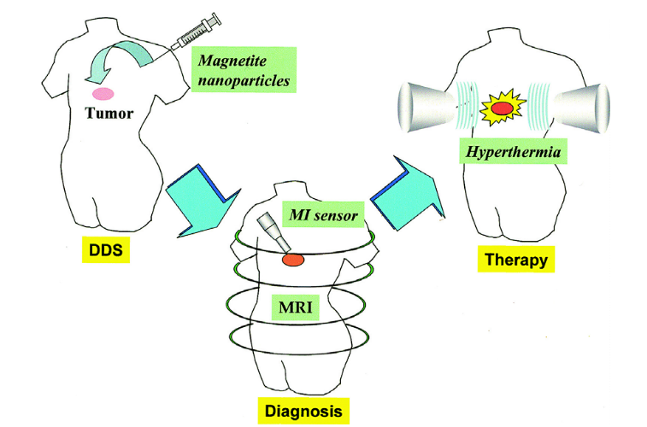
Magnetic resonance imaging (MRI) and hyperthermia
Illustration of the therapeutic strategy using magnetic particles.
Functionalized magnetic nanoparticles accumulate in the tumor tissues via the drug delivery system (DDS).
Magnetic nanoparticles can be used as a tool for cancer diagnosis by magnetic resonance imaging (MRI) or for magnetoimpedance (MI) sensor.
Hyperthermia is induced by AMF exposure.
➔ magnetic nanoparticles
for cancer therapy at the same time as diagnosis.
Cancer Treatment
(“hyperthermia”) at 40 – 44 °C
cytotoxic for cells in low p_{O2} and low pH,
= conditions within tumour tissue, due to insufficient blood perfusion.
→ Effects of both radiotherapy and many drugs are enhanced at an increased temperature
Akari Ito et al, J. BIOSCIENCE AND BIOENGINEERING 100 (2005) 1
“Heating the patient: a promising approach?” J. van der Zee, Annals of Oncology 13 (2002) 1173
Notes:
Heating the patient: a promising approach? J. van der Zee*
Erasmus Medical Center–Daniel den Hoed Cancer Center, Department of Radiation Oncology, Hyperthermia Unit, Rotterdam, The Netherlands Received 8 February 2002; revised 22 April 2002; accepted 16 May 2002
There is a clear rationale for using hyperthermia in cancer treatment. Treatment at temperatures between 40 and 44°C is cytotoxic for cells in an environment with a low pO2 and low pH, conditions that are found specifically within tumour tissue, due to insufficient blood perfusion. Under such conditions radiotherapy is less effective, and systemically applied cytotoxic agents will reach such areas in lower concentrations than in well perfused areas. Therefore, the addition of hyperthermia to radiotherapy or chemotherapy will result in at least an additive effect. Furthermore, the effects of both radiotherapy and many drugs are enhanced at an increased temperature. Hyperthermia can be applied by several methods: local hyperthermia by external or internal energy sources, regional hyperthermia by perfusion of organs or limbs, or by irrigation of body cavities, and whole body hyperthermia. The use of hyperthermia alone has resulted in complete overall response rates of 13%. The clinical
value of hyperthermia in addition to other treatment modalities has been shown in randomised trials. Significant improvement in clinical outcome has been demonstrated for tumours of the head and neck, breast, brain, bladder, cervix, rectum, lung, oesophagus, vulva and vagina, and also for melanoma. Additional hyperthermia resulted in remarkably higher (complete) response rates, accompanied by improved local tumour control rates, better palliative effects and/or better overall survival rates. Generally, when combined with radiotherapy, no increase in radiation toxicity could be demonstrated. Whether toxicity from chemotherapy is enhanced depends on sequence of the two modalities, and on which tissues are heated. Toxicity from hyperthermia cannot always be avoided, but is usually of limited clinical relevance.

Slide 8
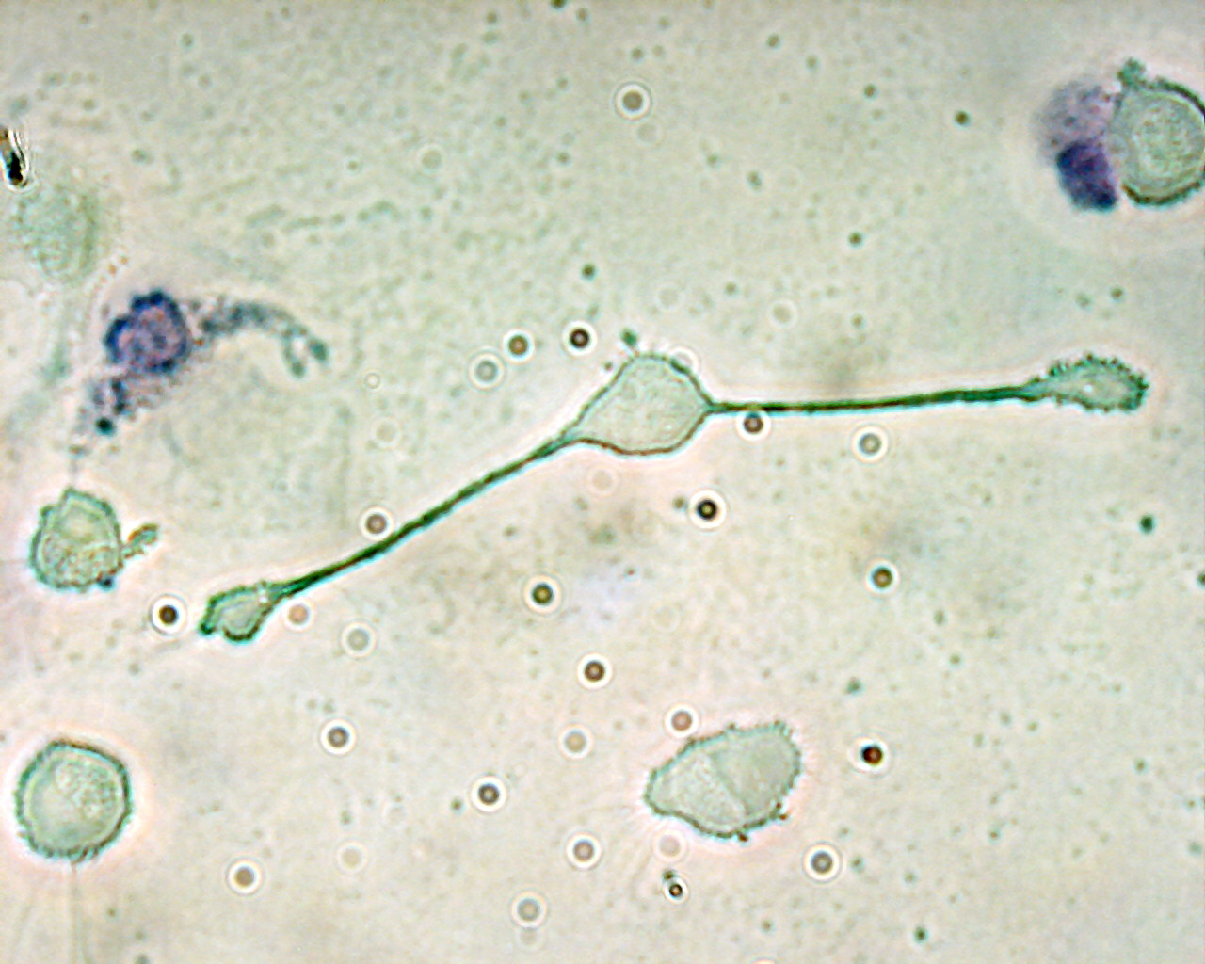
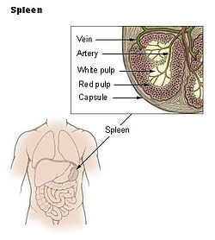
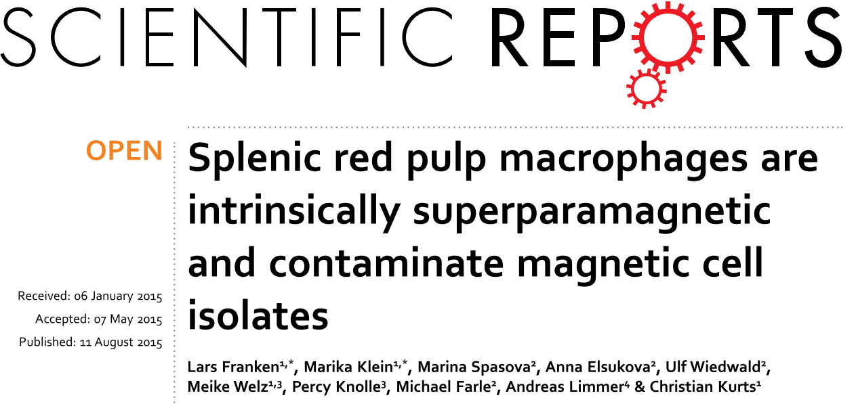
Vision
Use the immune system of the human body
→ teach, train and activate specific immune reactions
Макрофаг миши розтягується, щоб полготити дві частинки, можливо атогенні.
A macrophage of a mouse stretching its "arms" (pseudopodia) to engulf two particles, possibly pathogens. Trypan Blue Exclusion.
“Splenic red pulp macrophages engulf and digest cellular debris, foreign substances, cancer cells, and anything else that does not have the types of proteins specific to the surface of healthy body …”
Use food as targeting stimulus for the immune system.
Notes:
A main function of splenic red pulp macrophages is the degradation of damaged or aged erythrocytes. Here we show that these macrophages accumulate ferrimagnetic iron oxides that render them intrinsically superparamagnetic. Consequently, these cells routinely contaminate splenic cell isolates obtained with the use of MCS, a technique that has been widely used in immunological research for decades. These contaminations can profoundly alter experimental results. In mice deficient for the transcription factor SpiC, which lack red pulp macrophages, liver Kupffer cells take over the task of erythrocyte degradation and become superparamagnetic. We describe a simple additional magnetic separation step that avoids this problem and substantially improves purity of magnetic cell isolates from the spleen.
SPLEEN: an abdominal organ involved in the production and removal of blood cells in most vertebrates and forming part of the immune system.
76-79% of a normal spleen is red pulp
Macrophages (Greek: big eaters, from makros "large" + phagein "eat"; abbr. MΦ) are a type of white blood cell that engulfs and digests cellular debris, foreign substances, microbes, cancer cells, and anything else that does not have the types of proteins specific to the surface of healthy body cells on its surface^{[1]} in a process called phagocytosis. Macrophages were first discovered by Élie Metchnikoff, a Russian bacteriologist, in 1884.^{[2}

Slide 9
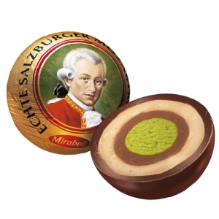
Motivation and Vision(s)
Non-invasive diagnosis and therapy
with physical and chemical technologies
„Heating the patient: a promising approach?” ©J. van der Zee on Hyperthermia
Use the immune system of the human body
→ teach , train and activate specific immune reactions
Food as controlled stimulus for the immune system ?!
→ Core/shell particles
Interfaces
„Mozartkugel“

Slide 10

A nanotechnology approach
Magnetic „nanohybrids“
Combine two or more function
to create
a new „hybrid“ functionality
Functions:
Texture and morphology
Soft and hard materials
Melting temperature
Smell
Taste
……
„hybrid“
functionality
„Mozartkugel“

Slide 11
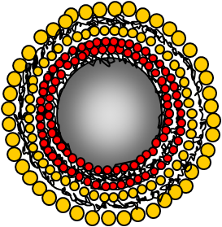
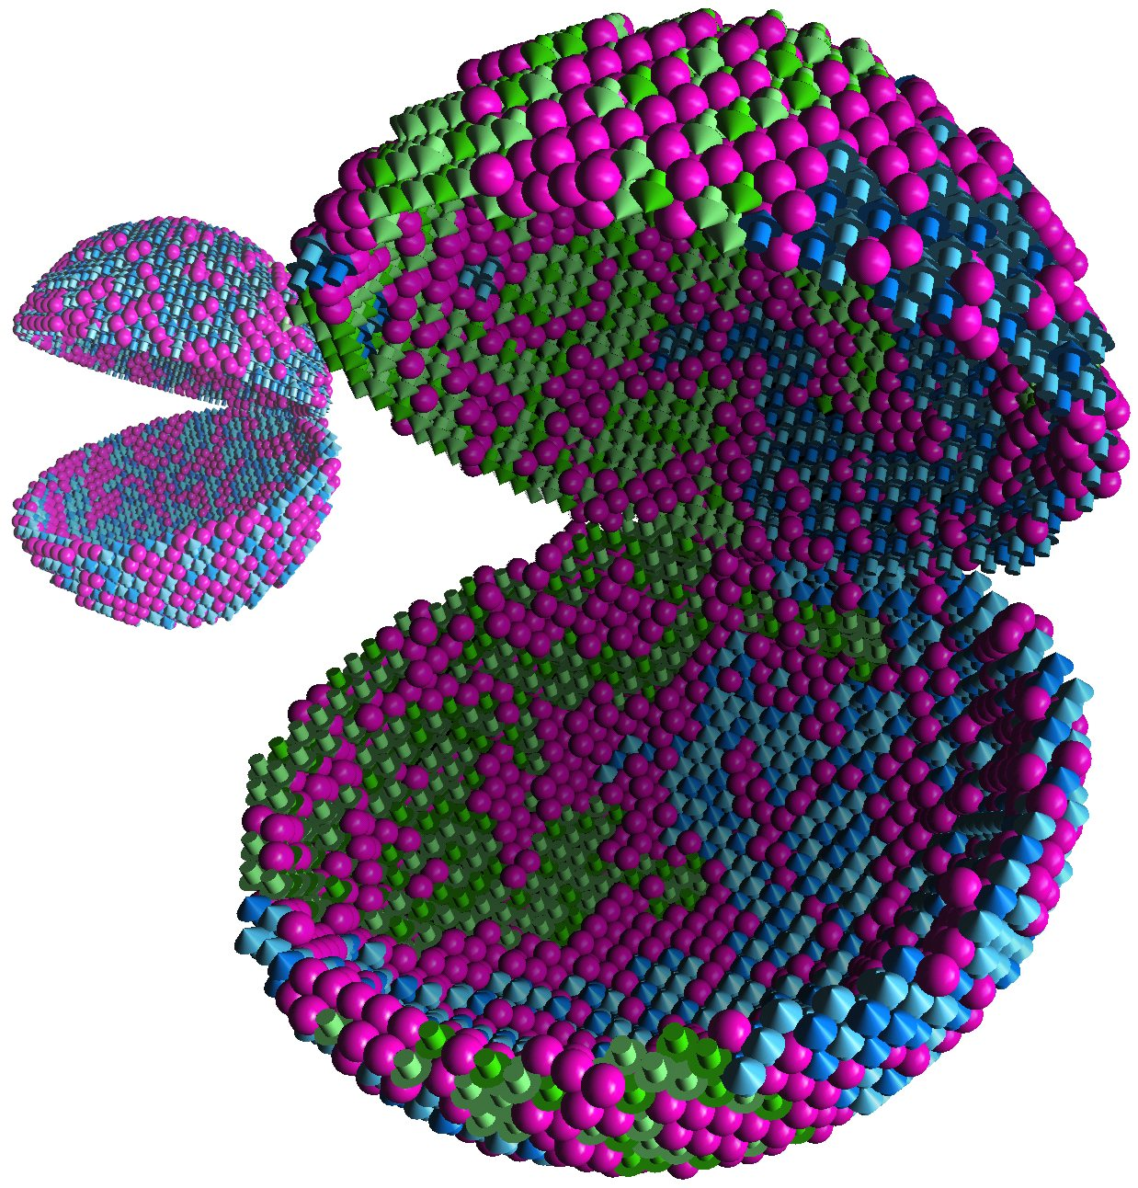
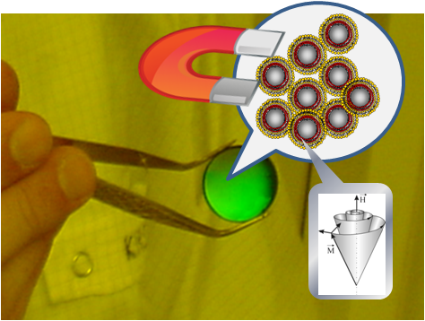
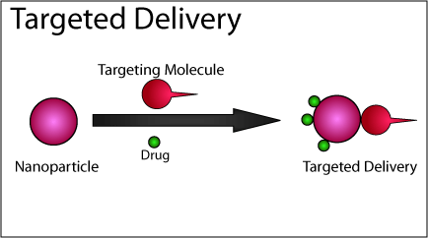
The bigger world of
Nanomagnetic Technologies
Biomedical
Micro Swimmers
Magneto – Photonics
Spin- (magneto) Electronics
E-mobility (automotive)
Wind power
Sensors
Data storage and processing
(hard disk and magnonics)
Light-weight RE free hard magnets
Top-Down =: Magnetic NanoSTRUCTURES
Bottom-Up =: Magnetic NanoCOMPOSITES

Slide 12
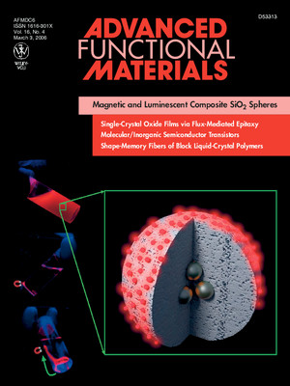
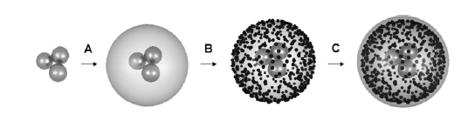
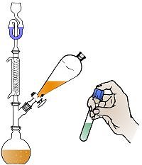
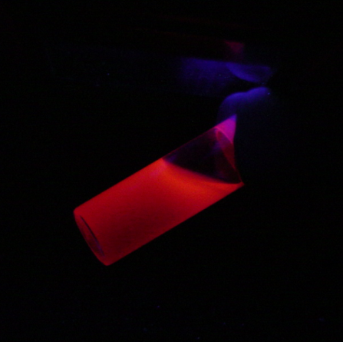
Biocompatible magnetic nanoparticles with luminescent functionality
Silica encapsulated magnetic core
covered with CdTe nanoparticles
Passivated by thin silica shell
CdTe on SiO_{x}
➔ luminescent
Fe₃O₄ in SiO_{x} ➔ magnetic
Adv. Funct. Mat. 16 (2006) 509

Slide 13
Multilayer-Composite Core-Shell Colloids
micron-sized optical and magnetic active hollow or filled spheres
2 Fe₃O₄ layers + 3 Au layers
J. Mater. Chem. 15 (2005) 2095 , Phase Transitions 78 (2005) 741

Slide 14
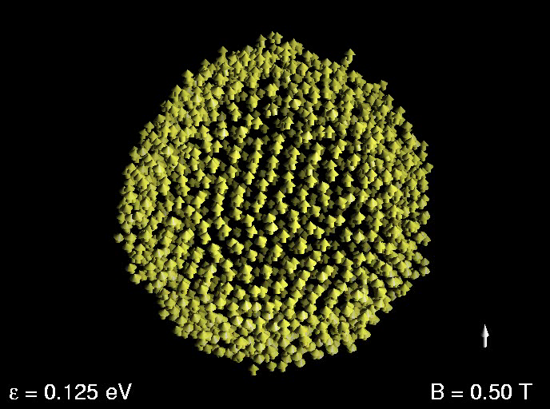
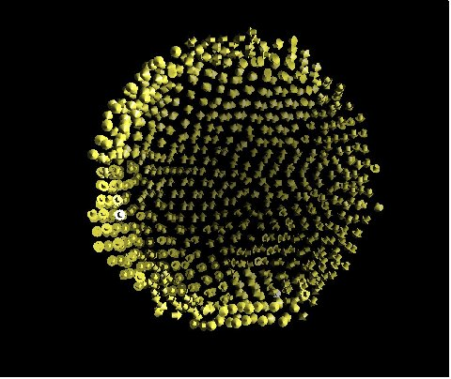
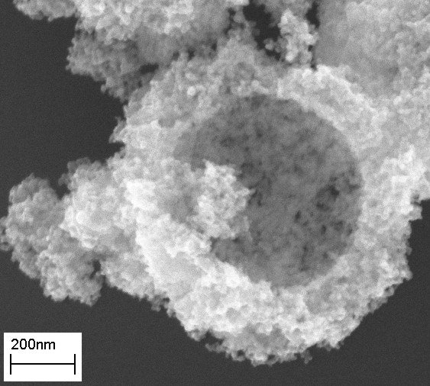
Non-invasive drug delivery: magnetic hollow microspheres
Simulation by M. E. Gruner and P.Entel
Nanoparticles coupled by magnetic dipole-dipole interaction
Rotating magnetic field B
(simulation)
Phase Transitions 78 (2005) 741
a virtual knife
_{Simulation:}
_{M. E. Gruner and P. Entel}
_{Particle Synthesis:}
A. Schlacher, M. Spasova and M. Farle

Slide 15
Multilayer-Composite Core-Shell Colloids micron-sized optical and magnetic active hollow or filled spheres
B
MagneticallyTunable
Photonic crystals
J. Mater. Chem. 15 (2005) 2095 , Phase Transitions 78 (2005) 741

Slide 16
Motivation: Designing new Materials
Structural Transformations ?

Slide 17
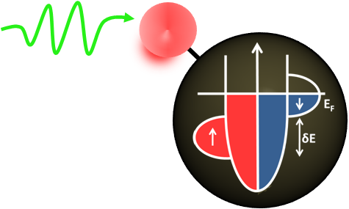
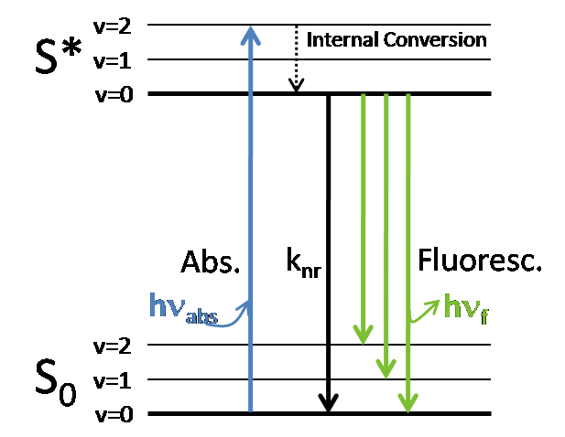
Modulating magnetism with light
Synthesis of small NPs (high surface/volume ratio)
Advantages of organic fluorescent molecules:
1- Stabilization of the NPs
2- Direct chemical interaction between dye and NP
Rhodamine B
- Well studied molecule
- High emission efficiency
- Low photobleaching
M. Comesana-Hermo et al. ChemPhysChem 12 (2011) 2915 – 2919

Slide 18
Rhodamine B @ Co : Synthesis
Fluorescent organic dye, Rhodamine B (RhB),
to stabilize cobalt NCs
+
3 bar H₂, 14 h
Room T, anisole
(1 equivalent)
(0.2 equivalents)
Diameter=3.8 nm
σ=0.6 nm
50 nm
M. Comesana-Hermo et al. ChemPhysChem 12 (2011) 2915 – 2919

Slide 19
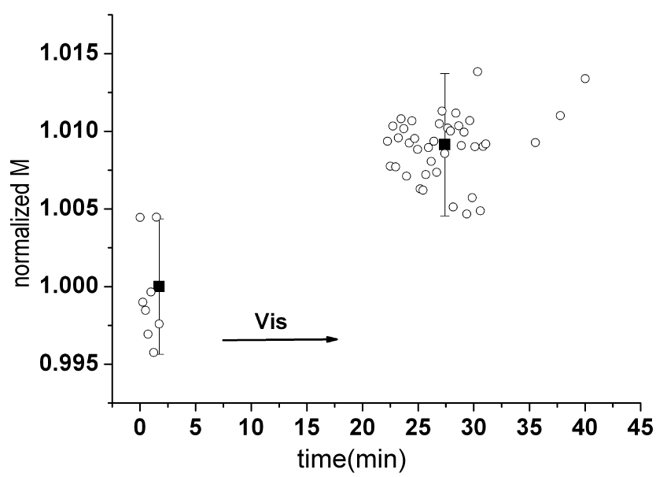
Rhodamine B @Co: Photomagnetic Effect
Magnetic properties of the sample
- M_{S}= 152 Am²/kg (93.2 % bulk)
-No oxidation
-T_{B}= 38 K
Radiation: white light (λ: 400-700 nm)
Power of the lamp: 50 W
Power at the exit of the optical fiber: 12 mW
M. Comesana-Hermo et al.
ChemPhysChem 12 (2011) 2915
10 K
B_{ext}= 5 T
M
0.3-0.9 %
Reversible process

Slide 20
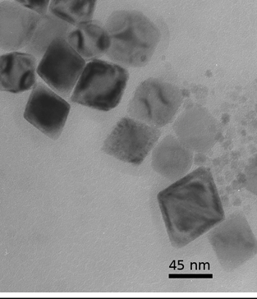
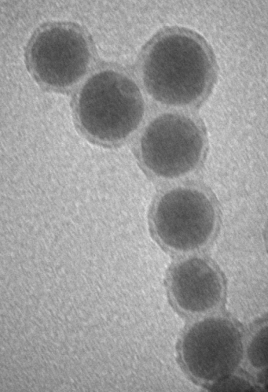
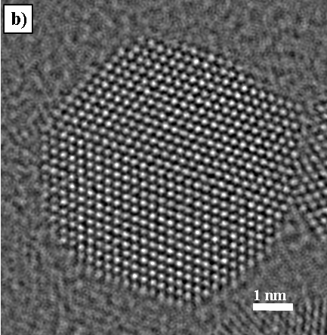
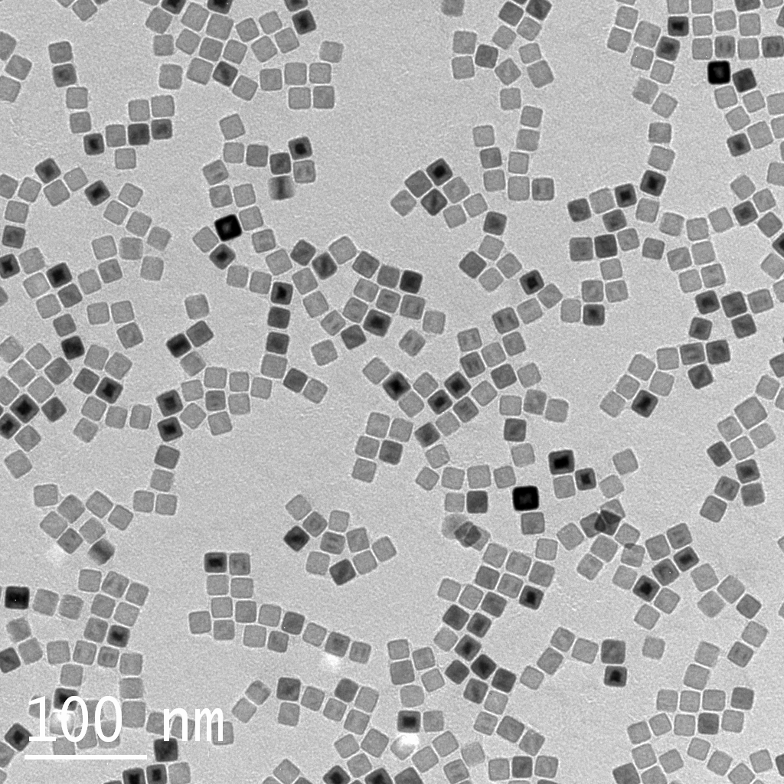
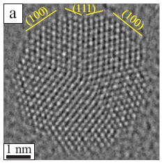
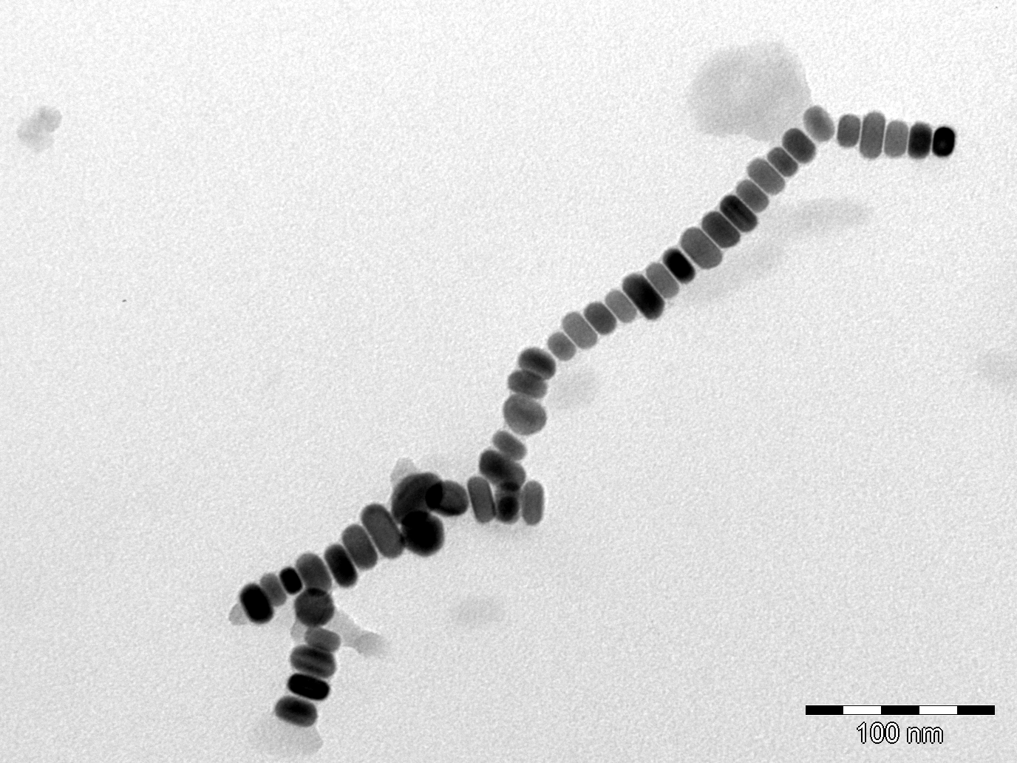
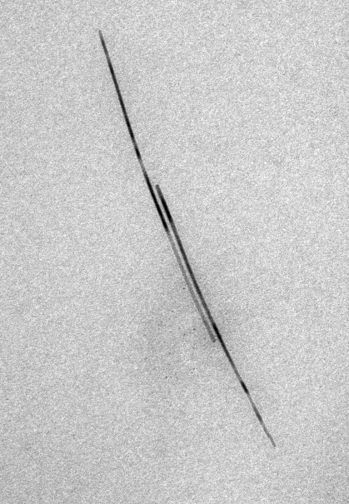
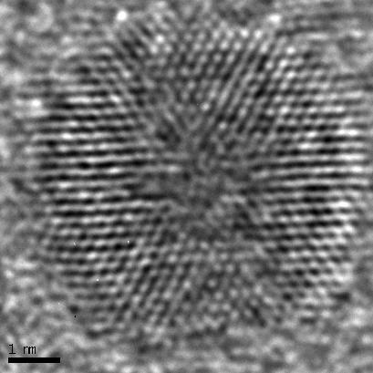
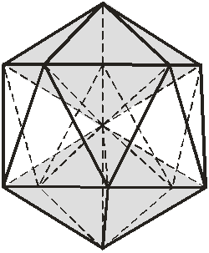
Structure and shapes of Nanoparticles
spheres
cuboctahedra
cubes
octahedra
20 nm
discs
rods
decahedra
O. Dmitrieva et al., J. Phys. D: 39 (2006) 4741
D. Ciuculescu et al., Chem. Mater 21 (2009), 3987
N. Fontaina-Troitino, Nano Letters 14 (2014) 640
Zi-An Li, et al, Phys. Rev. B 89 (2014) 161406(R)
3D Tomography by R. Wang, Ch. Kisielowski
NCEM, LBL Berkeley
icosahedra

Slide 21


Warning: Seeing = knowing ?
Is the interpretation from a 2D projection the real thing ?

Slide 22
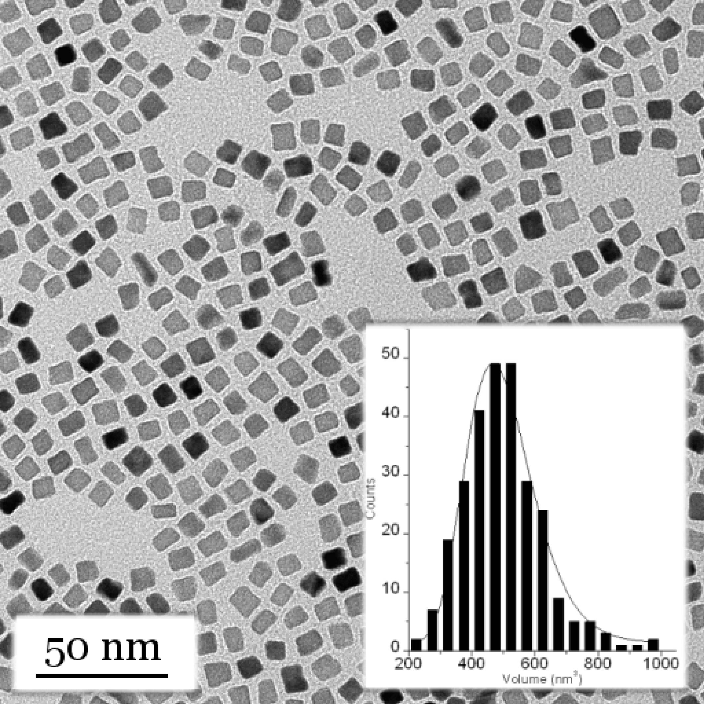
Challenge: Single particle detection
Ensemble probes:
Average of:
1. Distribution of
magnetocrystalline
anisotropy axes
2. Effects of dipolar
interactions
3. Size distribution
Magnetometry (SQUID, VSM) or Resonance (FMR, EMR)
Single particle properties
from ensemble measurements?
Magnetic anisotropy energy
Magnetic moment (S, L)
Magnetic relaxation
Correlation to ?
crystal structure
Morphology
composition
M(H) ?
χ“(ω) ?
Γ(ω,Τ) ?
TEM
A. Shavel et al., Adv. Funct. Mat. 17 (2007) 3870
I. Rod et al., Nanotechnology 20 (2009) 335301
F. Kronast et al., Nano Letters 11 (2011) 1710

Slide 23
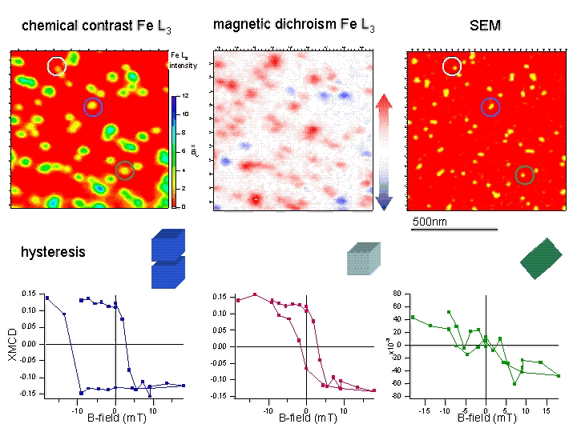
Hysteresis of Individual Nanoparticles
F. Kronast et al., Nano Letters 11 (2011) 1710
B
B
B
0.15
0.10
0.05
0.00
-0.05
-0.10
-0.15
0.15
0.10
0.05
0.00
-0.05
-0.10
-0.15
80
60
40
20
0
-20
-40
-60
-80
XMCD
*10⁻³
-15 -10 -5 0 5 10 15
-15 -10 -5 0 5 10 15
-15 -10 -5 0 5 10 15
magnetic field B (mT)
magnetic field B (mT)
magnetic field B (mT)
Al covered metallic 24 nm Fe cubes (300 K)

Slide 24
CoO Octahedra
Ferromagnetism
(ferromagnetic long range order)
at the interface
between two Antiferromagnets
with a Curie temperature
higher than
The Neel temperatures
N. Fontaina-Troitino, Nano Letters 14 (2014) 640

Slide 25
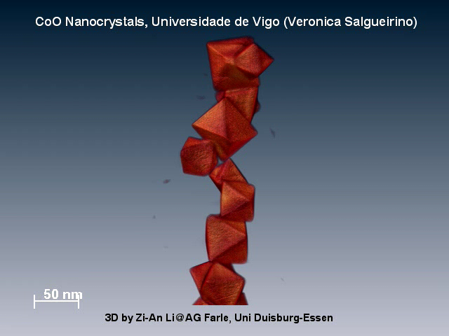
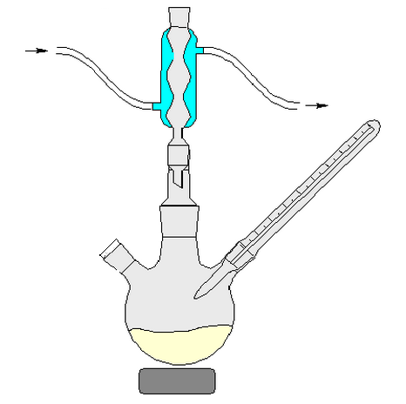
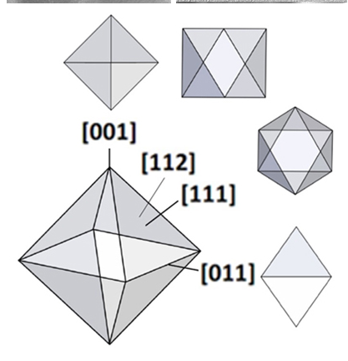
CoO Octahedrons
N. Fontaina-Troitino, Nano Letters 14 (2014) 640

Slide 26
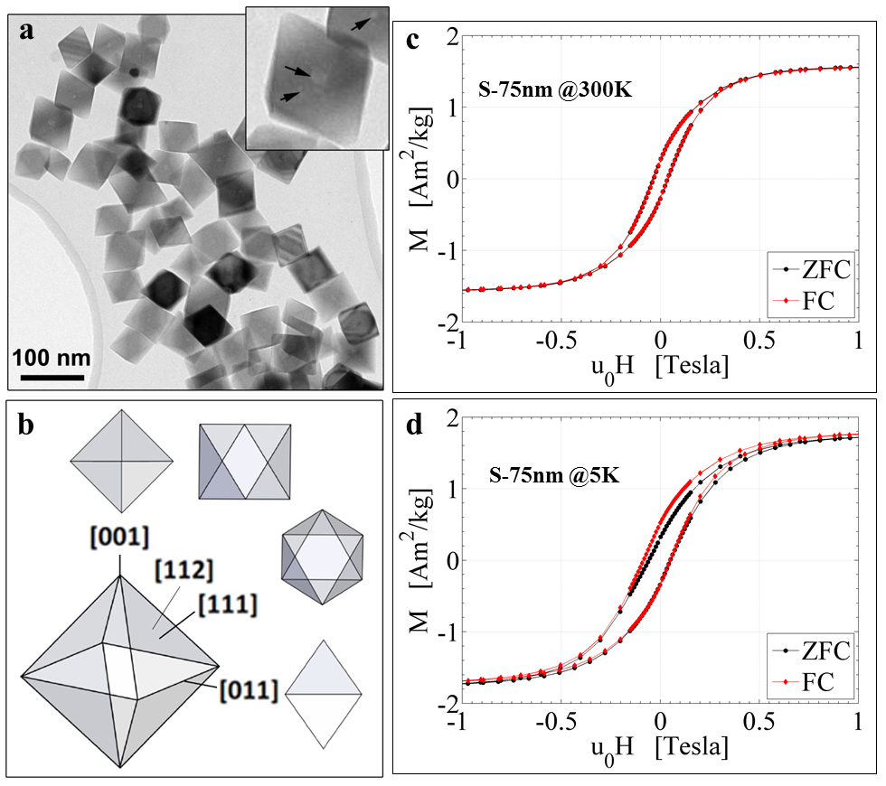
CoO Octahedra
Antiferromagnetic CoO : T_{N}= 292 K
Ferromagnetism
above T_{N} !!
Exchange Bias !
N. Fontaina-Troitino, Nano Letters 14 (2014) 640
Notes:
TEM and magnetic characterization of octahedral cobalt oxide nanocrystals. (a), TEM bright-field image of octahedral cobalt oxide
nanocrystals on an amorphous C support film. The particles exhibit patches of brighter contrast, which are likely to be related to the presence of voids inside the particles, as indicated by arrows in the inset. (b), Schematic representation of octahedral particle shape, its projections and the corresponding crystallographic orientations for a cubic crystal structure. (c), ZFC and FC hysteresis loops, recorded at 300 K from samples S-75 nm and shown after subtraction of the linear pm (300 K) component. (d), As for c but at T55 K, the FC magnetization curve is shifted horizontally to the left relative to the ZFC curve. Values of HC, MR and MS (see text) are given in Table T1 and T2.

Slide 27
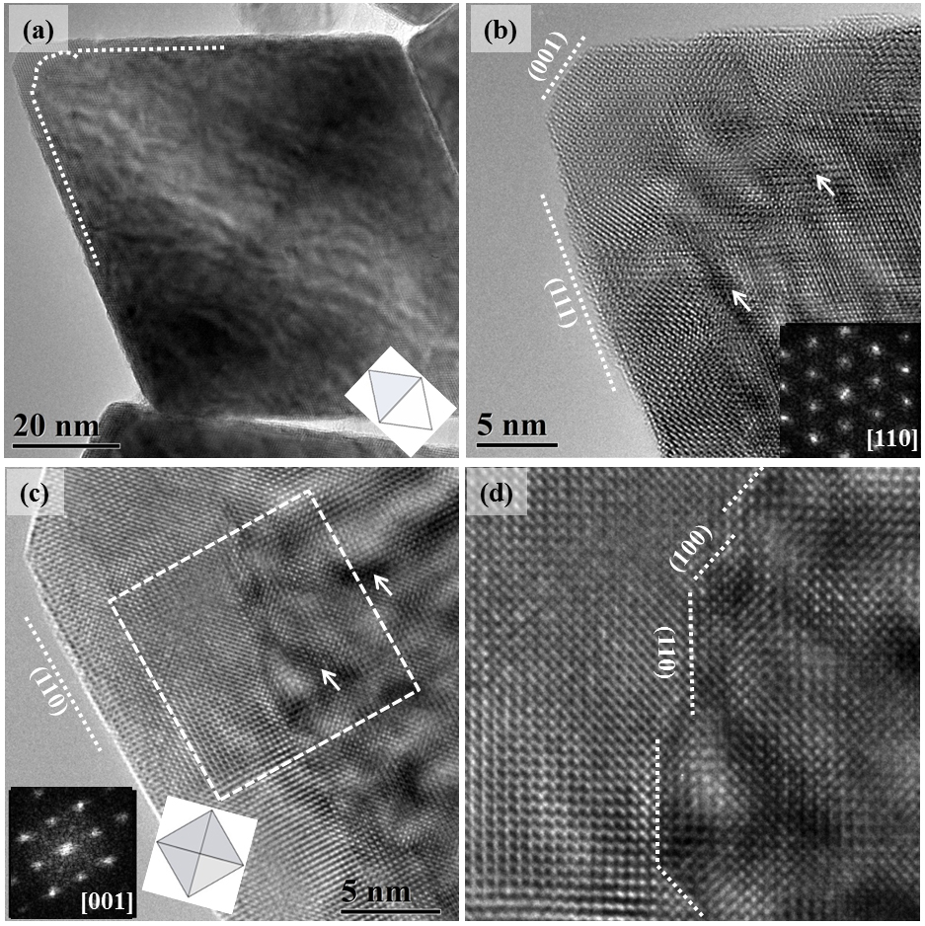
CoO Octahedra
High Resolution Transmission Electron Microscopy
Antiferromagnetic CoO :
T_{N}= 292 K
Antiferromagnetic Co₃O₄ :
T_{N}= app. 40 K
Nano Octahedra with
CoO core
Co₃O₄ shell
(app. 3 – 5 nm)

Slide 28
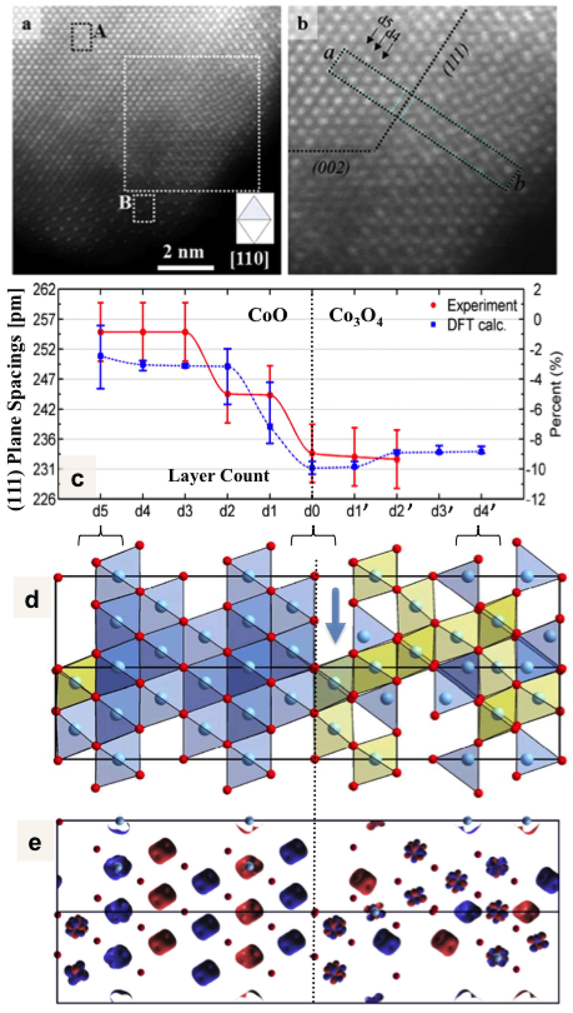
Theory: Interface Model CoO-Co₃O₄
CoO (111)
Co₃O₄
Theory versus Experiment
electronic reconstruction at
Co₃O₄ interface:
S=0 [Co³⁺]_{oct} ➔ S = 1/2 [Co²⁺]_{oct}
DFT Calculations (R. Pentcheva)
Scientific Reports 5 (2015) 7997
Notes:
STEM-HAADF image of a single octahedral cobalt oxide nanocrystal.
(a), Atom-column-resolved STEM-HAADF image of the edge of a [1–10]-oriented cobalt oxide nanocrystal acquired in STEM mode at 80 kV using a probe size of ,0.1 nm. The core region A and the shell region B exhibit contrast characteristic of [1–10]-oriented CoO and Co3O4 respectively.
(b), Enlargement of the interface area: (111)-type interface between a CoO core and the Co3O4 shell.
(c), Measured (111) (red dots) and calculated (blue dots) lattice plane spacings as a function of spacing number near the interface. ‘‘d0’’ denotes the spacing indicated by the dashed line in b.
(d), Side view of the relaxed geometry of the CoO/Co3O4 (111) heterostructure obtained from the DFT1Ucalculations. The interface plane (dashed line) of O²⁻ (red dots) connects octahedral Co ions (blue dots) in Co3O4 on the right to octahedral Co²⁺ ions in CoO on the left. Co²⁺ and Co³⁺ are denoted by blue/yellow polyhedra. As discussed in
the text, electronic reconstruction in Co3O4 reduces the S = 0 [Co³⁺]_{oct} to low spin [Co²⁺]_{oct}.
(e), Spin density of the CoO/Co3O4 (111) heterostructure obtained from the DFT 1 U calculations. Red and blue contours denote antiparallel orientations of magnetic moments. Besides the antiferromagnetic alignment of octahedral Co²⁺ in CoO and tetrahedral Co²⁺ in Co3O4, note a considerable spin density at the Co³⁺ sites in the inner Co3O4 layers (not present in bulk Co3O4). A key feature is the significant spin polarization in the interface Co3O4 signaling the reduction of octahedral Co³⁺ to Co²⁺ sites in an unanticipated low spin state (S = 1/2)

Slide 29
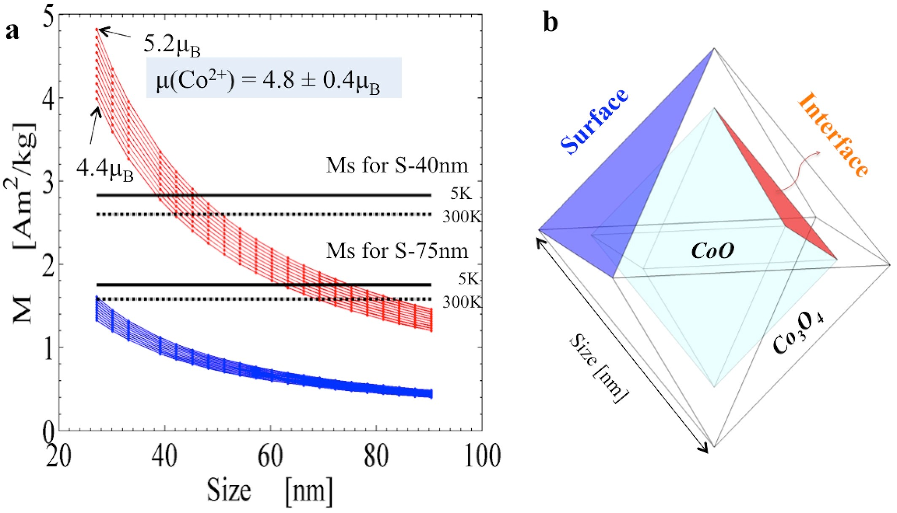
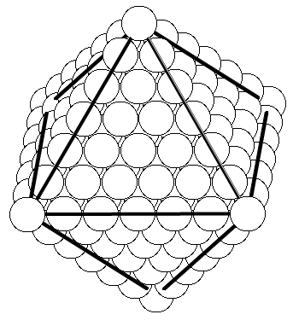
Model and Experiment: CoO-Co₃O₄
Two sizes of octahedra: S-40nm and S-75nm (edge length)
40 nm
fm interface
layer
CoO
core
Double layer of Co²⁺
at interface
Ferromagnetic interface order
Above (!) the Neel temperatures of CoO and Co₃O₄
75 nm
Co₃O₄
Single layer of Co²⁺
at interface
Exp.: ➔ 4.3u_{B}< Co²⁺ <5.2u_{B}
Scientific Reports 5 (2015) 7997
Notes:
(a) Size dependence of experimentally measured (black solid (T55 K) and dashed (300 K) lines) and calculated saturation magnetizationMS of CoO octahedra. A magnetic moment m of (4.8 6 0.4)mB per Co21 ion and a shell thickness of 3 nm Co3O4 is assumed. MS arises only from the Co cations at the surfaces or interfaces of the octahedral nanocrystals as indicated in the schematics (b). The blue lines are calculated values assuming only effectively one layer of Co21 cations at the Co3O4 surface, while the red lines correspond to a double layer of Co cations at the interface as discussed in the text.

Slide 30



Outline: Part 2 of 2
Biomedical Applications
Non-invasive diagnosis and therapy
Energy savings and harvesting
ultralight magnets for generators and motors
^{FP7-NMP2011.2.2-4-SMALL-5}

Slide 31
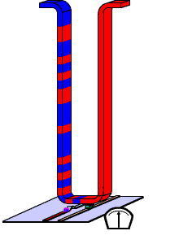

Saving energy with Magnetism
Magnetic data storage
conventional hard disk → Solid State Disk
Magnetic data processing
microprocessor → Spinelectronics and Spinlogic
Magnetic sensing, switching
magnetic tunnel junctions
Magnetocalorics
the solid state cooling device
Magnetic shape memory alloys
controlling movement without electronics
Magnetic superconducting devices?
Rare-Earth free hard magnets
Magnetic Nanohybrids
building blocks for interfacing with light, electronics, mechanics
Magic …..
or vision ?

Slide 32
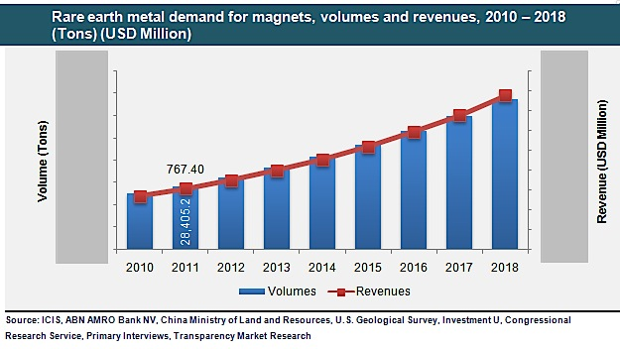
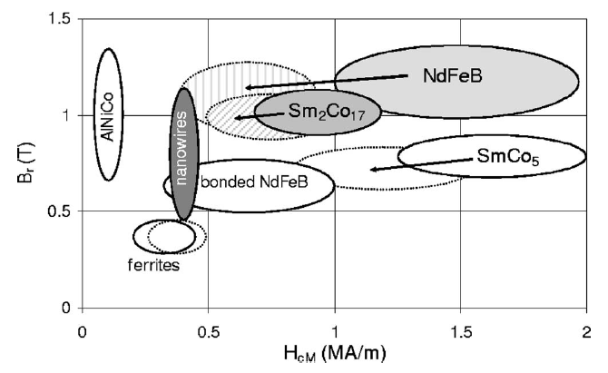

Motivation
Remanence and coercivity for the usual permanent magnets materials at room temperature
Requirement and Price estimation of rare earth metal:
[2] T. Maurer, et. al., APL 91, 172501 (2007)
Goal: high performance rare earth free permanent magnets
at room temperature using nanowire (NW) array structures

Slide 33
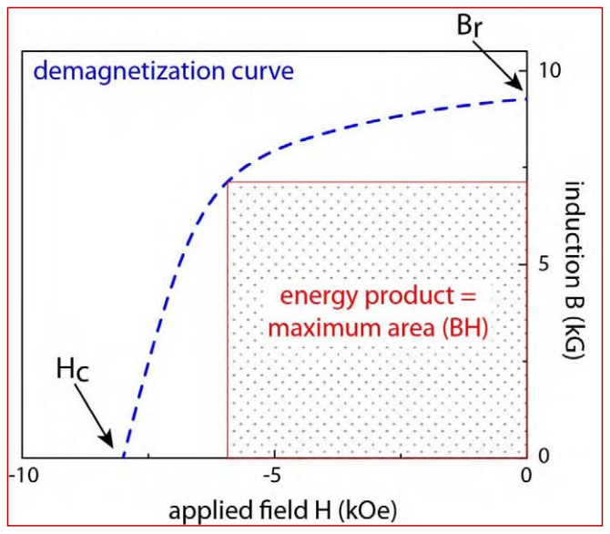
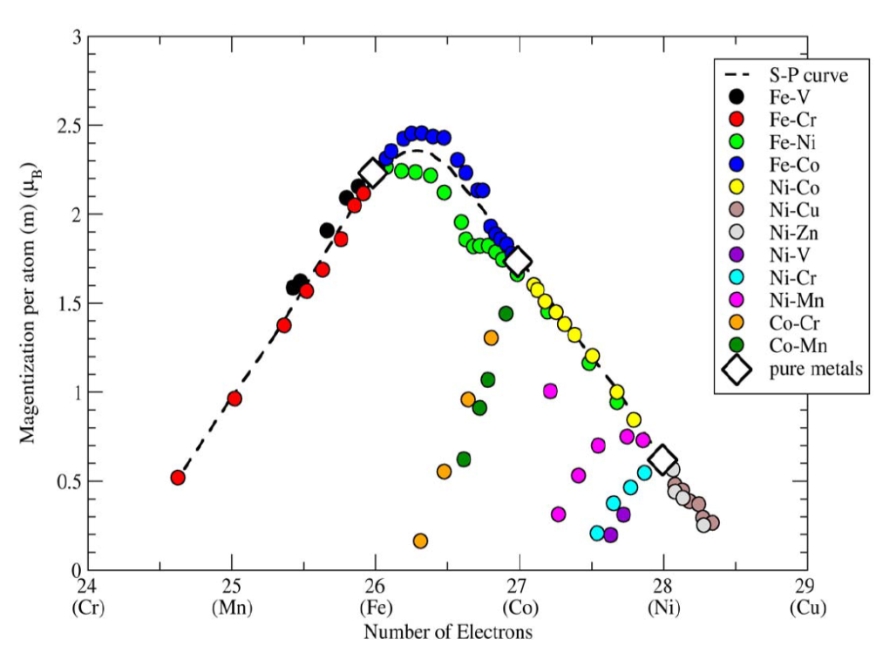
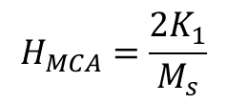


Concept for building new permanent magnets
Goal: to develop a new generation of novel materials for
high performance permanent magnets
which do not contain any rare-earth elements or platinum.
The figure of merit for a Ferromagnet: Energy Product (BH)max
Large H_{c}
Large B_{r}
Magnetic anisotropy field:
H_{an}= H_{mc}+ H_{shape}+ H_{strain} + H_{sur/interf} + H_{exch}
High aspect ratio
Easy axis II NWs long axis
Cover with an Antiferromagnet
Slater-Pauling Curve
3

Slide 34
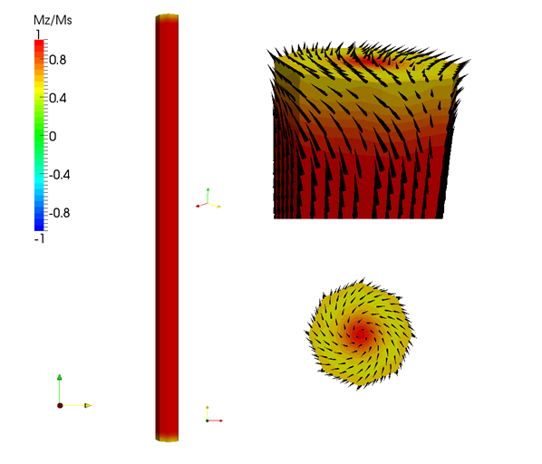
FeCo NWs: Micromagnetic modelling
Comparison of magnetization reversal processes at the end surfaces between of (a) Co and (b) Fe nanopillars with D = 60 nm and Length = 1000nm.
(a) Cobalt
(b) Iron
* Simulations courtesy of Prof. Joseph Fidler and Peter Toson.
The vortex structure of the atomic magnetic moment at the tip of the NW reduces the coercive field!
19

Slide 35


FeCo nanowires: motivation
Porous Anodized
Alumina Templates
Goal: to increase the coercivity in FeCo NWs
Micromagnetic simulations:
inhomogeneous magnetization reversal processes and nucleation at the tips leads to reduction of coercive field values.
To increase the coercivity → cap the tips with Ni₅₀Mn₅₀. (Antiferromagnet with high magnetocrystalline anisotropy)
Electrochemically prepared.
Collaboration with Prof. Vázquez
14

Slide 36




FeCo NWs: magnetic hysteresis (40 nm)
II NW long axis
0
Initial state
Δ=60mT
Δ=60mT
Δ=15mT
1
After removing Au
2
After removing membrane
Δ=12mT
Δ=52mT
Δ=52mT
3
After depositing NiMn
H_{exch} (10K) = 6 mT
24

Slide 37
FeCo NWs: conclusion
0
Initial state
INCREASE IN COERCIVITY of 20 % !
1
After removing Au
2
2
After removing membrane
NO INCREASE IN COERCIVITY AFTER COVER WITH NiMn ALLOY due to oxide !
3
3
After depositing NiMn
E. M Palmero et al. Nanotechnology 27 (2016) 365704
Fz. Wang et al., Nanotechnology xx (2017) in print
24

Slide 38

Types of Skyrmions
Observed in different magnetic systems: FeGe , Fe_{0.5}Co_{0.5}Si film, MnSi, ….
In magnetic materials that exhibit the Dzyaloshinskii-Moriya Interaction (DMI).
Configuration
(a) “radial” Skyrmion
(b) “chiral” Skyrmion
spiral rotation of the vectors
(in a Neel or Bloch domain wall style)
Both have a skyrmion number of 1 !

Slide 39
FeGe (B20 compound)
FeGe is a typical helical magnet
Skyrmion phase near room temperature
Bulk FeGe:
exhibits a paramagnetic to helimagnetic transition
at a Curie temperature T_{c}~ 280 K at zero magnetic field ^{[1].}
© Haifeng Du et al. (preprint)
[1] Wilhelm H., et al. Precursor phenomena at the magnetic ordering of the cubic helimagnet FeGe. Phys. Rev. Lett. 107, 127203 (2011)

Slide 40




Off-Axis Electron Holography in TEM
Aharonov–Bohm effect
An electrically charged particle is affected by electromagnetic field (E, B). The interaction of the electromagnetic potential with the charged particle's wave-function.
In-situ magnetization using the field of objective lens and specimen tilt
Magnetic induction field of Co rings
Titan 60-300 holo
@ER-C, Jülich
Schematic representation of
off-axis electron holography
Dunin-Borkowski, R. E. et al.
Microsc. Res. Tech. 64,(2004) 390

Slide 41


FeGe Lamella: Field dependence @ 95 K
b
180° Bloch wall
1273 Oe
Colors:
In-plane Projection
of magnetic moments
Black:
Pointing in- or out-of-plane
Note:
Edge magnetization curling
around lamella
1586 Oe
40 nm
75 nm
1885 Oe
Diameter depends on confinement !

Slide 42





Results (1): in-situ Electron Holography
H
@ 220K
Elliptical skyrmions
Robust edge twist
Critical dimensions (width) for skyrmion formation
Width-dependent stabilities of skyrmions

Slide 43


Summary on Skyrmions in 1D Stripe
148 mT; 220 K
a) Tuning the size and shape of individual skyrmions by geometrical confinement
elongated (elliptical) skyrmion;
edge-mediated spiral
and skyrmion structures
b) Differentiation between skyrmion and spiral states
1D confinement modifies edge states
Increased Stability of confined skyrmions
in applied magnetic fields
against thermal fluctuations.
Phase diagram for confined geometry
enhanced stability of skyrmion phase.
Nat. Comm. 8 (2017) 15569,
Nano Lett. 17 (2017) 1395–1401
43

Slide 44





ACKNOWLEDGEMENTS
  U. Duisburg-Essen
  R. Pentcheva et al.
group of nanomagnetism and magnetization processes
Instituto de Ciencia de Materiales de Madrid CSIC
Manuel Vázquez
Cristina Bran
Ester Palmero
  Ulf Wiedwald
  Marina Spasova
  Ruslan Salikhov
  Zi-An Li
  Sara Liébana-Viñas
  Behnaz Arvan
Technische Universität Wien:
- Josef Fidler
- Peter Toson
  U. Vigo
  V. Salgueiriño Maceira
  N. Fontaíña-Troitiño
ERC Grant IMAGINE
(R. Dunin-Borkowski) 258509
EC contract REFreepermag
280670
^{FP7-NMP2011.2.2-4-SMALL-5}

Slide 46



Innovative, Interdisplinary, and International Master of Science Study Programs
1) Functional magnetic materials for biomedical application
2) Functional magnetic materials for energy applications
3) Electromagnetic spectroscopy and nanophotonics
1st Semester starts September 1st, 2017:
Modern Topics in Magnetism,
Fundamentals in Condensed matter physics, Biology and Chemistry
Advanced scientific methods, Nanotechnology
The best students can perform part of the Master thesis at other international institutes:
- University of Duisburg-Essen, Germany;
- Lomonosov Moscow State University, Russia;
- Istituto di Struttura della Materia (ISM), University of Rome, Italy;
- Siberian State Medical University; Nat. Res. Tomsk Polytechnic University, Russia;
- Riga Technical University, Inst of Biomed. Eng. and Microtechnologies, Riga, Estonia

Slide 47

Summary:
Nanoscale Magnetism
composition, shape and crystal structure
Robust Ferromagnetism
at the interface between two antiferromagnets
Nanoscale wires for permanent magnets
Thank you for your attention
M. Farle, T. Silva, and G. Woltersdorf, Spin Dynamics in the Time and Frequency Domain, in Magnetic Nanostructures, Springer Tracts in Modern Physics 246 (2013) 37-83
H. Zabel and M. Farle (eds.) Magnetic Nanostructures,
Springer Tracts in Modern Physics 246 (2013)
C. Antoniak, et al; in A. Lorke et al. (eds.), Nanoparticles from the Gas Phase, NanoScience and Technology, p. 273, © Springer-Verlag Berlin Heidelberg 2012

Slide 48
Magnetic Skyrmions
What are they ?
localized non-collinear spin textures
particle-like solutions of non-linear field equations
Quasi “multidimensional, static, topological solitons”
Properties:
non-trivial topological properties, “topological charge”
lower energy with respect to homogeneous magnetized state
topologically protected -> no transition into topol. trivial states
Appear in Materials with :
Large spin-orbit coupling (Dzyaloshinskii-Moriya interaction, DMI)
Lack of inversion symmetry
Distinguish:
magnetic bubbles which are stabilized by dipolar magnetic interactions
Magnetic vortices which do not cover all orientation of S_{x},S_{y},S_{z}
Notes:
Magnetic skyrmions are localized non-collinear spin textures. They result as particle-like solutions of non-linear field equations and can be regarded as multidimensional, static, topological solitons. The twisting in the skyrmions' magnetization profile leads to a gain in energy with respect to a homogeneously magnetized, ferromagnetic state. As a result of this magnetization twisting, skyrmions have non-trivial topological properties, described by a topological charge, and are topologically protected against a transition into topologically trivial states. The energetics of skyrmionic states is explained by the Dzyaloshinskii-Moriya interaction being relevant in material systems exhibiting large spin-orbit coupling and a lack of inversion symmetry, in contrast to magnetic bubbles which are stabilized by dipolar magnetic interactions

Slide 49


Microwave Spectroscopy
Electron spin resonance
Ferromagnetic resonance
HF - absorption
magnetic nanoparticles
Anisotropy, blocking temperature, phase transitions, magnetic mping
ligand covered self organization
Biological markers
Metal/semiconductor heterostructures
Spintronics, spin transport/injection, current induced switching/damping
Magnetic storage media
Anisotropy, interlayer exchange, spin dynamics, domain resonance,
Hf-magnetoresistance
Photonic crystals
Phononic crystals
Magnonic crystals
Microwave devices
Organic materials
Para/superparamagnets
Biological systems
method: microwave spectroscopy (on µm- and nm- scale)
thermal near field microscopy lateral resolution ≤ 100 nm
thermal detection: direct measurement of dissipated heat in the sample
separation of excitation and detection
enhancement of detection limit compared to conventional FMR detection

Slide 50

FMR Stripline Micro Resonator:
R. Narkowicz, et al.,
J. Magn. Reson. 175, 275 (2003)
(20 µm loop diameter)
Au-capping layer: 40nm
Cu: 600nm
Permalloy
5000 x 600 x 46 nm³
A. Banholzer,
Nanotechnology 22 (2011) 295713

Slide 51
FeCo NWs: Magnetic hardening
Glue on Si substrate
Remove Au layer
Partial removal AAO membrane
Deposition NiMn
20

Slide 52






Magnetostatic Spinwaves in Thin Films excited by homogeneous microwave field
i) Infinite dimension in
film plane
ii) No exchange,
only dipole-dipole
interactions (λ>>0)!
iii) non-propagating
(standing waves)
Uniform mode k=0
B_{eff}
Standing spinwave k>0 ; k B_{eff}
T
Standing spinwave k>0 ; k B_{eff}
||
Animations: S. Stienen

Slide 53








Single Permalloy-Stripe:
Simulation and Measurement
OOMMF* Simulation
Measurement
16 mc 90°
1
3
4
5
2
2
3
4
[arb. u.]
1
5
B₀
Permalloy
5000 x 600 x 46 nm³
B_{ext} [mT]
B_{ext} [mT]
1) 203mT | 198mT
4) 252mT | 247mT
Sensitivity:
10⁷ Py-spins
(conventional FMR:
ca. 10¹¹ Py-spins)
2) 222mT | 217mT
5) 293mT | 284mT
*http://math.nist.gov/oommf/
3) 240mT | 234mT
Banholzer, Nanotechnology 22 (2011) 295713
C. Schoeppner, J. Appl. Phys. 116 (2014) 033913

Slide 54
Fe/FeOx Nanocubes in Micro-Resonators
TEM image of Fe/Fe_{x}O_{y} nanoparticles
Shape: cubes
Edge length: 43 nm
Polidispersity: 5%.
SEM image: Top-view of micro-resonator (X-band)
with Fe/Fe_{x}O_{y} nanoparticles

Slide 55

Fe- FeOx Nanocubes in Micro-Resonator
FMR spectrum of 600
43 nm Fe/Fe_{x}O_{y} nanocubes
Conditions of measurements:
Frequency: 9.54 GHz
Temperature. 295 K
Atmosphere: Air
[3]
Individual resonances!
Sensitivity: 10⁶ µ_{B}
microwave absorption [mV]
Different positions of the peaks due to different orientation, size and composition of the individual particles.
Magnetic field [mT]
A. Sukhov, P.P. Horley, J. Berakdar, A. Terwey, R. Meckenstock, M. Farle, IEEE Transactions on Magnetics 50(12) (2014) 1301209

