Slide 1

Education
AESS Board of Governors Meeting
April 27-28, 2018
Oklahoma City, OK, USA
Lorenzo Lo Monte
Young Professionals Rep

Slide 2
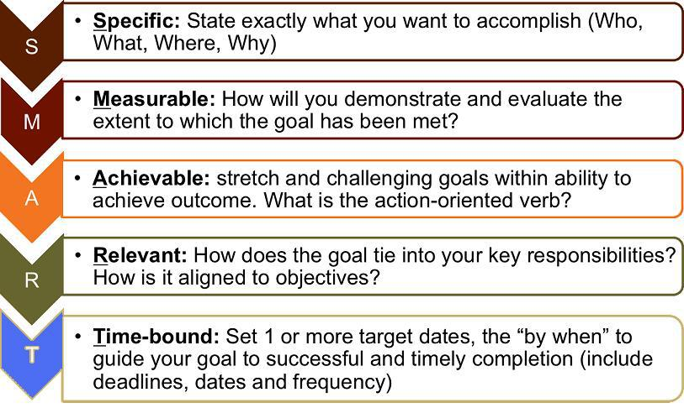

Objectives
What are our long term strategic objectives?

Slide 3
Objectives
Establish Young Professionals Events at Major AESS Conferences
Procure Funding and Establish Good Relations with YP ExCom
Help/Support AESS Committees where YP are directly involved
  Mentoring Program
  Radar Summer School
  Short Course Committee
  Industry Committee
Engage AESS in YP-Sponsored Activities/Conferences
Mentor/Train Officers and Chairs on YP-related activities

Slide 4
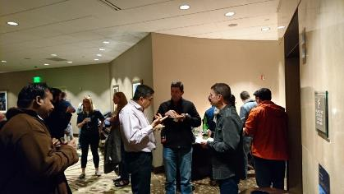
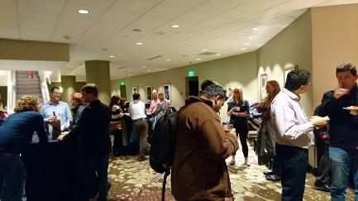
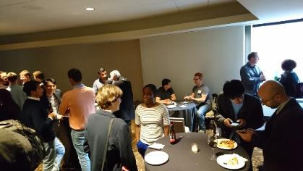
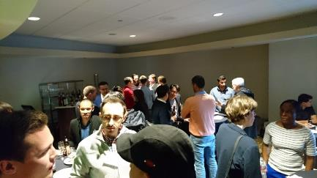
Initiatives
IEEE Radar Conference 2017 (Seattle) – 40 attendees

Slide 5
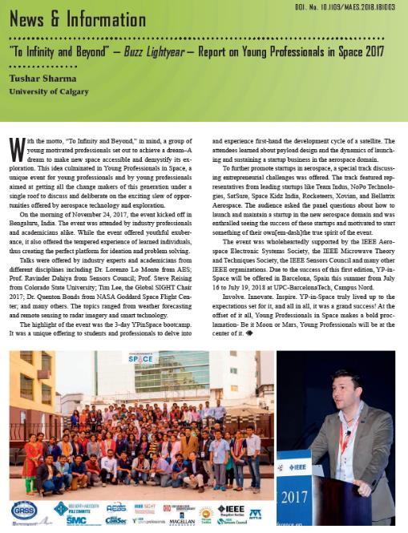
Initiatives
YP In Space
(Bangalore)

Slide 6
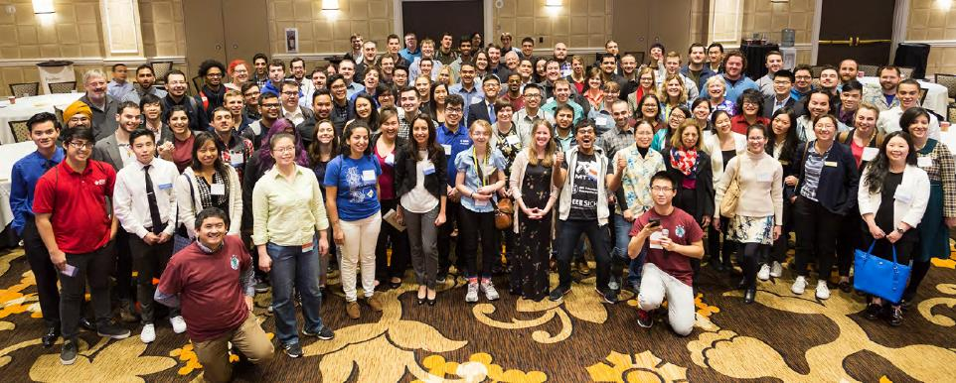
Initiatives
IEEE Rising Stars 2017

Slide 7
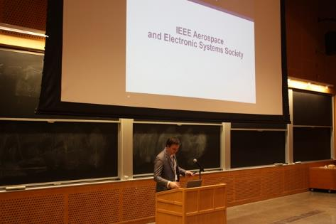
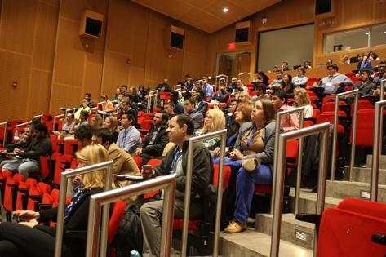
Initiative
MIT Annual Student Conference

Slide 8
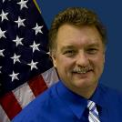
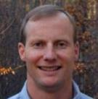
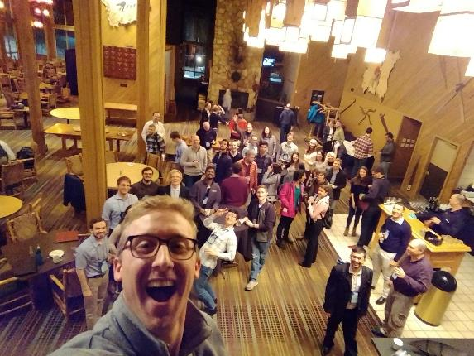
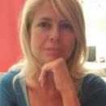
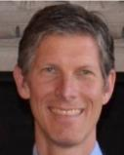
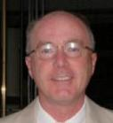
Initiatives
YP Event at AeroConf 2018

Slide 9
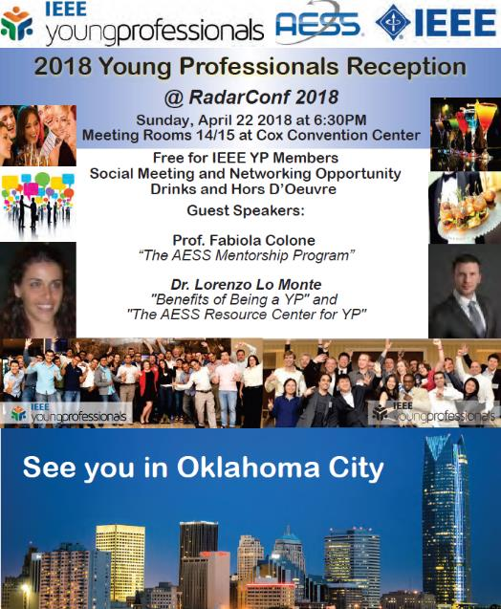
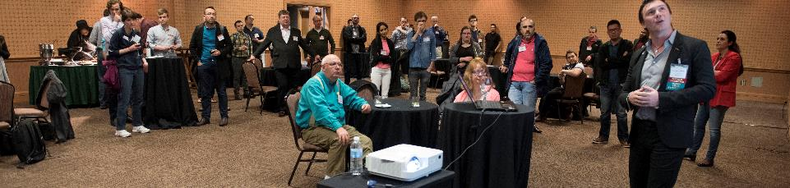
Initiatives
YP Event at
RadarConf
60 Attendees
AESS Speakers

Slide 10
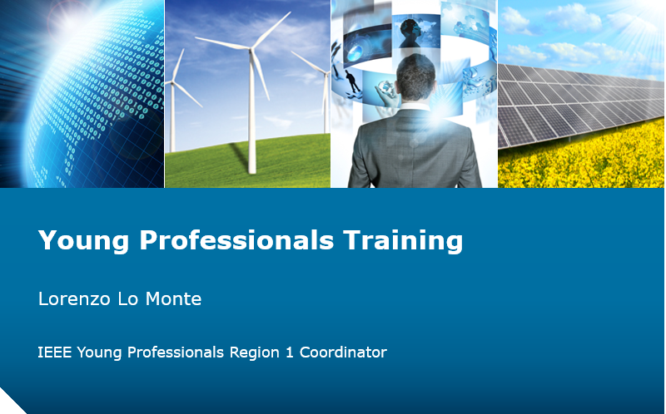
Initiatives
YP Training for Section Officers and Chapter Chairs

Slide 11

Supported Initiatives

Slide 12
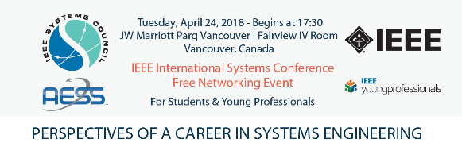
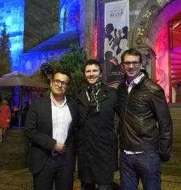
Supported Initiatives
IEEE SYSCONF 2018 YP Event
  Bob Rassa, Jamie Ritchie
IEEE SENSORS 2017 YP Event
  Hadi Heidari

Slide 13
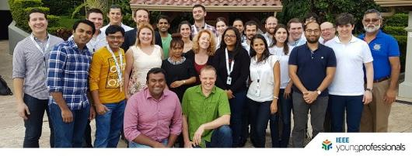
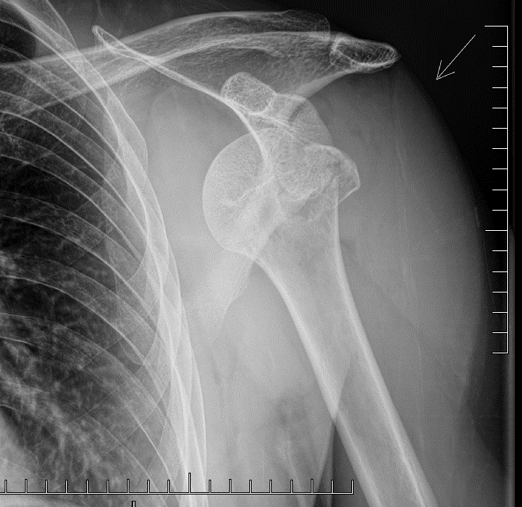
YP ExCom Meetings
Costa Rica (2017)
Orlando (2018)

Slide 14
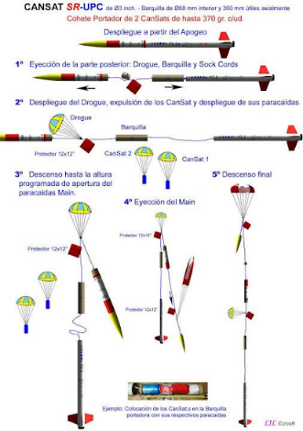
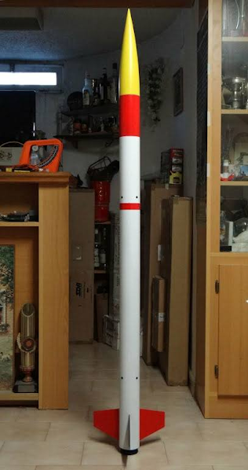
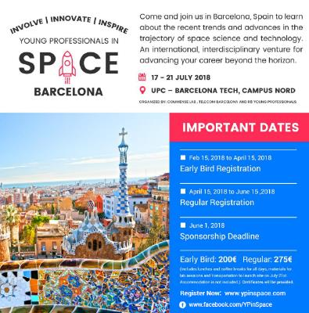
AESS Sponsorship:
YP In Space
Launch your own rocket!

Slide 15
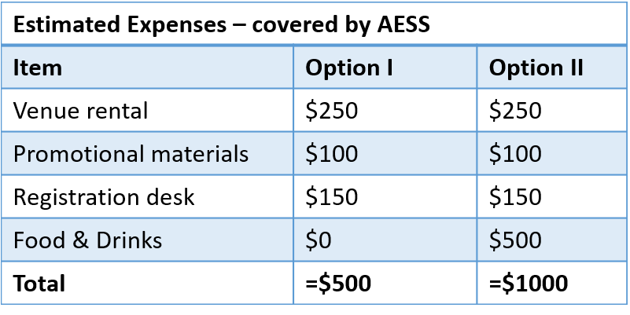
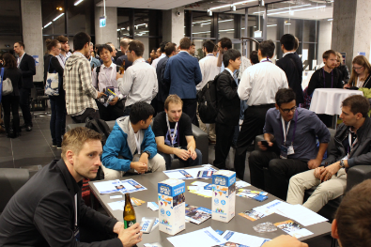


AESS Sponsorship
MIKON 2018
IEEE Young Professionals Meet-Up @ MIKON’18
Poznań Conference Center, Poland
May 16, 2018, 6:00 PM
During the MIKON’18 the IEEE YP Meet-Up will be organized where all attendees (100+) can expand their personal and professional networks and learn more about the Societies and IEEE Community.
Recently MTT-S and AP-S confirmed their support. Since we would like to promote all three Societies equally we invite simultaneously the AESS to take a part in the national IEEE networking event.
Introduce AESS Mentoring Program
Introduce AESS Resource Center
*the funds can be directly transferred to CB account
of IEEE Poland Section.
EPE’17
180 people
at Meet-Up

Slide 16

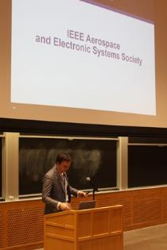
AESS Sponsorship
Rising Stars 2018
AESS table at the conference and handout AESS flyers to students and YPs
  Targeted attendance is 320
I will be an invited speaker: Have students and YPs learn about AESS
Technical topics relevant to AESS are already presented for several years at Rising Stars - NASA, Made in Space and other relevant companies where AESS can take advantage from.
AESS Logo advertised on website, brochures and agenda.

Slide 17
Kameron LaCalli
Bio:
Kameron LaCalli received his B.S. in Electrical Engineering from University of San Diego in December, 2016. While in school he participated in and held leadership positions in Tau Beta Pi (President), IEEE (Secretary), and the Ultimate Frisbee Club Team (Co-Captain), and also served as the electrical team lead for the SAE Mini Baja project team. Through internships throughout the school years held at Space Micro, Cubic Global Defense, Ericsson, and Automated Tooling Systems (ATS), he developed a fascination for all things space and aerospace, attending and presenting at relevant conferences whenever possible. Upon graduation, he was hired as a hardware and systems engineer for ViaSat, Inc. in Carlsbad, CA, developing tactical satellite network systems for both U.S. and foreign militaries. Working in hardware Kameron has keen interest and experience working with SATCOM ground terminal architecture, phased antenna arrays, and FPGA based/embedded designs for various communication systems.
IEEE Bio:
At the University of San Diego, Kameron served as the secretary for the USD IEEE chapter, organizing chapter meetings, helping spread chapter awareness, and attending various IEEE conferences and events. He recently helped coordinate and run the Young Professionals/AESS social event at the 2018 IEEE Aerospace Conference in Big Sky, Montana.
YP Rep Statement:
As an AESS YP rep I would focus my energy on spreading awareness of AESS and YP through my various channels and connections to young engineers in industry and academia. YP and AESS have much more to offer than I initially realized, and I would make it my goal to create partnerships between AESS YP and local organizations to help others to realize the same. I am involved with the local TBP chapter (engineering honor society), and I keep in contact with current graduate and undergraduate students at USD, UCSD, and SDSU, that can all greatly benefit by learning more about the incredible education, mentorship, and networking opportunities available to them through YP AESS. Those that know me know that I am not shy, and that I am a hard worker, willing to do whatever is needed to further the advancement of the programs I am involved in, while still having a good time doing so. I hope to soon apply this enthusiasm as an AESS Young Professionals Representative.

