Slide 1


AESS Membership in China – A Strategic Outlook
Xiaopeng Yang
September 28-29, 2018
Rome Park Hotel, Rome, Italy

Slide 2
Outline
Current status of AESS in China
Improve Influence of AESS in China
Increase Chinese Membership
My Personal Role
Strategic Plan

Slide 3
Current status of AESS in China
Number of Chinese AESS member is small
  130 Chinese members at July 2018
  2.8% in AESS member (4615 AESS member)
  0.8% in IEEE Chinese member (over 15,000 Chinese IEEE member)
  None of Chinese AESS fellow (over 140 Chinese IEEE fellow)
  None of Chinese received AESS awards
Here, all the figures are only accounted in Mainland China

Slide 4
Current status of AESS in China
Number of local AESS chapter or section is small
  Only one chapter in whole China (AESS Beijing chapter)
    No activity organized by Beijing chapter (At least I don’t know)
  None of student sections
  But IEEE China council has 8 local branches and over 40 student sections, and over 67 technical society chapters

Slide 5
Current status of AESS in China
Number of conferences sponsored by AESS is small
  Technical co-sponsor to IET International Radar Conference 2018
    October 16-19, Nanjing, China
    Organized by IET, BIT, Radar society of CIE
    Hold every two years
  Sponsor to International Conference on Radar of 5 nation circle
    Hold every five years
    Fewer attendees from overseas, more less from USA
  But IEEE sponsors over 100 international conferences per year in China

Slide 6
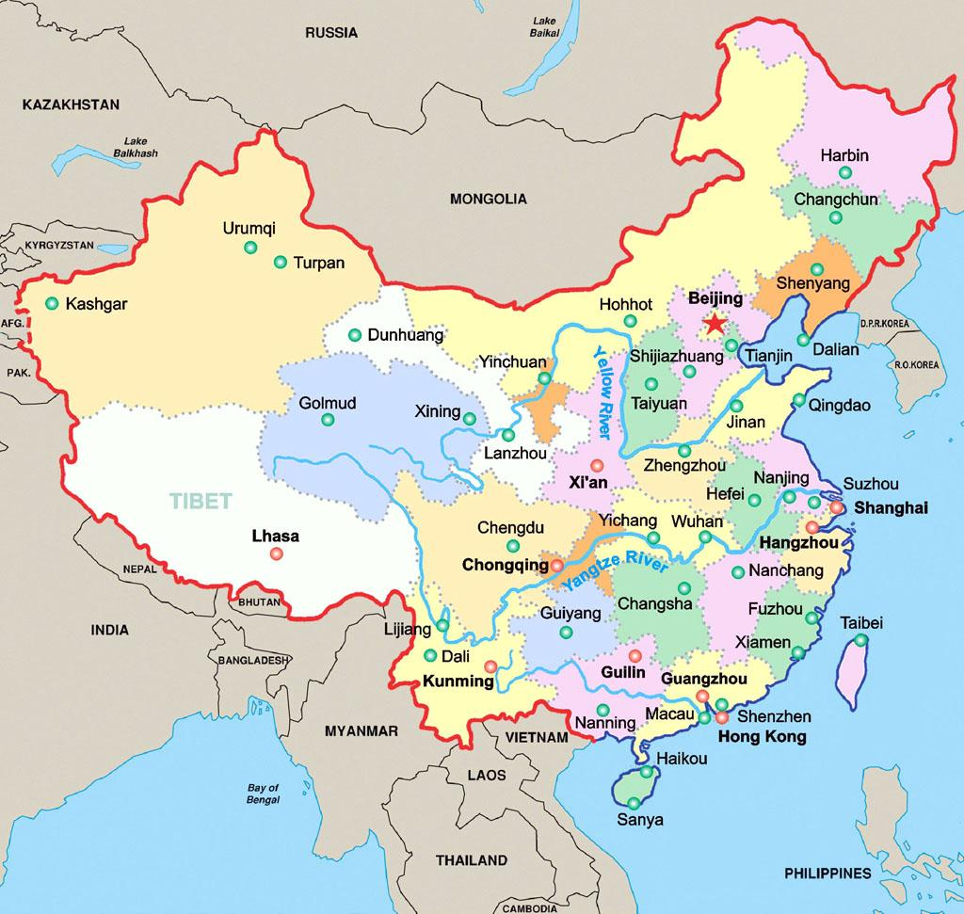
IET International Radar Conference 2018
Conference city: Nanjing, China
October 16-19, 2018
Distance to Nanjing
1000 km from Beijing
300 km from Shanghai
1400 km form Hong Kong

Slide 7
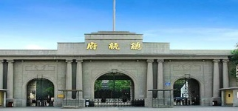
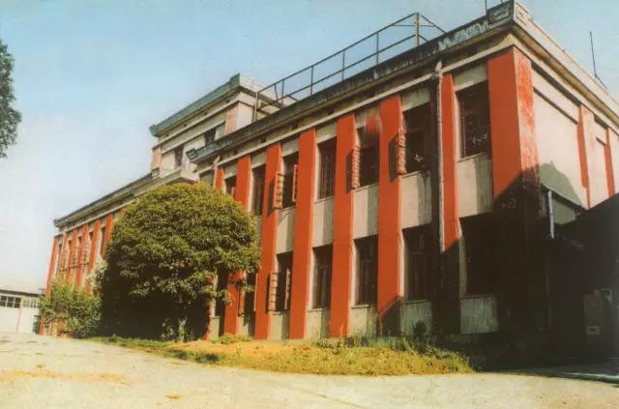


IET International Radar Conference 2018
Conference city: Nanjing, China
Birthplace of radar research in China
Over 7000 years history of civilization
Over 2500 years city history
Ancient capital of six Dynasties
A beautiful city

Slide 8

IET International Radar Conference 2018
Conference venue
Hilton Nanjing Riverside Hotel
Address: No.1 Huabin Road, Gulou District, Nanjing,21001,China

Slide 9
Current status of AESS in China
Influence of AESS technical Journals is not high
  Chinese Scholars do not like to submit paper
    Review and publish period of TAES are too long
    Number of papers in AES Magazine is small
    Impact Factors of TAES and AES Magazine are not high
  IEEE TSP, TAP, TGRS, TCOM, SP Magazine, ect. are well recognized in China, which are listed as the top Journals in most of Chinese Universities.
  In BIT, publishing one paper on top Journals is satisfied on the minimum condition to apply for PhD.
  But three papers on IEEE TAES is required as the minimum condition.

Slide 10
Current status of AESS in China
Attending overseas radar conference is still not easy
  The reject rate of Chinese scholar's papers is still high
    Reason is complex (English, quality, others)
    No review comments for some rejected paper
  Visa issue
    Some researcher can not get visa, especially the senior researcher

Slide 11
Current status of AESS in China
Influence of AESS in China is not high
  Less activities organized by AESS
    Don’t know the activities organized by AESS
  AESS is not well known in China
    Some Chinese industry researchers don’t know
  Interactions between AESS and IEEE China are not many
But China is huge, we can not ignore it
  2,879 Universities (accounted in March 2018)
  over 37 million college students (accounted in April 2018)
  over 9 million gradated student per year
  We should improve influence of AESS in China

Slide 12
Outline
Current status of AESS in China
Improve Influence of AESS in China
Increase Chinese Membership
My Personal Role
Strategic Plan

Slide 13
Improve Influence of AESS in China
Increase technical communication activities in China
  Avoiding sensitive research, special application and background
  Civilian radar, new technology, human wellbeing related topic, etc.
  Extend the area from radar to all other research direction of AESS
    Such as Fusion, Digital Avionics, Instrumentation Measurements, and Navigation
  Education and skill training
    Student education and summer school, etc.
  Invite famous expert to give lecture in China
    Using IEEE distinguished lecture program
    Supported by our own research project

Slide 14
Improve Influence of AESS in China
Involve more effectively into conference hold in China
  Sponsor or Technical co-sponsor conferences hold in China
  Involve more effectively into national Radar conference of China
    Send representative to attend conference
    Give talks for national Radar conference
  Give more guidance for international conference submission to attractive more attendees from China
    Give more review comments on Chinese submission, including the technical and English corrections
    Especially student submission

Slide 15
Improve Influence of AESS in China
Increase interactions with Chinese technicial organizations
  IEEE China
  China Association for Science and Technology
  Chinese Institute of Electronics (CIE) (including 46 technical societies)
  China Radar Industry Association
  Radar Society of CIE
  Signal Processing Society of CIE
  Beijing Institute of Electronics (BIE)

Slide 16
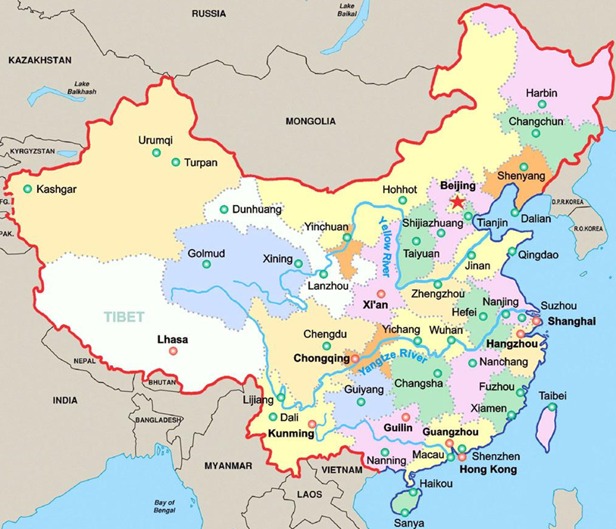
Improve Influence of AESS in China
Establish more local chapters
Establish two more chapter?
    Beijing chapter
    Shanghai chapter
    Xi’an chapter
In the following?
    Chengdu chapter
    Harbin chapter
    Student section in Universities
    Requirement to chapters
    Chapter Committee
    Organize activity
    Give annual report to AESS
    Increase membership

Slide 17
Improve Influence of AESS in China
Attract high level Chinese researchers to involve AESS activity
  Improve number of Chinese IEEE fellow
  Encourage more Chinese senior member
  Invite high level Chinese researchers to give a plenary talk or invited talk in conference
  Invite some professors to give the oral presentation in conference
    Usually Chinese professor takes some students together to attend
    Now Chinese University has funding to support international travel

Slide 18
Improve Influence of AESS in China
Enrich AESS awards
  Invite more Chinese to apply for AESS awards, it will cause more attention from China
  Invite Chinese student to apply for the PhD thesis award
    Language Issue?
    Ask Chinese student to summarize the thesis in 10 pages English version, which will be helpful for the review
  Encourage Chinese student to apply for the conference paper award
  Establish the student conference travel award

Slide 19
Improve Influence of AESS in China
Improve the recognition of AESS Journals
  reduce the review period and improve the impactor factor of TAES
  Establish a new Journal to accelerate period to publish
    For example, IEEE Radar Technology Letter?
  Publish new achievement or hot topic to IEEE AES Magazine or IEEE News Letter
    For example, quantum radar research in Nanjing
  Invite some high level Chinese researchers to submit papers
  Send AESS news in Chinese to Chinese researchers

Slide 20
Outline
Current status of AESS in China
Improve Influence of AESS in China
Increase Chinese Membership
My Personal Role
Strategic Plan

Slide 21
Increase Chinese Membership
Introduce benefit of membership in AESS Journals or email news periodically, including the email news in Chinese
Establish some connection with related University and Industry to encourage to apply for member
    Encourage professor to apply, and then ask him to encourage his students to apply
    Encourage the group leader of industry to apply, and then ask him to encourage his group member to apply
  We should develop more member from Chinese industry, not many AESS members are from Chinese industry
  Many large research institute in China, such as

Slide 22
Increase Chinese Membership
  Especially pay attention to encourage the student member
  Perhaps student member will become regular member after graduation
  It is necessary to establish student sections, especially high level Universities
    Such as BIT, Xidian U, UESTC, Tsinghua U, Beihang U, HIT

Slide 23
Increase Chinese Membership
Ask chair of local chapter to increase member
  Increase 30 new members each chapter each year?
    Set this as qualified target to chapter chair
    If failed, give a warning
    If failed continuously, change the chapter chair
  Establish more local chapters, because China is large
  Ask leader of student section to increase member
  Increase 15 new members each section each year?

Slide 24
Increase Chinese Membership
Membership fee discount program
  For the student member
    Free for first year membership (new member)
    Half rate for second year membership
    Regular rate from the third year
  For regular member
    Half rate for first year membership (new member)
    Regular rate from the second year
  Randomly select 20 student membership fee free each year

Slide 25
Increase Chinese Membership
When submit paper to AESS conferences and Journals
  Give the AESS member special discount
    Now conference discount for IEEE member, we could set AESS member discount for AESS sponsored conference
    Journal paper charge discount
  For none of member, set the option to apply for AESS membership in the submission system , then give member special discount immediately

Slide 26
Increase Chinese Membership
  The applicant of IEEE fellow from AESS must be AESS member
AESS award candidate must be AESS member
  AESS technical awards
  PhD thesis award, conference paper award, conference travel award, etc.
  The recommendation letter must be from AESS member
AESS member has the priority for registration of AESS activities

Slide 27
Outline
Current status of AESS in China
Improve Influence of AESS in China
Increase Chinese Membership
My Personal Role
Strategic Plan

Slide 28
My Personal Role
  Improve connection between AESS and Chinese technical societies or organizations
  Member of BOG of China Radar Industry Association
  Standing Committee Member of Radar Society of CIE
  Deputy General Secretary of Radar Society of CIE
  Deputy Director of Radar Society of BIE
  Committee Member of Signal Processing Society of CIE
  Committee Member of Young Scientists Club of CIE
  Chair of Signal Proc. and Theory Comm. of Radar Society of CIE
  Chair of Signal Proc. and System Comm. of Signal Processing Society of CIE

Slide 29
My Personal Role
  Improve effect of AESS based on our organized conference
  Start to organize a series international conference on SP
    IET International Conference on Signal, Information and Data Processing
    Organized by IET, BIT and signal processing society of CIE
    August 14-16, 2019, Guiyang, China
    Hold every two year in China
    apply for technical co-sponsore of AESS

Slide 30
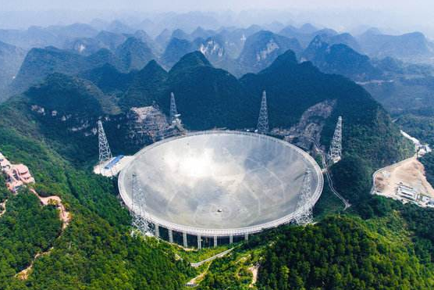

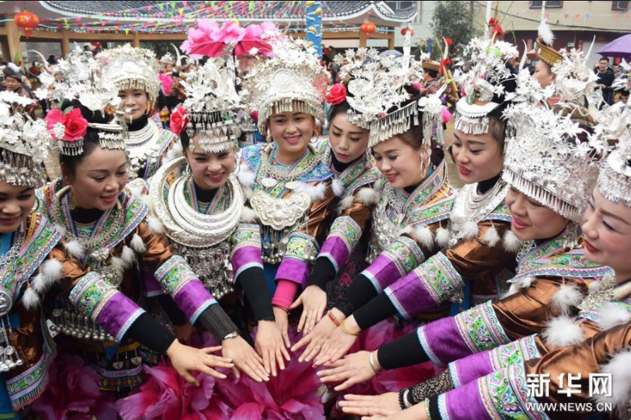
Guiyang

Slide 31
My Personal Role
  Improve effect of AESS based on our organized conference
  IET International Radar Conference
    Technical co sponsored by AESS
    Next will be hold in Xiamen, China
    November 4-6, 2020 (every two year in China)

Slide 32

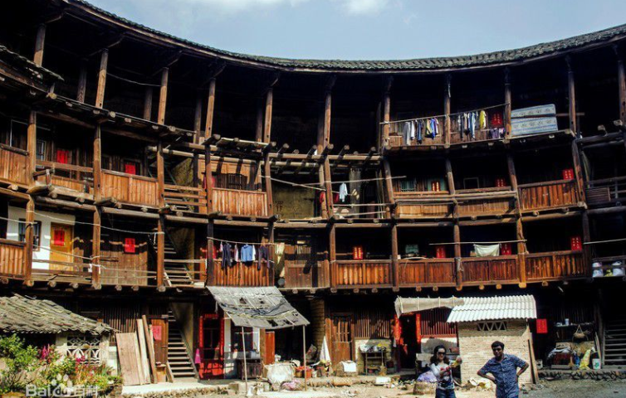
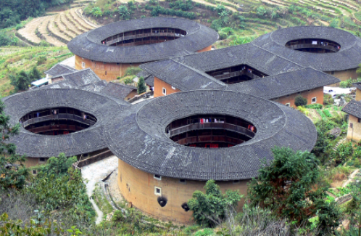
Xiamen

Slide 33
My Personal Role
  Improve effect of AESS based on our organized conference
  National Radar conference of China
    Every two year in China
    Over 680 submissions and 540 accepted paper and more than 700 attendees in 2017
  Give AESS a exhibition booth in these conferences
  Set a special registration discount for AESS membership
  Distribute AESS material to the attendees
  Introduce AESS in a suitable way, especially how to apply for the AESS membership

Slide 34
My Personal Role
  My research group can give some contribution to AESS
  Radar Research Laboratory
    35 faculty, 5 post Doc, 60 PhD and 150 Master students
    The largest radar research group in Chinese University level
  We have some projects to support international collaborations
    The Program of Introducing Talents to Universities (111 Project)
    National key project of NSFC for international collaborations

Slide 35
International Programs：State 111 Project
The Program of Introducing Talents to Universities (111 Project)：
Approved by The Ministry of Education and The Foreign Expert Bureau of China
Supporting our teachers and foreign experts for international communications
Funding: 1.5 Million USD （5 years）
Introducing more than 1000 top world-class scholars
From top 100 world’s universities or research institutes
Establish 100 world-class intelligence bases in China

Slide 36
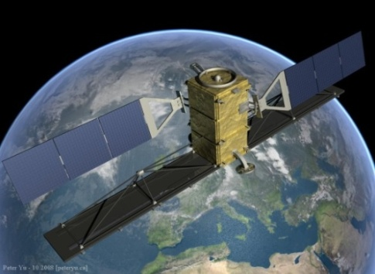
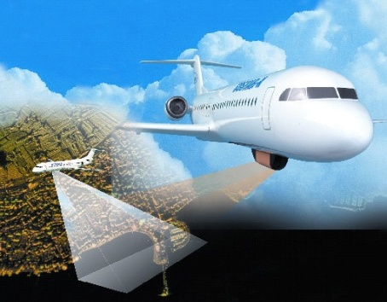
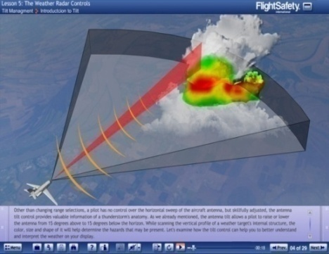
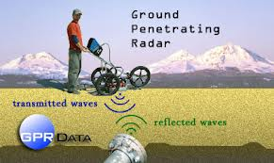
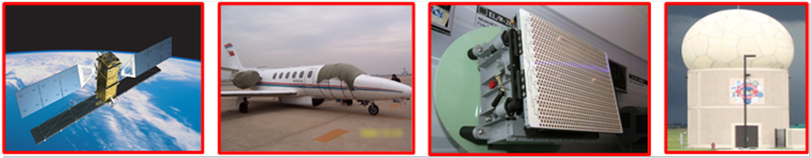
International Programs：State 111 Project
Research field：
  Radar System
  Signal and Information Processing
  Microwave and Microelectronics
  Communication in Netted Radar System

Slide 37
My Personal Role
  We have good connection with overseas Universities
  I spent 5.5 years in Japan and 2 years in Syracuse, USA
  We have international students from Asian, Europe and Africa
  We invite more than 40 international experts and professors to give lectures or talks in BIT every year
  These will be helpful to improve the influence of AESS and increase membership

Slide 38
Outline
Current status of AESS in China
Improve Influence of AESS in China
Increase Chinese Membership
My Personal Role
Strategic Plan

Slide 39
Strategic Plan
  Short term (2018)
  Introduce about 30 new Chinese members
    Encourage faculty and students from our group
    Encourage faculty and students from other Chinese Universities
  Middle term (2019-2021)
  Establish new local chapter and student section
    Ask local chapter and student section to introduce new member
  Using our international conferences to improve the influence of AESS
  Using my position in Chinese technical societies to improve the influence of AESS

Slide 40
Strategic Plan
  Long term (beyond 2022)
  Improve the effect of AESS in China based on the mentioned method
  Make AESS very known in China
  Make AESS member to increase self-motivated or applied by themselves

Slide 41
  Thanks for your attention!

