Slide 1
Women in Engineering and AESS
Report from AESS Liaison
Kathleen A. Kramer

Slide 2
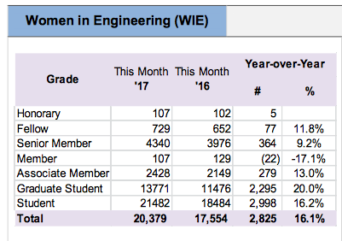
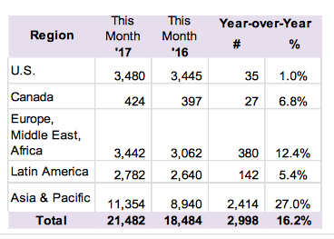
IEEE Women in Engineering (WIE)
The mission of IEEE WIE is to facilitate the global inspiration, engagement and advancement of women in technical disciplines. IEEE WIE envisions a vibrant community of IEEE women and men collectively using their diverse talents to innovate for the benefit of humanity
Membership is FREE to student members (→ many student members), particularly in Region 10, but there is a society-level fee for non-student members.
16% year-over-year growth (mostly in students): 20,379 members and student members at end of 2016
100/4660=2.1% of AESS members are in WIE.
Seattle has the most.

Slide 3
IEEE WIE International Leadership Conference (WIE-ILC)
WIE ILC 2017 is this month: May 23-24, 2017
Looking to grow even more
1200+
“WIE Leadership Summits” are being organized worldwide to bring WIE-ILC to other places.
AESS is sponsoring one in Goa, India

Slide 4
IEEE WIE Conferences Strategy
Major strategy of WIE: WIE-themed conference sessions
IEEE Radar Conference (via Women in Radar) -
We agreed to offer support for these (10/16).
WIE funds supported the one at IEEE Radar Conference.
major WIE event at every IEEE Board Series
“WIE Leadership Summits” organized
brings WIE-ILC to other places
WIE Summit in Detroit, WIE Summit in San Diego (AESS Liaison Opening Keynote), WIE Summit in…
AESS sponsoring IEEE WIE International Leadership Summit in Goa July 13-15, 2017

Slide 5
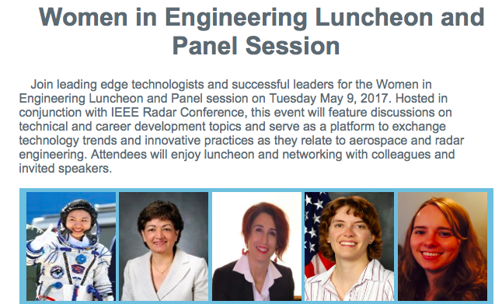
IEEE WIE Committee
WIE Panel at IEEE Radar Conference (May 9, 2017)
Organized by Irena Atov. Featuring: Dr Soyeon Yi (Former Astronaut), Dr Fariba Alamdari (VP Marketing, Boeing), Maria Greco (Professor, University of Pisa),Dr Julie Jackson (Associate Professor, Air Force Institute of Technology), Chelsea Parkman (Project Engineer, Honeywell Aerospace)
“Your Panel Session and Luncheon for Women at the Technical Conference
is exactly what we promote as a best practice for bringing important visibility to women in profession and for building a powerful net-work…”
Borzenna Pasik-Duncan
IEEE WIE Chair
May 11, 2017

Slide 6
IEEE WIE Committee
WIE Committee
IEEE MGA (Membership and Geographic Activities) committee
10 committee members, 43 WIE liaisons/coordinators (including AESS, featured as “new”). Celia Desmond (IEEE Board and COMSOC liason) leading an effort to improve society-based efforts.
(WIEC) meetings via telecon and one face-to-face each year
AESS liaison could not attend meeting in Poland 4/8-9, but next year?

