Slide 1
VP Conferences Report
AESS BoG Meeting
Crystal City VA
May 2015
Mark E Davis & Iram Weinstein
medavis@ieee.org

Slide 2
Agenda
Strategic Plan
Technically Co-sponsored Conferences
Implications of 2016 Changes
Issues for AESS
PLANS/ISISS Merger Status

Slide 3
Strategic Plan
Conference Mission Statement – AESS conferences provide the most technically advanced and highly relevant conferences in the field of interest as defined in our overarching mission statement. AESS will achieve this by refining and promoting best practices in planning, management, publications and financing conferences that directly or indirectly benefit the AES Society Membership.
Vision Statement– AESS conferences will be the first choice of practicing engineers in industry for insight into the latest technology, systems, and best practices
3 Year (long term) Strategic Objectives
Convert 2 TCS conferences to at least 10% FCS
Find ways to use conferences to attract and retain young members
Need To Re-evaluate Strategy Based On Recent Changes In Conference Management Policies

Slide 4
Technically Co-sponsored Conferences
Beginning in 2016, IEEE rules will change
If 0% IEEE financial interest, IEEE Technical cosponsors will be charged $1000 +$15/paper sent to xPlore
If the Sponsoring IEEE OU desires, it can ask MCE to bill the Conference for some or all of this cost
All revenue collected by MCE from external conferences will be given to the Sponsoring IEEE OU
If multiple IEEE entities are TCS the fee and revenues would be split
If an IEEE entity is a financial sponsor, the TCS fee will not be charged
I obtained data to see what the financial impact would have been if the rules were in place in 2013

Slide 5
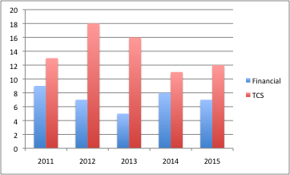
AESS Financial And Technical Sponsorship History
Revenues From Financial Sponsorship Has Been Steady
Fusion Alternating Financial and TCS
2016 Change In Publishing Charges For Technical Cosponsorship
Difficulty With AESS/AIAA Financial Arrangements
DATC lost
ICNS possible

Slide 6
Impact of New TCS Rules
TCS Fees based on current year uploads
Roughly offsets “Indirect Content” Credit of $18+
Revenues from past years are substantial
New TCS commitments will run at a loss until 3-5 year tail is created
Policy agreement with TCS partners needed
 |  |  |  | Assuming New Rules
Conference | # IEE TCS | No. Years | 2013 Revenue | 2013 Est. TCS Fee | 2013 Revenue Est. | Change
Fusion | 1 | 6 | $ 29,608 | $ (5,635) | $ 23,973 | -19%
EURAD | 3 | 8 | $ 13,980 | $ (2,498) | $ 11,481 | -18%
Int'l Radar (IRS) | 1 | 3 | $ 9,724 | $ (3,880) | $ 5,844 | -40%
RAST | 2 | 5 | $ 7,617 | $ (1,895) | $ 5,722 | -25%
Waveform | 3 | 3 | $ 7,209 | $ - | $ 7,209 | 0%
NAVITEC | 1 | 2 | $ 6,406 | $ (3,970) | $ 2,436 | -62%
Carnahan | 1 | 3 | $ 3,756 | $ - | $ 3,756 | 0%
 |  |  | $ 78,300 | $(17,878) | $ 60,422 | -23%
Recommendations
Committee to set AESS Policy
Discuss with our TCS partners
Be careful about new TCS
Consider taking FCS position
Strengthen our program committee participation

Slide 7
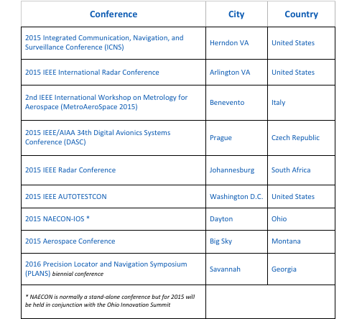
AESS 2015 Financial Conferences

Slide 8
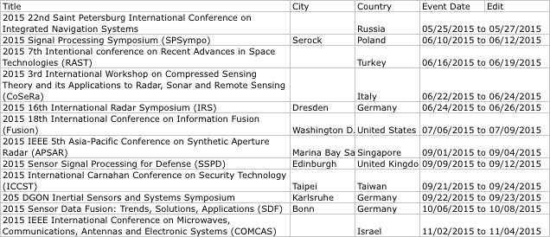
2015 Technically Co-sponsored Conferences
12 Conferences, 8 with AESS as the only IEEE sponsor

Slide 9
Issue MOU Process
IEEE Conference Exchange (ICX) is the new IEEE conference-management platform. Does the Society have any experience interfacing with ICX for any of its conferences at this time? If so, what kind of feedback can the Society provide?
The ICX is regularly used in the setup and management of IEEE Financial Sponsorship conferences.
The Conference Management Services are working well. However, the change in process for establishing the Memoranda of Understanding (MoU) within ICX has been a recurring problem.
The “automated” drafting and approvals for these MOUs causes significant delay in obtaining the agreements and signatures from both IEEE OUs as well as outside non-IEEE organizations
In particular for the Technical Cosponsored (TCS) conferences, there are severe problems with interpretation of the MOU wording in terms of IEEE and non-OU co-sponsorship responsibilities. Specifically, the fact that the MoU says it is “non-binding” has caused our technical co-sponsorship parties to ask why it even exists.

Slide 10
PLANS/ISISS Merger Status
The Chair of the PLANS executive committee, Phil Dugandzic, reached out to a couple of his colleagues …serving on the ISISS organizing committee.
Apparently the ISISS conference grew out of meetings that were sponsored by Andrei Shkel (UC Irvine) when he was managing an advanced inertial sensors program at DARPA.
The participants wanted an annual public conference where folks (especially the academics) could publish their research.
The first conference (held this past February)
It was so successful that they are greatly expanding the conference for the second offering this coming March.
One of the merger concerns that has been raised already has to do with the fact that ISISS is planning to hold its conference annually whereas PLANS is biennial.
A telecom was held on 2 April -- If we wanted to allow for some collaboration, we could:
` We begin the process of cross-fertilization. Highly publicize each conference at the other.
We could move PLANS to an annual conference, to co-host them in the same venue, showing the separate topics.

