Slide 1
AES Society – Education Board Meeting May, 2015
Joe Fabrizio
VP Education

Slide 2
AESS Education – Mission and Vision
Mission Statement
AESS education provides a central reference point for training resources, learning activities and continuing education programs vital for professional growth in AESS fields of interest and to develop the future generation of contributors to the Society. Vision Statement
AESS Education will be recognized for its leadership in creating an essential forum for professional development by providing world-class services and products that are valued by AESS members and technical communities throughout the world.

Slide 3
AESS Education – Strategic Objectives
Strengths
Effective and efficient DL program (high usage, low cost, fast process, positive feedback)
Excellent core of mature & authoritative members willing to contribute to AESS education
Exciting new initiatives aimed at younger members approved by BoG being implemented
Weaknesses and Opportunities
Online education is of high quality and relevance but has not recorded significant usage
Reaching out to countries with low membership base and local budgets (e.g. Argentina)
Opportunity exists to apply a key strength to address these weaknesses simultaneously
What are our long-term strategic objectives? (1) Continue to improve existing products and services - Distinguished Lecture (DL) Program - Online Education incl. Video Tutorials
- Young Professionals (formerly GOLD) (2) Provide more benefits to attract and retain members - Mentoring program [In Progress] - AESS short courses [New] - Robert Hill award [Approved by IEEE] (3) Raise awareness for members & potential members
- AESS Magazine, website, QEB and IEEE-TV
- AESS promotional slide-packs & brochures
Overarching Goals
Grow internationally and technically through education
Increase AESS revenue (not only membership per se)

Slide 4
Distinguished Lectures – Strategic Initiatives
1. Increase Activity
Active DLs are needed to be effective ambassadors of the AESS
→ Introduce two-year term, monitor activity & review DL list annually [current]
2. Reduce Costs
Reduce DL program expenses while maintaining/enhancing benefits for the AESS
→ DLs indicate planned travel dates and locations next to their website profile [new]
3. Enhance Accessibility
Emerging AESS chapters do not have funds to host DL events involving long-distance travel
→ Improve geographic distribution of DLs, increase max AESS limit, short-course initiative [new]
4. Standardize Procedure
Efficient process that minimizes potential for misunderstanding between DL, host, and AESS
→ Introduce a DL request form that clearly defines agreement and also provides DL guidelines [current]
5. Evaluate Benefit
Measure benefit perceived by AESS members and other participants (not only the host)
→ Register attendance, provide this to VP Education, and send on-line evaluation requests [new]
6. Promote AESS
Don’t miss opportunity to promote AESS to members and potentially new customers
→ Continually review and improve promotional materials and ensure its use at DL events

Slide 5
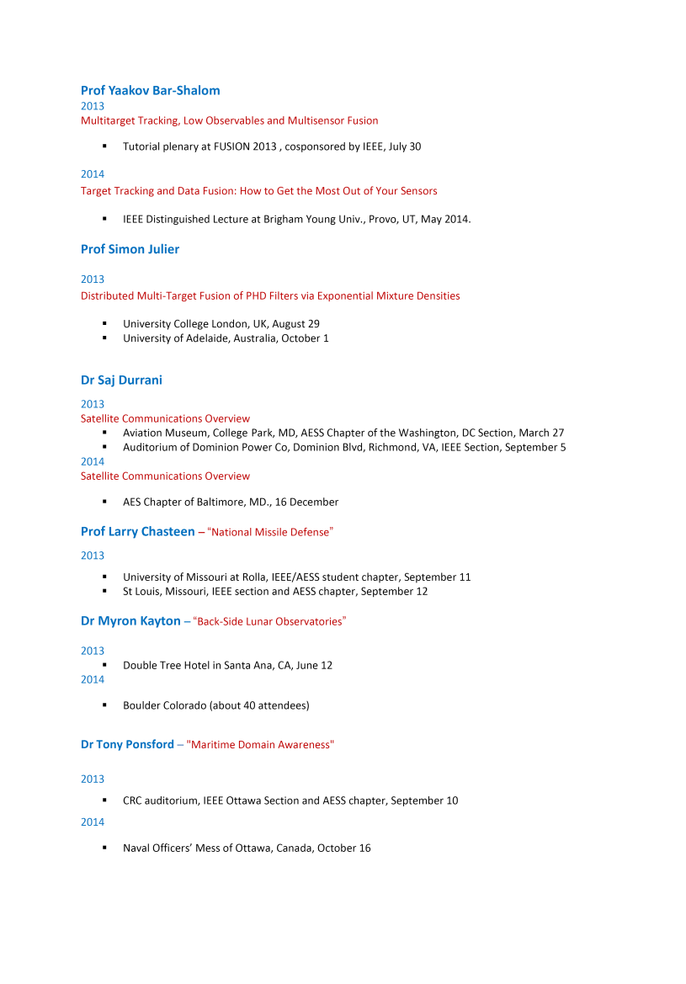
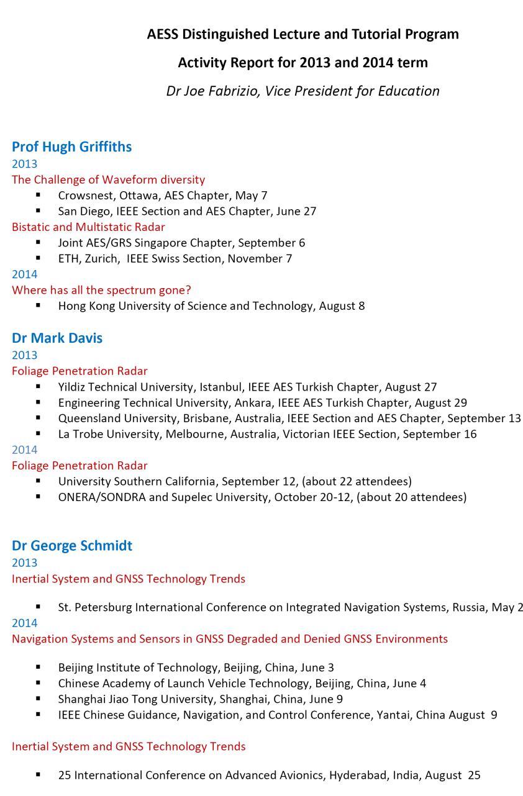
Activity Report – Previous Term (2013 and 2014)
Action item (suggested by Teresa Pace) - Publish DL activity report in AES magazine

Slide 6
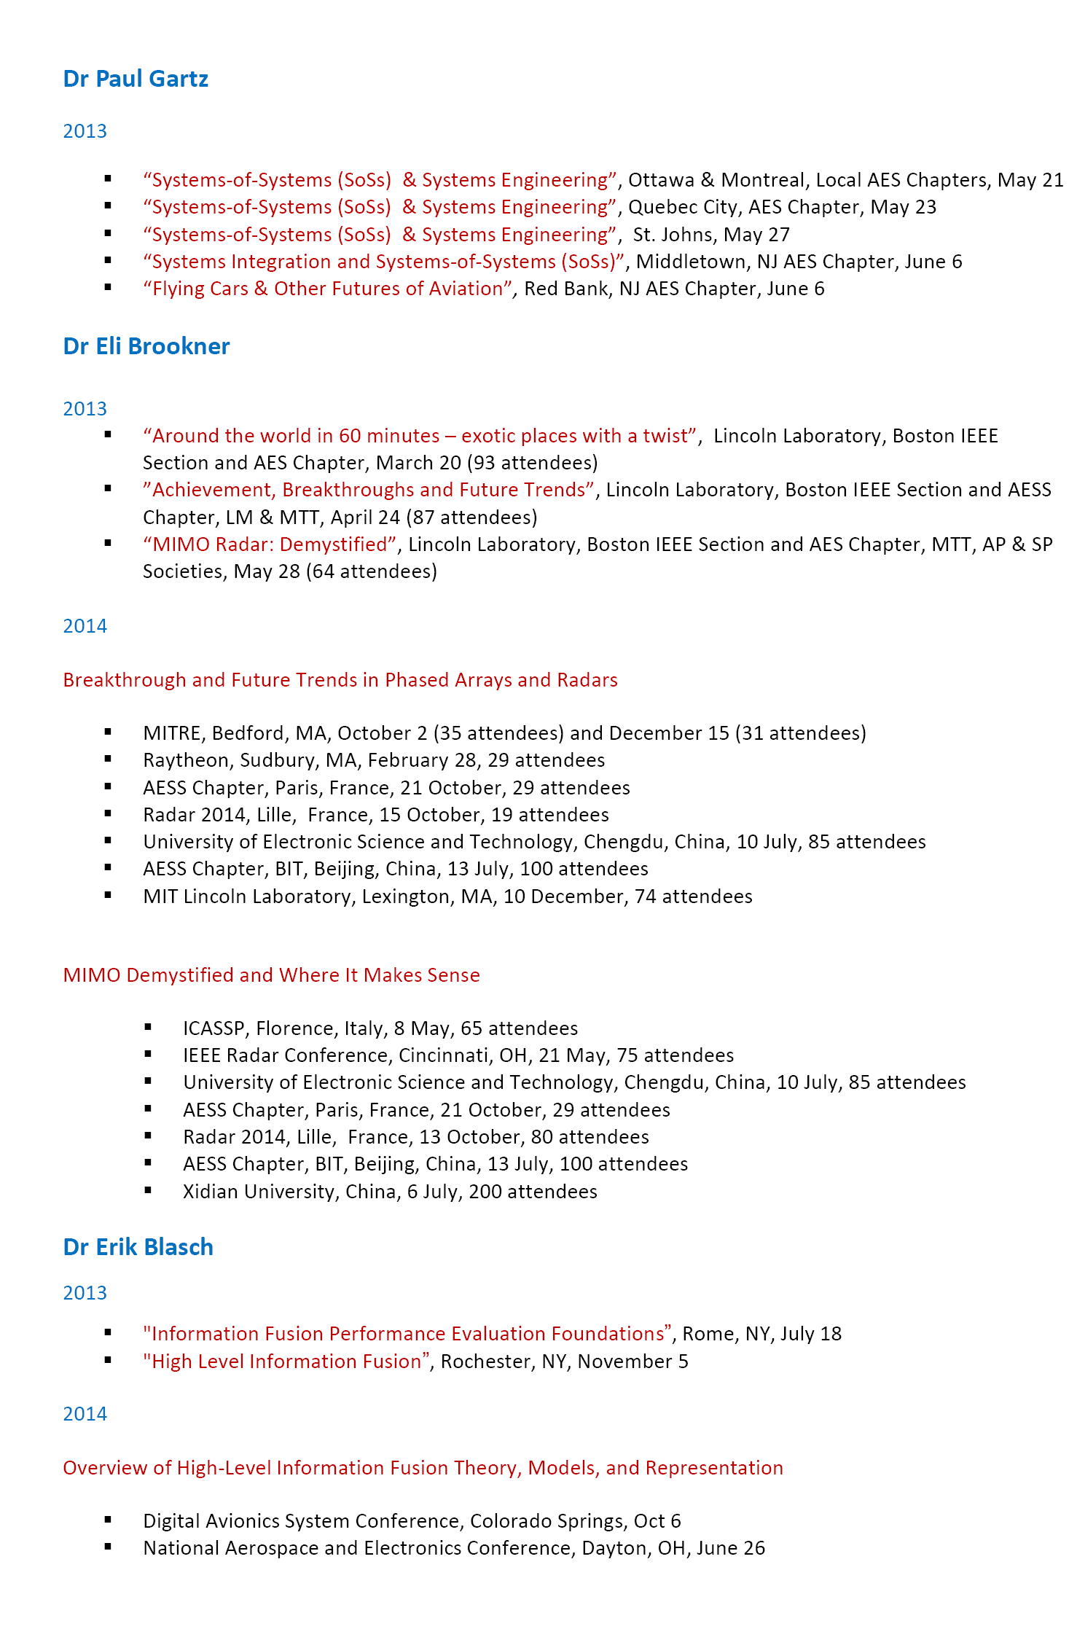
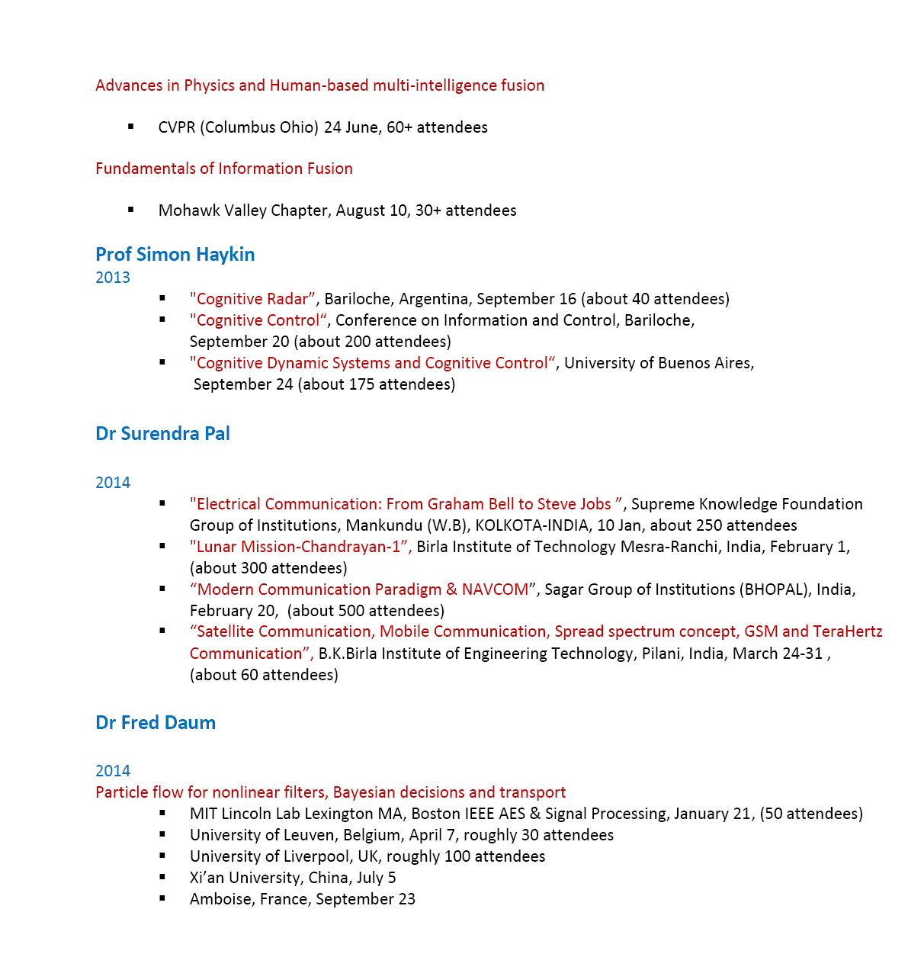
Activity Report – Previous Term (2013 and 2014)
Three-year summary:
2012 – 12 DLs for AESS-portion funding of $17,900 (Strategic Plan)
2013 – 27 DLs (17 international) for AESS-portion funding of $8,268
2014 – 39 DLs (26 international) for AESS-portion funding of $5,360

Slide 7
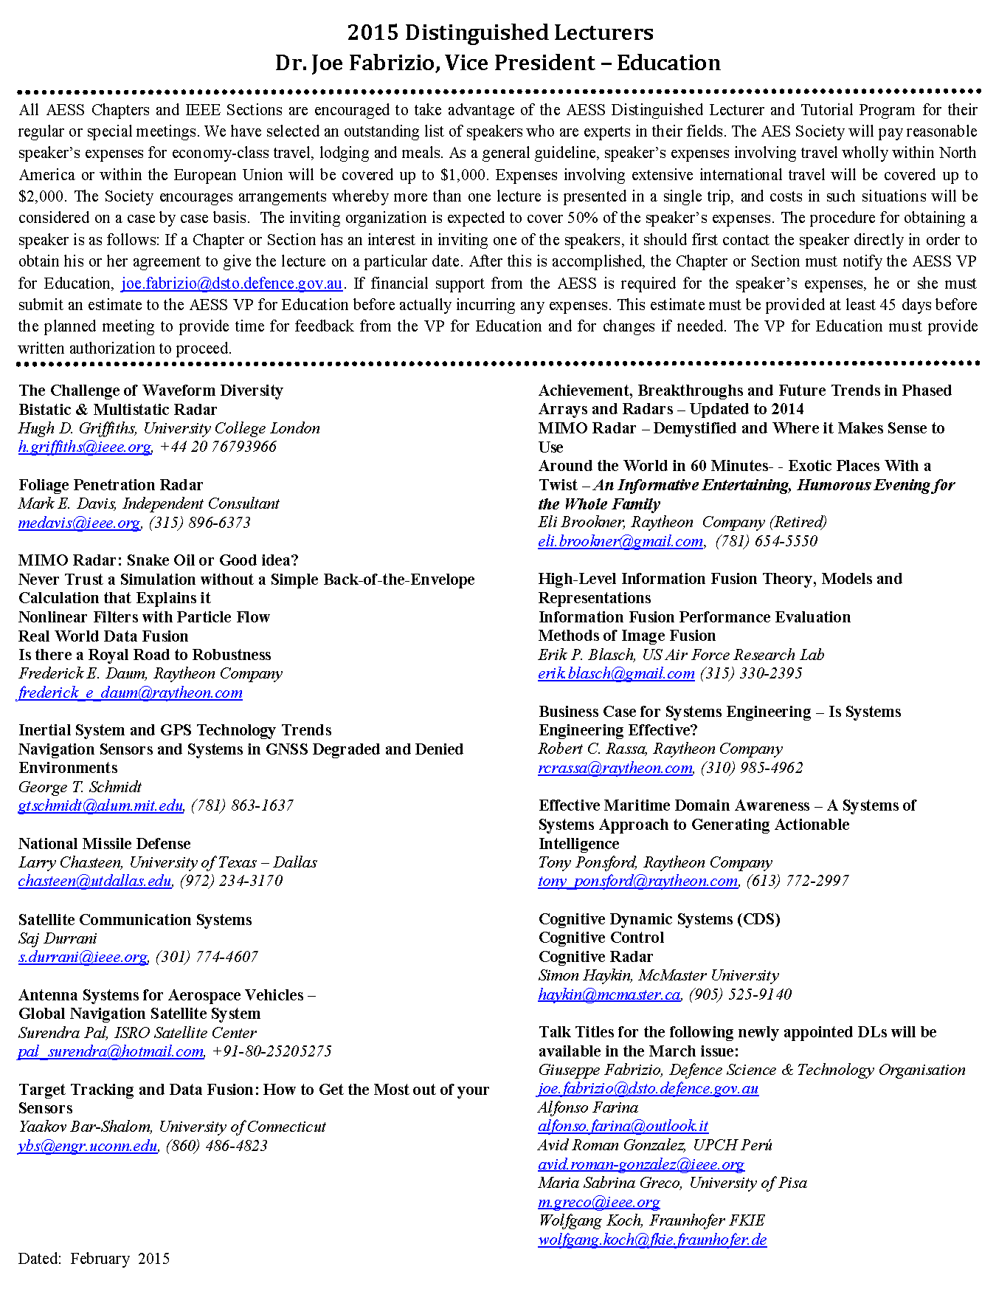
DL Roster – Current Term (2015 and 2016)
Revised DL Page
Approved roster (18 DLs)
Five nominations received (all accepted)
DLs from Germany, Italy, Australia, Peru
Two inactive DLs were rotated off the list
Desirable features:
Improved geographic distribution
Technical panel alignment (Walt)
Scope to continually adapt roster
Current status:
Communications (& certificates) sent
New DL profiles & lectures are online
Revised DL page for AESS Magazine

Slide 8
Promote AESS – Revised Slides (Thanks to Judy)
Improved format
Available online
In DL guidelines

Slide 9
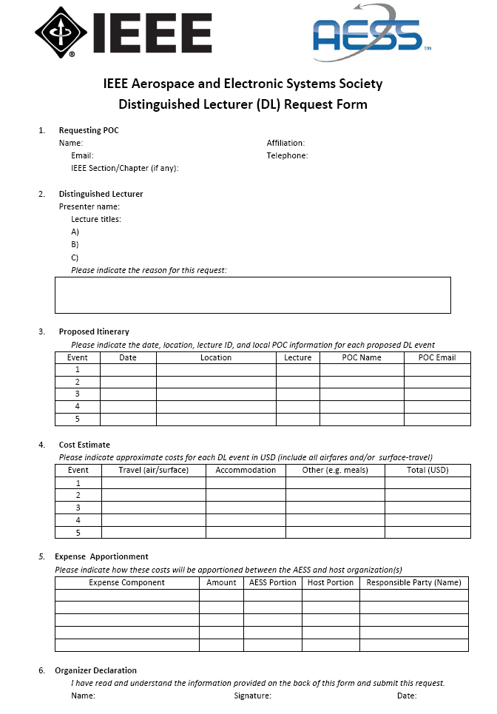
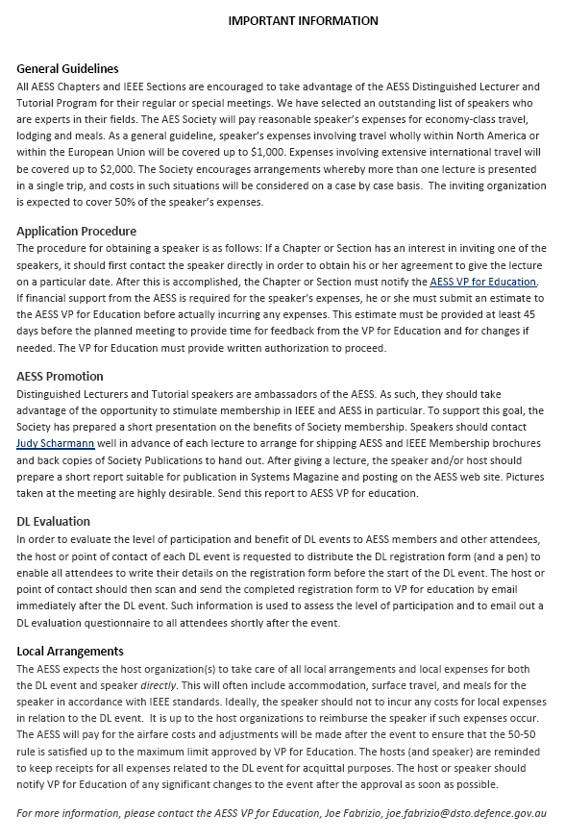
Standardize Procedure – DL Request Form (Available Online)
Page 1 (Fillable PDF)
Page 2 (DL Guidelines)

Slide 10
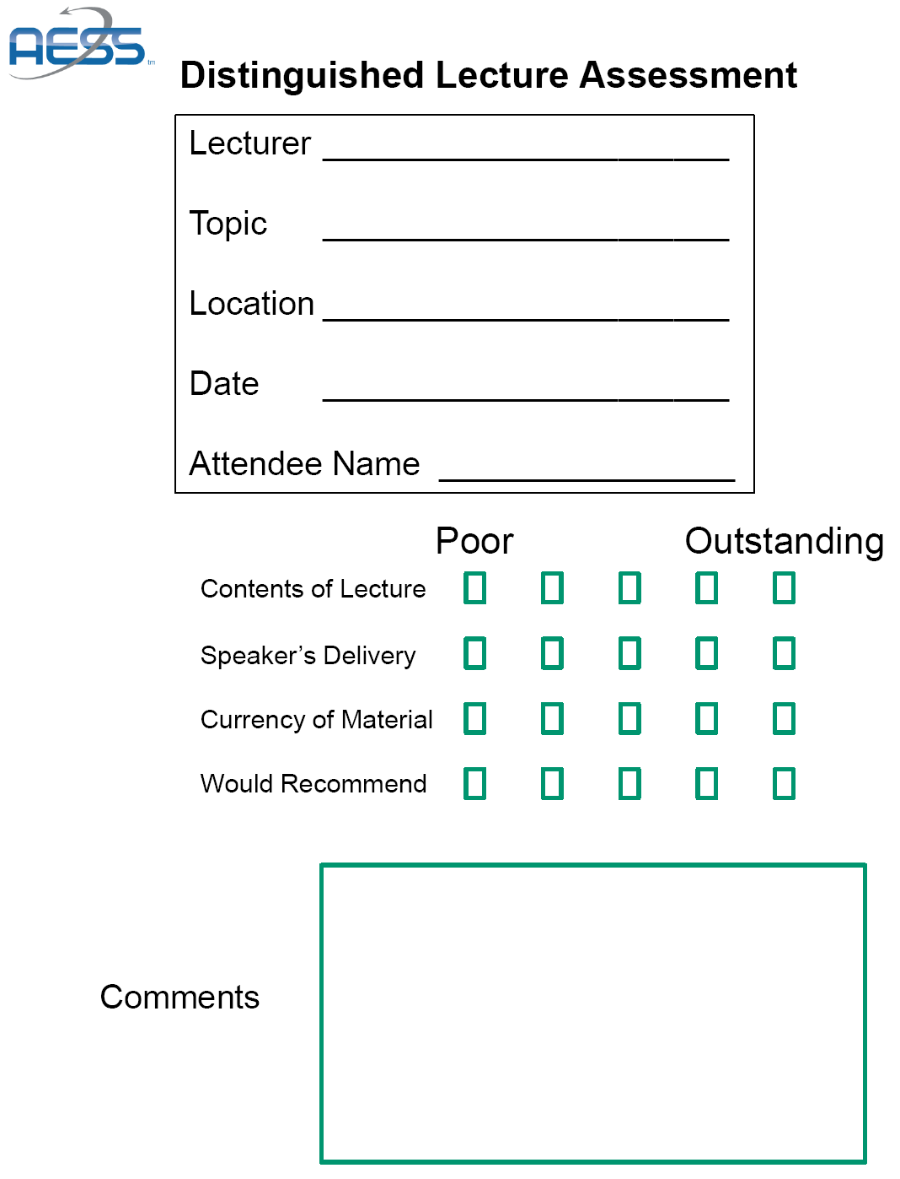
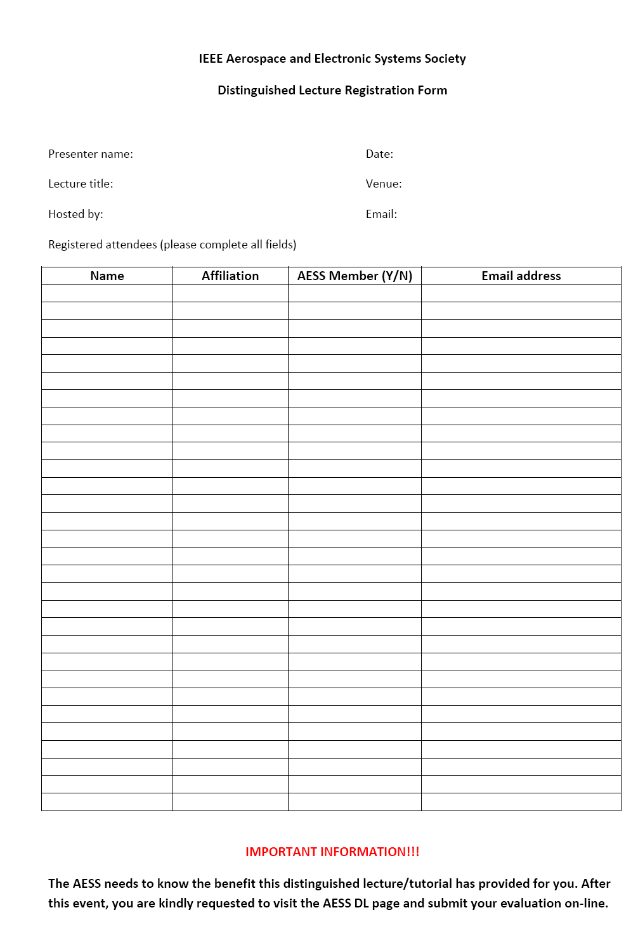
Assess Benefit – Registration & Evaluation Forms (Draft Only)
Registration of attendance at DL event

Slide 11
Metrics and Scorecard – DL program
From 2013 to 2014:
Operating costs were reduced by 35%
Number of DLs increased by 44 % (international increased by 52%).
General observations:
DL program tracking well (efficient and cost-effective)
Strongly suggests that strategic initiatives are working
Main recommendations:
Continue with the implementation of current and new strategic initiatives
Maintaining DL funding at ~$15K despite a trend of lower running costs

Slide 12
Video Tutorials – Current Status
Available Online
Bistatic & Multistatic Radar – Hugh Griffiths
GPS/GNSS + Inertial Navigation – James Farrell
Radar System Performance Modeling – Dick Curry
Sea Clutter - Simon Watts & Keith Ward
Fundamental Concepts in Radar Signal Processing - Mark Richards
Introduction to Stealth – Dave Lynch
Under Discussion
Foliage Penetration – Mark Davis
Inertial System and GPS Technology Trends – George Schmidt
Introduction to Image Fusion – Erik Blasch

Slide 13
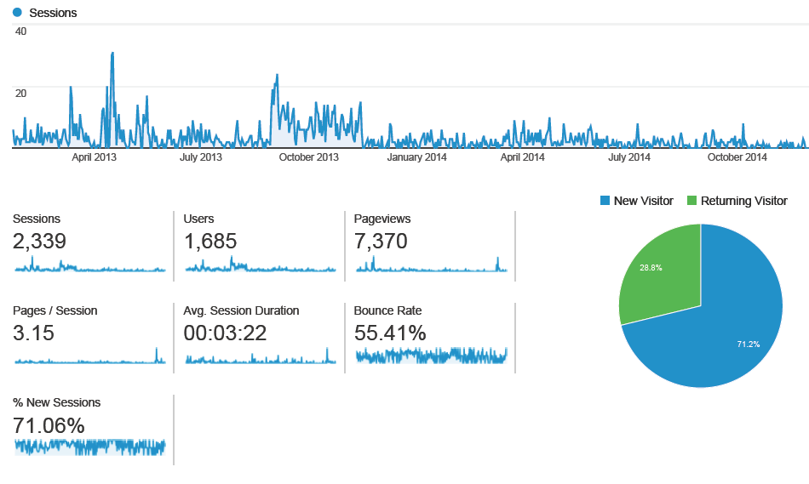
Usage Statistics – Google Analytics
Analysis of Hits (Two year period, 2013-2014)
Number of hits is much lower than desired (~100 per month)
Most viewers take quick peek and leave ( avg. time < 4 min)
Less than 30% of all visitors return to the site

Slide 14
Way Ahead – Online Education
Despite the high quality and relevance of the products, the usage statistics indicate that general area of AESS online education is in need of attention.
Preliminary strategic initiatives:
❖ Engage a two-person committee to review and revitalize AESS online education. This requires two volunteers from the AESS Board, preferably not heavily engaged in other Society duties.
❖ Part of the committee’s charter would be to weigh up the reward for effort and opportunity cost of pursing online education at the expense of alternative (newly proposed) initiatives.
Volunteers please see me.

Slide 15
Online Education – Strategic Initiatives
Broaden Topics
Better representation of AESS FOIs and search for emerging topics where AESS can provide home
Reach out to AESS technical panel chairs and request at least 5 potential topics & presenter names
Open Access
Allow previews or limited portions of tutorials to be viewed by non-members
Enabled by modifying log-in on website and issuing of viewing certificates
Expand Resources
Develop an indexed compendium of useful links to existing open source education information
Consult with education committee of International Radar Systems Panel to for a start design
Feedback Page
Implement a feedback page to better understand online education needs of AESS members
Regularly monitor page and adapt online education services based on member suggestions
Advertise Services
Advertise video tutorials in the AESS magazine and QEB to raise awareness of this service

Slide 16
Robert Hill Best Ph.D. Dissertation Award
IEEE TAB approved submission made by Awards Chairman
VP Publications to advertise new IEEE award in AESS Magazine
Provide information to members on how to nominate candidates
Post award description & application process on AESS website
VP Education
Solicit nominations through technical panels
Establish a selection committee
Announce the winner of the Robert Hill Award.
Awards Chairman to organize presentation of plaque and honorarium to winner
Financial assessment: The prize for the winner is a plaque and $1000 honorarium.
Measure of success: Quantity and quality of nominations.

Slide 17
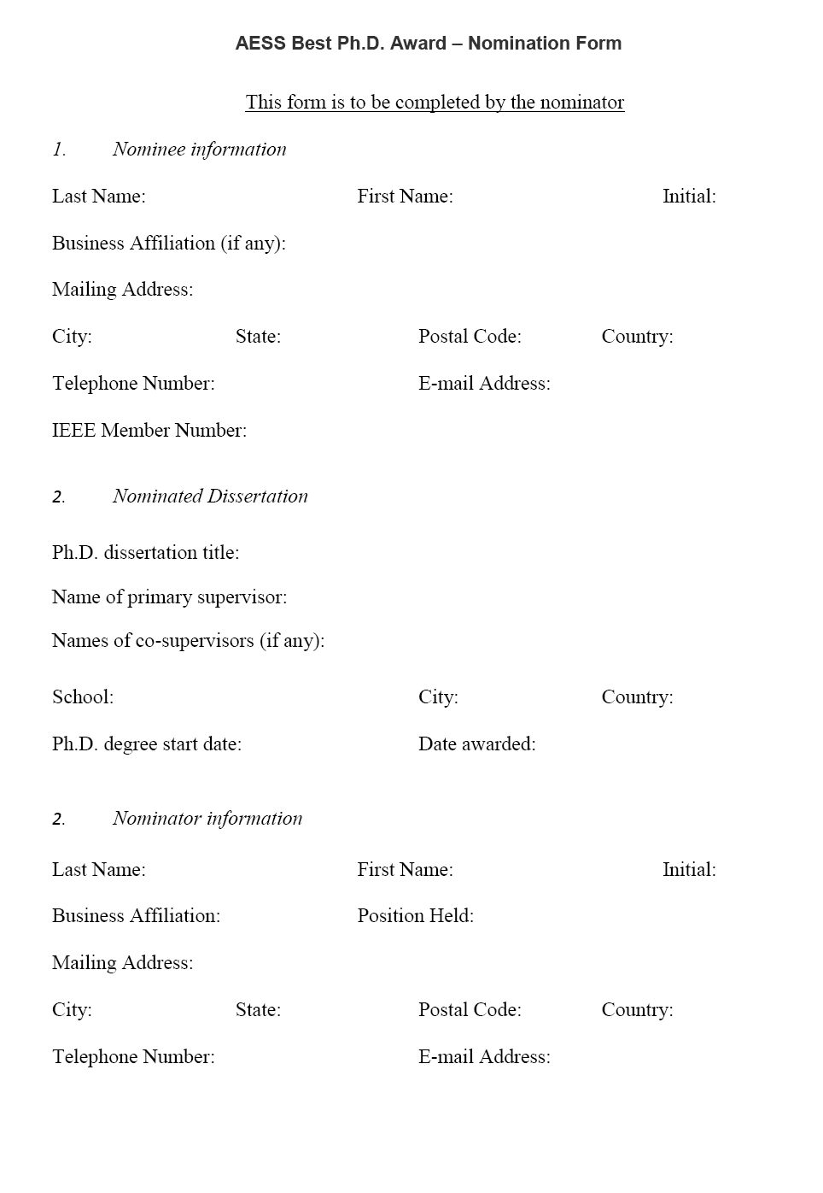
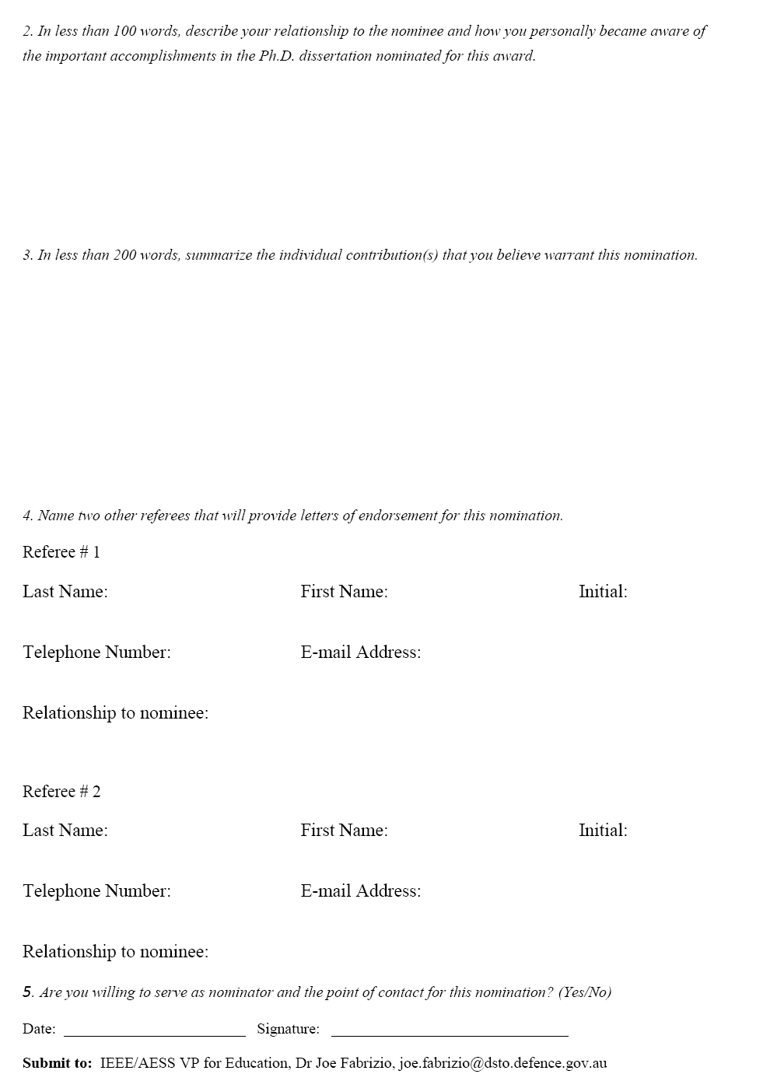
Best Ph.D. Dissertation Award – Nomination Form (Draft Only)
Page 1
Page 2

Slide 18
AESS Mentorship Program
Background & Motivation
Students and young professionals are often left to their own after joining the AESS
Structured scheme to help young members integrate quickly into AESS community
Access to this professional mentoring program is only available to AESS members
Strategic initiatives:
Develop a detailed process including participant guidelines & information briefs
Implement and promote a pilot scheme for the San Diego Chapter (K. Kramer)
Adapt the implementation based on the received feedback
If successful, progressively roll out to other AESS chapters
Publicize this new service in the AESS Magazine and QEB
Financial assessment: Promotional costs (workshops and flyers) estimated at $2000
Measure of success: Level of participation (particularly young mentees) and feedback

Slide 19
Program Design and Web Content
Operations Manual
Major Headings

Slide 20
IEEE-AESS Short Courses – New Initiative
Motivation:
Growing chapters in locations with a low membership base can be a challenging task
Local chapters do not have effective mechanisms to raise revenue to benefit members
Approach:
AESS has an excellent core of mature members willing to contribute to education activities
Chapters can raise funds by empowering members to offer fee-paying AESS short-courses
Participants:
Industry, government, and academia with training budgets for staff professional development
Stakeholders are the IEEE, the organizing local AES chapter, the Society, and the presenters
Status:
VP Education working with a team from the AESS BoG to develop an implementation model
Precedents exist in other IEEE Societies, follow a model already used by Computer Society

Slide 21
Action Plan – AESS Short Courses
Develop Process:
Chapter responsible for identifying training needs, organizing course and local arrangements
Work with IEEE Section or AES Society for seed funding and for concentrated banking in US
Technical Panels:
Consult with technical panels to identify course presenters in AESS FOIs (not limited to DLs)
Request course descriptions and presenter biographies & post these on Education webpage
Implement Initiative:
Guidance on how to handle financial aspects – registrations, reimbursements, use of surplus
Carefully clarify distinction between Distinguished Lectures, Video Tutorials & Short Courses
Advertise Program:
Promote the short course initiative on the Education webpage and AESS Magazine, QEB
Write letters to local chapters to run short courses matched to interests of local institutions

Slide 22
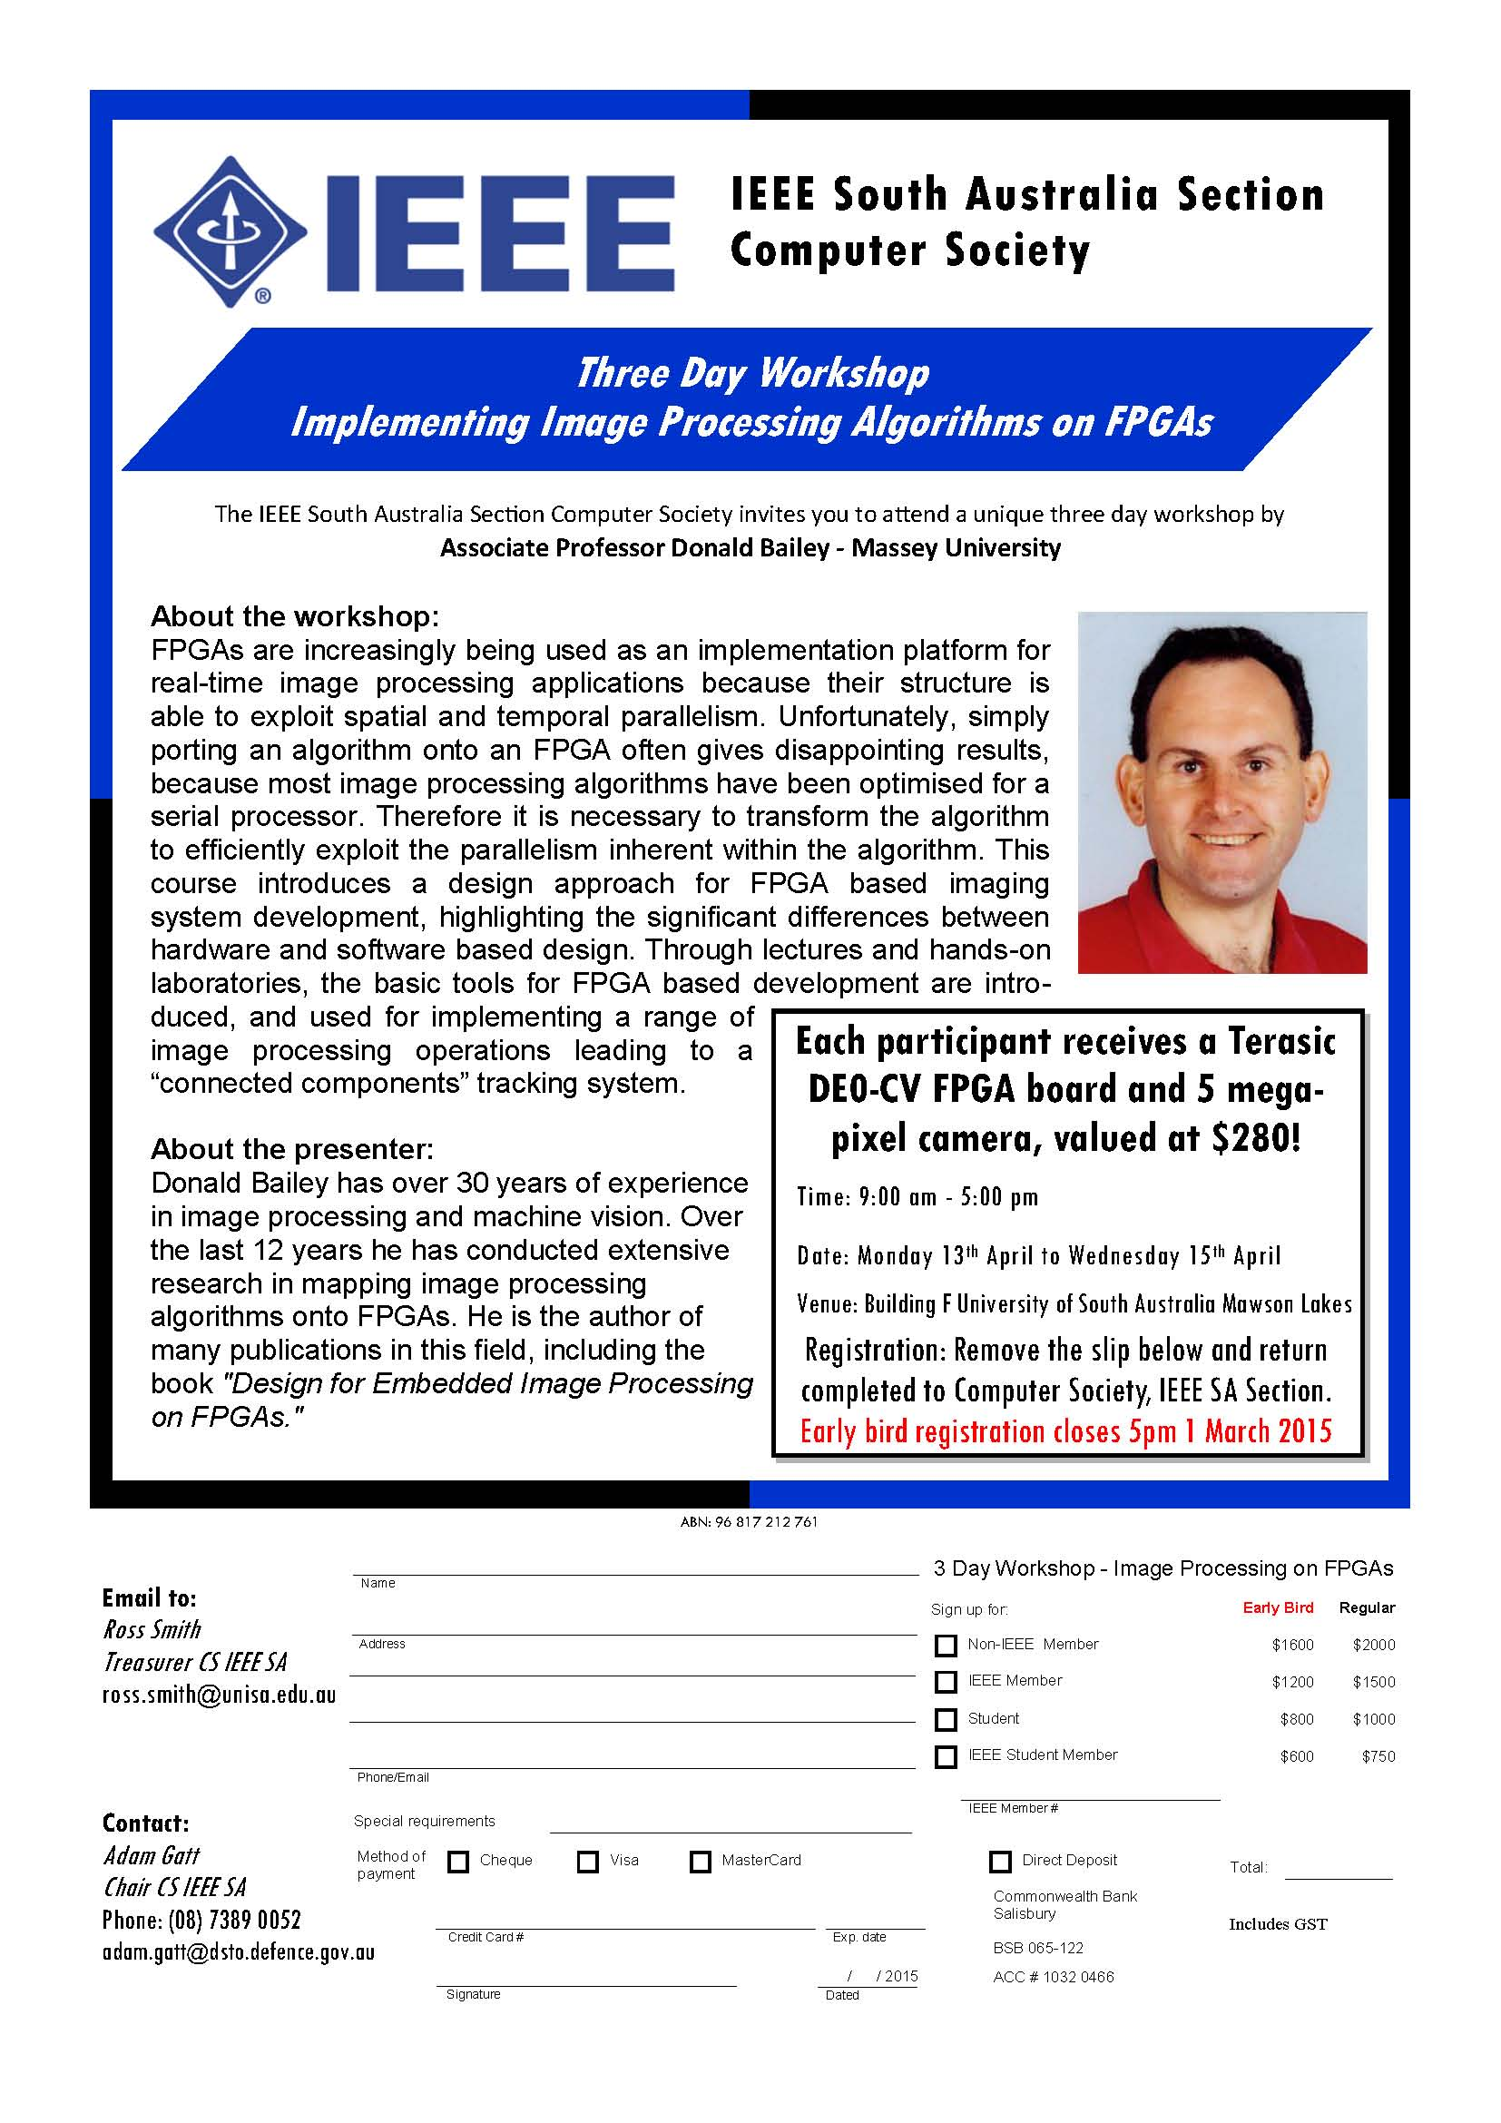
First AESS Example
Computer Society
Aerospace and Electronic Systems Society

Slide 23
Summary
Growing the AESS and revenue (not only membership per se)
Important to do more than simply advertise existing services and benefits
Growth requires the implementation of new customer-focussed strategies
Strategy for AESS Education
Improve existing services: Distinguished lecture program, online tutorial and education
Provide more benefits: new short-course initiative, mentorship scheme, Bob Hill Award
Grow technically: creating a professional home for alternative/emerging fields of interest
Overarching Strategy
Our members should be more encouraged and empowered to help grow the AESS
Use membership resource to grow internationally (esp. under-represented regions)

