Slide 1
Education
AESS Board of Governors Meeting
April 27-28, 2018
Oklahoma City, OK, USA
Federico Lombardi
Graduate Student Rep

Slide 2
Key Points
Members landscape
Visibility
Members attraction
Members development

Slide 3
Membership status: 2017 figures
IEEE Annual Statistics
AESS vs IEEE statistics:
Student members: 5,8% vs 18,5%
Graduate Student members: 4,7% vs 10,2%
AESS vs Division IX statistics:
GSM StM
AES010 231 (4,7%) 285 (5,8%)
GRS029 302 (7,7%) 170 (4,3%)
IT012 289 (9%) 99 (3%)
ITSS038 152 (8%) 52 (2,7%)
OE022 84 (4,7%) 90 (5%)
SP001 1648 (10%) 563 (3,5%)
VT006 249 (5,4%) 132 (2,7%)

Slide 4
Membership status: 2017 figures
AESS vs Division IX performance:
Student members: 15% of the total divisions StM.
Graduate Student members: 7% of the total divisions GSM.
GSM engagement:
GSM members remained stable from 2016 to 2017 (against the Division IX trend and IEEE globally).
GSM are lower than the StM (against the Division IX trend).

Slide 5
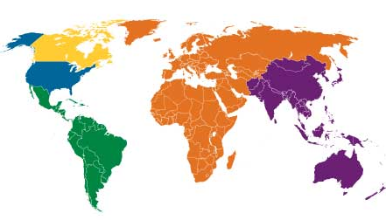
Visibility: Chapters
Region 1-6: 35
Region 7: 9
Region 8: 20
Region 9: 6
Region 10: 13

Slide 6
Visibility: Chapters vs Members
IEEE Annual Statistics
AESS vs Division IX statistics:
Members Chapters
Region 1 11 9
Region 2 16 5
Region 3 16 6
Region 4 7 2
Region 5 27 9
Region 6 36 4
Region 7 8 9
Region 8 42 20
Region 9 59 6
Region 10 63 13

Slide 7
Visibility: "Active" Chapters
Website activities (when available)
Region 1-6: 4 (3)
Region 7: 1 (0)
Region 8: 20 (1)
Region 9: 0
Region 10: 2 (0)

Slide 8
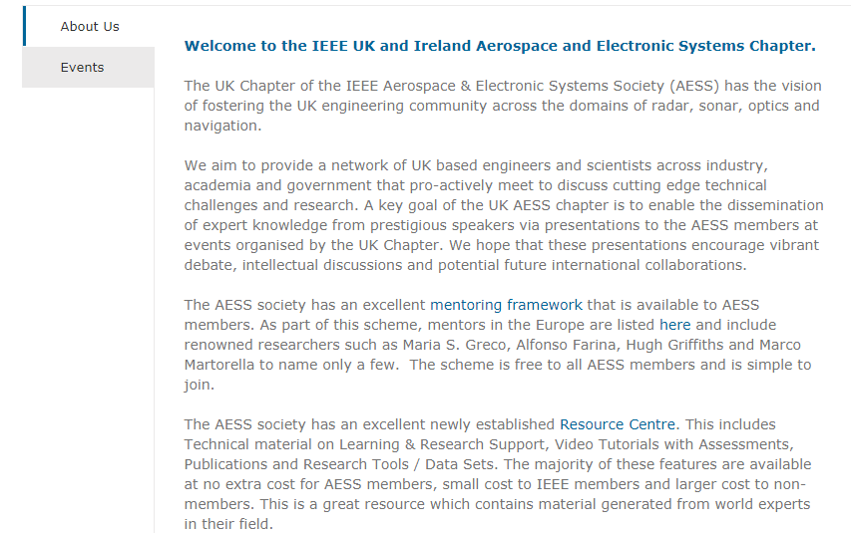
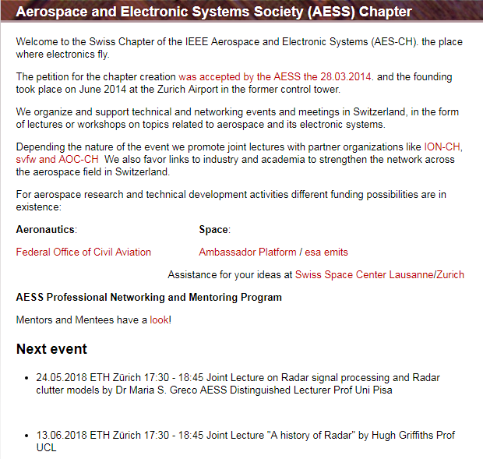
Visibility: Chapters
Example of smart homepages

Slide 9
Initiatives & Opportunities
Member
attraction
AESS visibility:
Update or set-up websites for each Chapter.
Update the website for Student branches.
Encourage regional chapters formation.
AESS Members evolution:
Understand the patterns.
Reach out to GSM.
Suggest feasible benefits.
Member development

