Slide 1
IEEE AESS Publications: Status W. Dale Blair, VP Publications Marriott Hotel Rome, Italy September 25, 2015

Slide 2
Outline
Overview of AESS Publications – Dale Blair
T-AES Report – Lance Kaplan
AES-M Report – Sabrina Greco
QEB Report – Bill Walsh
AESS Web Site – Dale Blair
Administrative Editor Report – Bill Walsh
Income, Expenses, and Budgets
Magazine Vendor Selection
Business Editor – Jose Bolanos
Other Issues

Slide 3
AESS Publications Initiatives
XML Tagging of submissions to the transactions at submission for early posting on IEEE Xplore
EJ Press were to deliver beta product in July 2015 – waiting on IEEE standard
(2) Establish and Implement Term Limits for Editors of the Transactions
Complete for TEs by end of 2015 – on track
Complete for AEs by end of 2016
(3) Implement advertising plan in the magazine
Soliciting advertisers
Coordinate content with advertisers
(4) Increase the presence of student activities in the magazine.
Student editors
Student highlights
(5) Improve the Operations of Editorial Board for the Magazine.
Develop Operations Manual for the magazine
Improve training of the editors for the magazine
(6) Increase industrial participation in AES publications
New magazine column: “Industry Tips and Insights”
Plan special issues around industrial needs
(7) Provide list of authors who are not members to George (VP Member
Services) for Invitation Letter
.

Slide 4
Status of the Transactions
Lance Kaplan, EIC

Slide 5
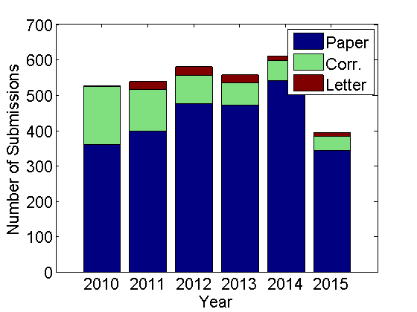
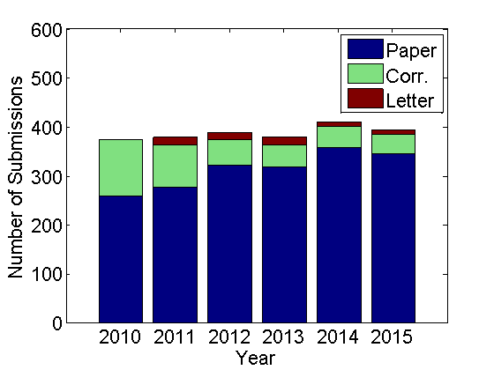
Number of Submissions
Full Year
Eighth Month

Slide 6
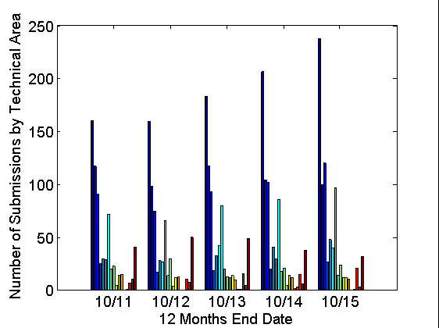
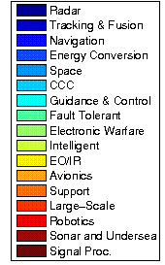
Submissions by Technical Area

Slide 7
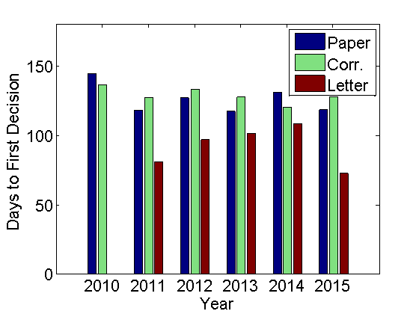
Time to First Decisions

Slide 8
IEEE Policy News
IEEE Xplore
July 2015 issue has NOT been posted
EJPress Post-Acceptance Workflow
Still under development
Automatic generation of early access PDFs:
Need to work on better cooperation between IEEE and EJPress
M. Barry Carlton Award
2011 Award decision is still in process (waiting for input by VP of Publications)
2012 Award process will start in October
Accepting nominations for 2013 and beyond

Slide 9
Editors
Resignations
Thomas Robertazzi (Intelligent Systems/CCC AE)
New Appointees
Keith Davidson (Sonar Systems AE)
Khanh Pham (Intelligent Systems AE)
Prashant Pillai (CCC AE)
Alexander Charlish (Radar AE)
Jon Wallace (CCC AE)
Tricia Willink (CCC AE)

Slide 10
2015 TE Departures
Muralidhar Rangaswamy (Radar Systems)
Marina Ruggieri (Space Systems)
William Polivka (Energy Conversion Systems)
Thomas Robertazzi (Intelligent Systems)
John Tague (Sonar Systems)
Can we provide plaques in recognition of their tremendous service?
Notes:
Five technical editors are departing on December 31 this year in response to the PRAC’s request to institute term limits.
Note that William for example has been an editor for energy conversion systems since 1989. I do know that Marina and John’s tenure predates Peter Willett’s EIC tenure. We should do something special for them.

Slide 11
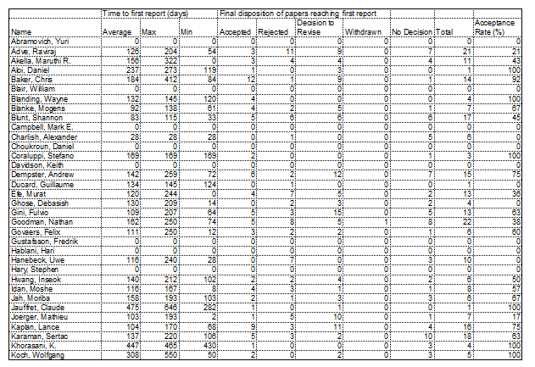
AE Performance

Slide 12
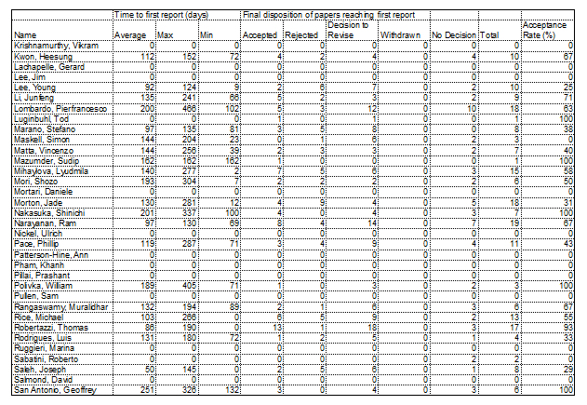
AE Performance (Cont)

Slide 13
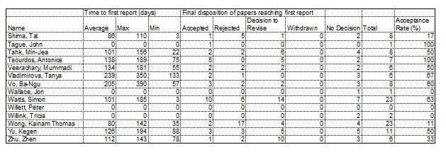
AE Performance (Cont)

Slide 14
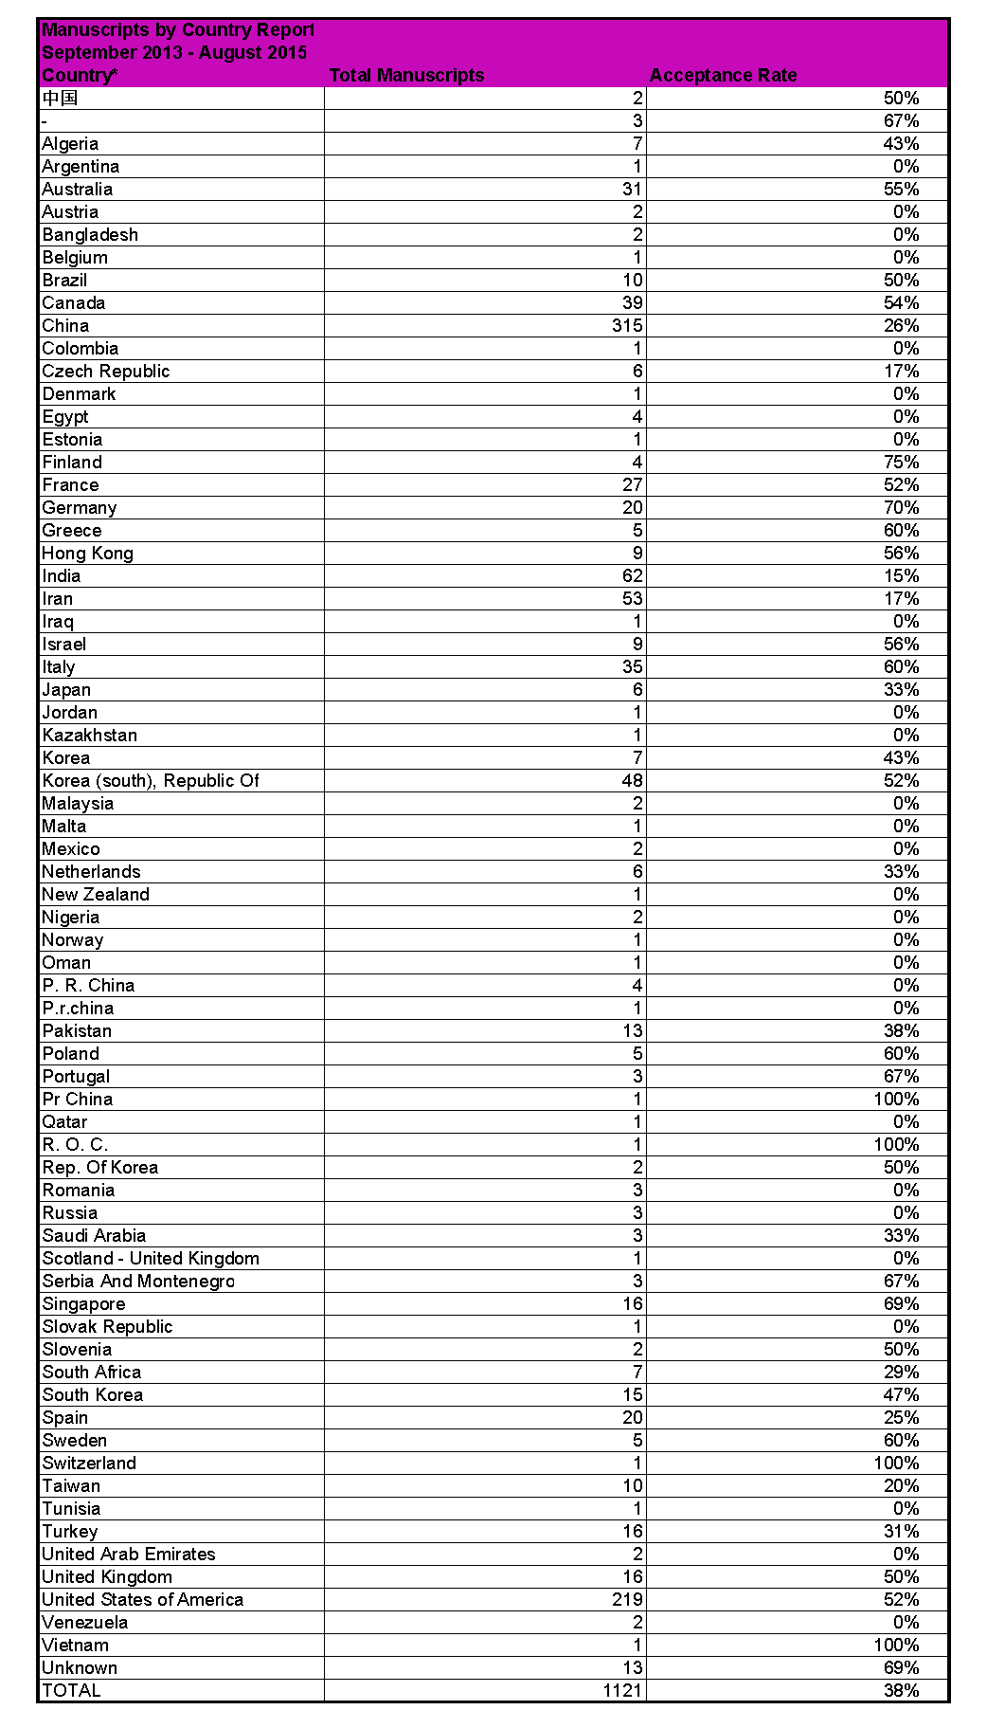
Submission by Country

Slide 15
AES Magazine
Maria S. Greco, EIC

Slide 16
Magazine AEs: Status
New Associate Editors
Domenico Ciuonzo - AoS: Communications, Signal Processing and Data Fusion (since January 2015)
Daniel O’Hagan - AoS: Radar Systems (since January 2015)
Teresa Pace - AoS: Electro-Optic and Infrared Systems, Image Processing (since January 2015)
Antonio Franchi - AoS: Robotic Systems (since May 2015)
Michael S. Braasch - AoS: Navigation Systems (since June 2015)
Wenbo Dou- AoS: Student Highlights (since March 2015)
Roberto Sabatini - AoS: Student Highlights (since November 2015)
Retired Associate Editors
Shirley Cheng - AoS: Guidance (since January 2015)
Carles Fernandez-Prades - AoS : Navigation Systems (since June 2015)
Rick Coogle (graduated) – AoS : Student Highlights (since March 2015)

Slide 17
Magazine Content
Magazine includes:
Peer reviewed Manuscripts Student highlights
Award Summaries and Articles Advertisements (as available)
Tutorials Special issues
Interview articles Book Reviews
News and Information Calls for Papers (CFPs)
History Articles Industry Insights
Notes:
WASPS – Women Airforce Service Pilots

Slide 18
New and Newer Content
Student highlights
Now published almost on a monthly base
Advertisement
In some issues. Still understanding how to make it more effective. Working especially for next Special Issues.
Interviews
Dave Dobson Interview (D. Blair) appeared on June 2015 issue
Marshall Greenspan interview (Mark Davis) will appear on October issue
Princess Marconi (A. Farina) interview will appear on November issue.
Industry Insights
Short paper (3-4 pages) focused on industry “tip and tricks”, dedicated to industrial readers (upcoming in Fall/Winter with introduction Editorial)

Slide 19
Special Issues and Tutorials
In 2015
Special Issue on “Avionic Systems”, August 2015
Tutorial VIII, February issue, Vol 30 Number 2 Part II
Basic tracking using nonlinear continuous-time dynamic models (Crouse)
Navigation using inertial sensors (Groves)
Special Issues Planned for 2016
Special Issue on Waveform Diversity: September 2016
Special Issue on Sense & Avoid : June/July 2016
Special Issue on Passive Radars for Civilian Applications: Nov. 2016
Tutorial IX Planned for March 2016
Detection over Sensor Networks: A Tutorial (Javadi)
Geometry of Complex Data (Sangston)
A Survey of Radar Systems for Medical Applications (Pisa, Pittella, Piuzzi)
A Survey of Correlated Waveform Design for Multi-Function Software Radar (Ahmed, Alouini)
Looking Toward the Future of Radar Detection in Non-Gaussian Clutter (Sangston, Farina)
Tutorial on Waveform Diversity (Adve, Picciolo)
Tutorial on Sense and Avoid (Maroney, Fasano)
Recursive Bayesian Filtering in Circular State Spaces (Kurz, Gilitzchenski, Hanebeck)

Slide 20
2012 & 2013 Harry Rowe Mimno Award
Erik P. Blasch, Dale A. Lambert, Pierre Valin, Mieczyslaw "Mitch" M. Kokar, James Llinas, Subrata Das, Chee Chong and Elisa Shahbazian, "High Level Information Fusion (HLIF): Survey of Models, Issues, and Grand Challenges," IEEE Aerospace and Electronic Systems Magazine, 2012.
Hugh Griffiths, "The German WW2 HF Radars Elefant and See-Elefant" and "Radar Detection and Tracking of German V-2 Rocket launches in WW2," IEEE Aerospace and Electronic Systems Magazine, January 2013, March 2013, respectively.
2014 Harry Rowe Mimno Award
Deadline December 31 2015. Solicited nominations from Chapters and Panels members

Slide 21
More Information from 2015 PRAC Report
 | 2015 (January only) | 2014 | 2013 | 2012 | 2011
Region of author affiliation | % | % | % | % | %
Regions 1 – 6 (U.S.A.) | 33 | 31 | 35 | 41 | 45
Region 7 (Canada) | 11 | 0 | 0 | 0 | 1
Region 8 (Europe/Africa, Middle East) | 23 | 41 | 46 | 30 | 24
Region 9 (Central/South America) | 0 | 0 | 1 | 0 | 0
Region 10 (Asia/Pacific) | 33 | 28 | 18 | 29 | 30
More balance among number of authors form US, Europe and Asia
Year | Impact Factor (regular, with self-citations) | Impact Factor (w/o self-citations) | Citation Half Life | Immediacy Index
2014
2013 | 0.438 | 0.404 | 8.4 | 0.073
2012 | 0.343 | 0.313 | 8.1 | 0.037
2011 | 0.297 | 0.282 | 6.9 | 0.015
2010 | 0.179 | 0.172 | 6.3 | 0.014
Steep increasing of the impact factor, still large room for improvement through more special issues, invited and solicited papers, industry insights

Slide 22
Status of QEB
Bill Walsh, EIC
Judy Scharmann, Executive Assistant

Slide 23
QEB Objectives
Purpose and intention:
Provide time-sensitive news and useful information for AESS members
Draw attention to each of the specific technical areas that our Society represents and pursues
Document activities and events from individual Chapters of the Society
Highlight content of current and upcoming issues of the Systems magazine
Objectives:
Increase and enhance awareness in all aspects of our professional society
Promote and enable outreach to the various technical tenants that make up our interest areas
Provide links to articles and other items as part of a true electronic newsletter.
Making QEB accessible through social networking.
Features:
Chapter Corner – an opportunity for individual AESS chapters to provide activity updates and announcements
Featured AESS Technical Panels (new in 2015!) – introduction to the highlighted Panels, POCs, links to related conferences, other pertinent information on how to actively participate

Slide 24
3Q AESS QEB - Content
President’s Message
Society News
Conferences
Education
EVTS
Distinguished Lecturer Program
GOLD for GOLD Lecturers
Industry Relations
Membership
Awards
Chapter News
Student Activities
Publications
Systems Magazine
Transactions
Tutorials
Website
Technical Operations
Technical Panels
Systems Magazine
Transactions
Tutorials
Website
Technical Operations
Technical Panels

Slide 25
QEB Process
For 2016, the QEB will be published on the following dates (with content submission dates):
4 January 2016 (Content submitted by 21 December 2015)
5 April 2016 (Content submitted by 22 March 2016)
6 July 2016 (Content submitted by 22 June 2016)
3 October 2016 (Content submitted by 19 September 2016)
EDITORIAL
Bill Walsh is in his 2nd year as Editor-In-Chief for QEB (appointed in January 2014)
Lauren Stockman (Conference Catalysts, LLC) provides editorial and production support

Slide 26
Status of AESS Web Site
Dale Blair, VP Publication
Judy Scharmann, Executive Assistant

Slide 27
Motion for Refresh of IEEE AESS Web Site Passed In Spring 2015 Meeting
Motion for Refresh of IEEE AESS Web Site Passed In Spring 2015 Meeting
$10,000 be allocated to Conference Catalysis to refresh the IEEE AESS Web Site by moving to a newer version of the host software and adding a multistate banner.
Telecon on September 4 to review draft version of web site.
Added
Awards Tab added to Front Page
Adding “Member Obituaries” under Members Tab

Slide 28
AESS Publications Operating Budget
2015 Budget Expenses Summary
January - August 2015
Bill Walsh, Administrative Editor

Slide 29
2015 Budget Expenses Estimate AES Transactions
Allen Press (AE-T) - $289,680
2nd year of 3 year contract for integrated services
Managing Editing, Copy Editing, Typesetting, XML tagging
Precision Computer Works (EJP) - $22,000
eJournal Database
Includes Task Order #TT16842 – IEEE: Export with IEEE DTD
Total for 2015: $311,680
Does not include IEEE-related expenses attributed to Transactions (e.g. various purchase services, XPLORE, etc.)
2% escalation on Allen Press Contract
EJP estimate covers work for Systems Magazine as well
Based on Year-to-Date trends, and near-term expectations, Estimated Expenses at Year-End are: $304,000

Slide 30
AES Transactions Expenses – Estimated vs. Actual

Slide 31
2015 Budget Expenses Estimate AES Systems Magazine
Publication & Delivery Services - $317,322
Allen Press (AP-S) – Task Order Contract
Administrative/Asst. Administrative Editors - $35,000
Susanne J. Walsh (SJW) – Independent Contractor
Editorial & Publication Consultant - $20,000
Dave Dobson (DD) – IEEE Part-time employee
Total Budgeted Expenses for 2015: $372,322
Does not include IEEE-related expenses attributed to Transactions (e.g. various purchase services, XPLORE, etc.)
Comparative expenses for 2014: $360,000 (Difference is 2% escalation for Year 2 of Allen Press contract).
Based on Year-to-Date trends, and near-term expectations, Estimated Expenses at Year-End are: $293,391

Slide 32
AES Systems Magazine Expenses – Estimated vs. Actual

Slide 33
RFP for “Comprehensive Publication Services for IEEE Aerospace and Electronics Systems Magazine”
Allen Press is the incumbent.
3 year contract (2016 – 18)
Three Proposals received: Allen Press, The Sheridan Group, and IEEE Publications
AESS Editorial Board principles (Greco, Blair, Pace, Willett, Walsh) evaluating and scoring proposals – quantitative and qualitative measures. (Oct. 1st)
Contract award – Oct. 9th
Expected contract execution - Oct. 26th (to support January 2016 issue)

Slide 34
Page Charges Income
January - August 2015
Jose Bolanos, Business Editor
Volume 51, No. 1 - $40,950.
Volume 51, No. 2 - $39,400

Slide 35
Other Issues
Plagiarism complaint against an authors of a paper published at the 2015 RAST conference.
GRSS and AESS are sponsors or 2015 RAST
AESS taking the lead on the investigation
GRSS provided one committee member
Committee chair has been assigned
Electronic Version of AES Magazine

