Slide 1
Women in Engineering
AESS Board of Governors Meeting
September 28-29, 2018
Rome, Italy
Kathleen A. Kramer
Liaison to WIEC, AESS

Slide 2
IEEE Women in Engineering (WIE)
WIE Membership has increased within AESS, but is only about 3.3%.
Seattle has the biggest concentration.
100/4660 → 153/4655
153/4655=3.3% of AESS members are in WIE.
Seattle has the most.

Slide 3
IEEE WIE Committee
WIE Committee
IEEE MGA (Membership and Geographic Activities) committee
10 committee members, 43 WIE liaisons/coordinators (including AESS, featured as “new”). Celia Desmond (IEEE Board and COMSOC liaison) leading an effort to improve society-based efforts.
(WIEC) meetings via quarterly telecon and one face-to-face each year
AESS liaison could not attend meeting this year

Slide 4
IEEE WIE Conferences Strategy
Hold at least one IEEE WIE event at your Society’s/Council’s conference.
Example: hold a networking luncheon. Other options may include holding special sessions, technical workshops, professional development workshops, panels or conference tracks where women are represented.
preferably on the first day of the Society’s conference.
Invite women plenary speakers and awardees to address the event.
Invite men to the event (it is important to create a group of male advocates for women).
Invite the General Chair of the conference and President of the Society/Council to come to address the group and stay for the event.
Encourage attendees to assume volunteer roles within your Society/Council.
Ask IEEE WIE to send a box of items to give out to the attendees. This should be done at least 3 weeks in advance to account for shipping time, etc.
Add this event to the Society Conference Planning Manual.

Slide 5
AESS and IEEE WIE Conferences Strategy
IEEE Radar Conference (via Women in Radar) -
AESS agreed to offer support for these (10/16).
WIE funds (not AESS) supported the one at IEEE Radar Conference. -- Organized by past-WIE chair
Kudos to Women in Radar
First time: International Radar Conference (YP/WIE Panel)
First time: DASC Career Panel Moderated by Fahmida Chowdury of NSF– WIE affiliated/included

Slide 6
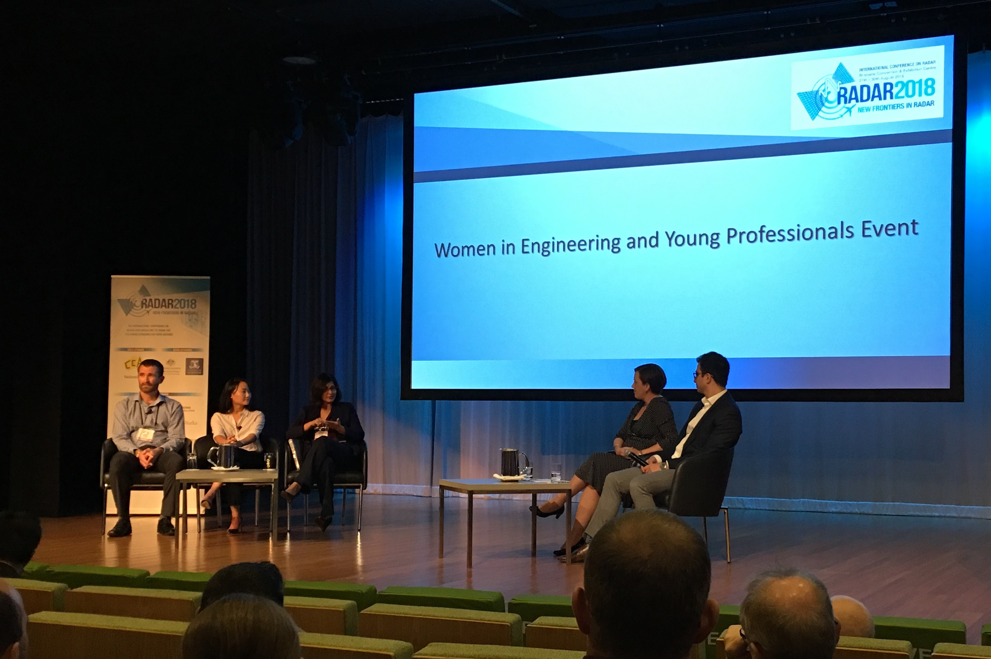
WIE/YP at 2018 International Radar Conference
The International Conference on Radar 2018 incorporated a Women in Engineering and Young Professionals panel session into the program. The panel was chaired by the IEEE Queensland Women in Engineering Chair Dr Marie-Luise Wille, and Young Professionals Chair Rob Makaremi. It consisted of three keynote speakers
Dr Jamie Lien of Google Advanced Technology and Projects
Prof Fauzia Ahmad of Temple University
Dr James Palmer of Silentium Defence
Panelists shared career experiences, and answered questions ranging from how they became involved in radar technology to what male engineers can do to foster an inclusive workplace for their female colleagues. The session was well received by the audience, and provided an opportunity to learn from these highly successful researchers. Thanks go to the panelists, chairs, and Dr Pina Dall’Armi-Stoks and A/Prof Vaughan Clarkson for their efforts in arranging the event.

Slide 7
IEEE WIE International Leadership Conference (WIE-ILC)
WIE ILC: May 25-27, 2019
1200+
Moving to Austin, TX
“WIE Leadership Summits” organized
AESS DL spoke at WIE Tech Summit for Women in National Laboratories

Slide 8
More WIE Advocacy
Edit a spotlight column in the Society Newsletter, enhancing diversity and inclusion.
Focus on IEEE WIE members’ activities, international WIE affinity group activities.
Consider publishing a special issue of Society/Council publication to highlight the contributions of women. This may contain technical papers and informal portraits of members at different stages in career, diverse geographic areas, and from industry, academic, and regulatory bodies.
Maintain a dedicate Society WIE web page promoting your Society’s WIE activities and initiatives

